Slide 1

ECE700.07: Game Theory with
Engineering Applications
Lecture 2: Preferences and Utilities
Seyed Majid Zahedi

Slide 2
Overview
Ordinal preferences
Axioms of rational behavior
Utility theorem
Risk attitudes
Readings
  MAS Sec. 3.1

Slide 3
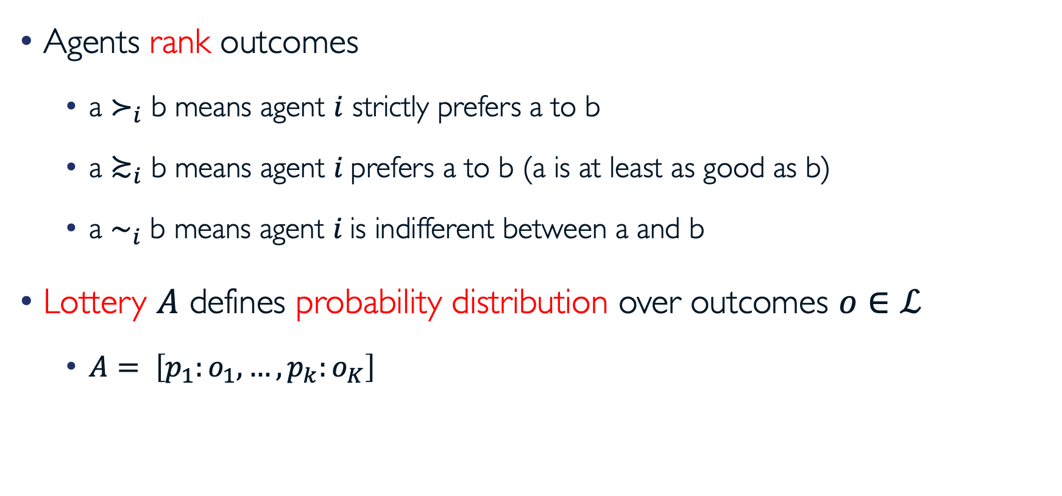
Ordinal Preferences
Agents rank outcomes
  a $≻_{i}$ b means agent $i$ strictly prefers a to b
  a $≿_{i}$ b means agent $i$prefers a to b (a is at least as good as b)
  a $\sim _{i}$ b means agent $i$is indifferent between a and b
Lottery $A$ defines probability distribution over outcomes $o∈ℒ$
  $A= \left[p_{1}:o_{1},…,p_{k}:o_{K}\right]$

Slide 4
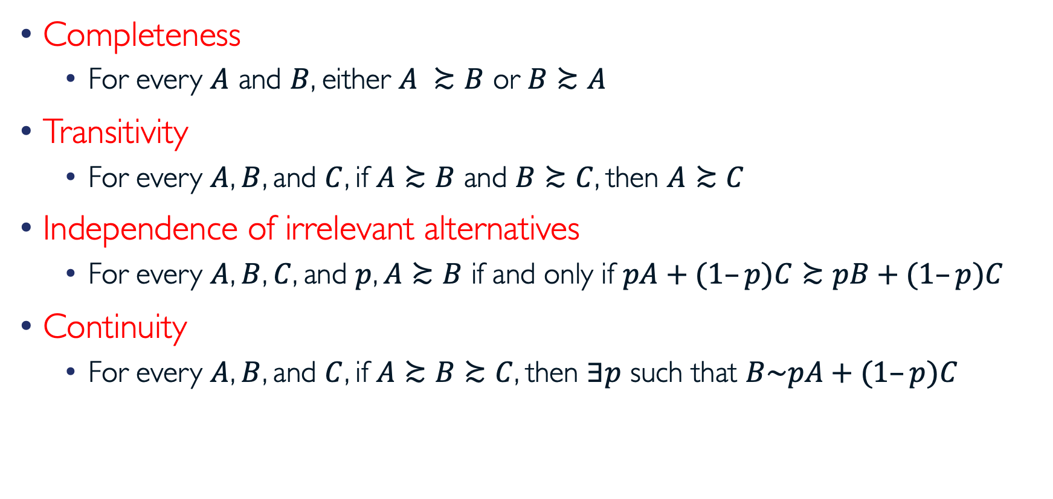
Axioms of Rational Decision Making
Completeness
  For every $A$ and $B$, either $A ≿B$ or $B≿A$
Transitivity
  For every $A$, $B$, and $C$, if $A≿B$ and $B≿C$, then $A≿C$
Independence of irrelevant alternatives
  For every $A$, $B$, $C$, and $p$, $A≿B$ if and only if $pA+(1–p)C≿pB+(1–p)C$
Continuity
  For every $A$, $B$, and $C$, if $A≿B≿C$, then $∃p$ such that $B\sim pA+(1–p)C$

Slide 5
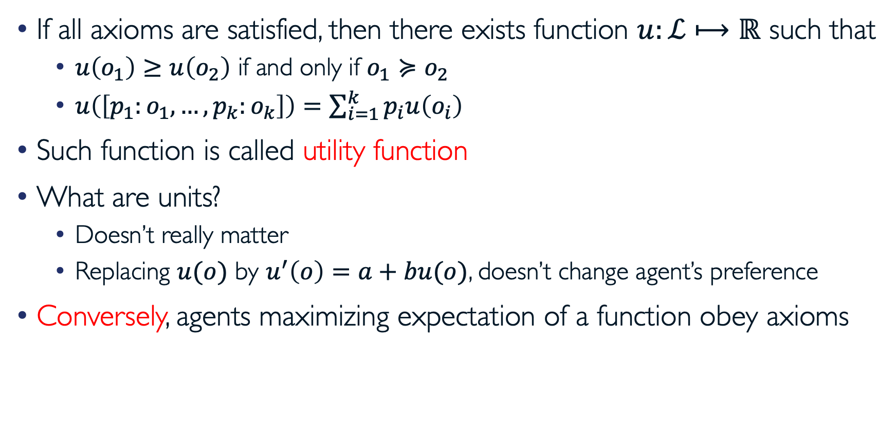
von Neumann-Morgenstern Utility Theorem
If all axioms are satisfied, then there exists function $u:ℒ⟼ℝ$ such that
  $u\left(o_{1}\right)≥u\left(o_{2}\right)$ if and only if $o_{1}≽o_{2}$
  $u\left(\left[p_{1}:o_{1},…,p_{k}:o_{k}\right]\right)=\sum_{i=1}^{k}{p_{i}u\left(o_{i}\right)}$
Such function is called utility function
What are units?
  Doesn’t really matter
  Replacing $u(o)$ by $u^{′}\left(o\right)=a+bu(o)$, doesn’t change agent’s preference
Conversely, agents maximizing expectation of a function obey axioms

Slide 6
Are People “Rational” Decision Makers?
Which one do you prefer?
  Lottery ticket that pays out $10 with prob 0.5 and $0 otherwise
  Lottery ticket that pays out $3 with prob 1
How about these?
  Lottery ticket that pays out $100,000,000 with prob 0.5 and $0 otherwise
  Lottery ticket that pays out $30,000,000 with prob 1
Usually, people do not simply go by expected value

Slide 7
Uncertainty and Risk Attitudes
Risk-neutral agent cares about expected value
Risk-averse agent prefers expected value of lottery to the lottery ticket
  Most of people are this way
Risk-seeking agent prefers lottery ticket to expected value of the lottery

Slide 8
Example
Typically, at some point, having one more dollar does not make people much happier (decreasing marginal utility)
utility
buy a nicer car (utility = 3)
buy a car (utility = 2)
buy a bike (utility = 1)
money
$200
$1400
$5000

Slide 9
Example (cont.)
utility
buy a nicer car (utility = 3)
buy a car (utility = 2)
buy a bike (utility = 1)
$200
$1400
$5000
money
Which one is better?
  Lottery 1: get $1400 with prob 1
  Lottery 2: get $5000 with prob 0.25 and $200 otherwise
What about expected amount of money?
Notes:
maximizing expected utility is consistent with risk aversion

Slide 10
Risk Attitudes (revisited)
utility
money
Green has decreasing marginal utility → risk-averse
Blue has constant marginal utility → risk-neutral
Red has increasing marginal utility → risk-seeking
Grey neither risk-averse (everywhere) nor risk-seeking (everywhere)

Slide 11
Questions?

Slide 12
Acknowledgement
This lecture is a slightly modified version of ones prepared by
  Asu Ozdaglar [MIT 6.254]
  Vincent Conitzer [Duke CPS 590.4]

