Slide 1
The Heat-conduction/Diffusion and
Wave Equations in 2 and 3 Dimensions
Douglas Wilhelm Harder, M.Math. LEL
Department of Electrical and Computer Engineering
University of Waterloo
Waterloo, Ontario, Canada
ece.uwaterloo.ca
dwharder@alumni.uwaterloo.ca
© 2012 by Douglas Wilhelm Harder. Some rights reserved.

Slide 2
Outline
This topic discusses numerical solutions to the heat-conduction/ diffusion and wave equations in two and three dimensions:
  Examine the finite difference equations
  Determine the effects of insulated boundary conditions
  Look at numerous examples

Slide 3
Outcomes Based Learning Objectives
By the end of this laboratory, you will:
  Understand how to approximate the heat-conduction/diffusion and wave equations in two and three dimensions
  You will understand the differences between insulated and Dirichlet boundary conditions

Slide 4
Terminology
The dimension of a vector is the number of entries:
  For example,
  are 4-dimensional row and column vectors, respectively
  Matlab refers to the dimension of a vector based on its data-structure/physical representation as an array
    It is called the length

Slide 5
Terminology
The dimensions of a matrix are the row and column dimensions:
  For example,
  is a 4 × 5 matrix with a row dimension of 4 and a column dimension of 5
  Matlab refers to the dimensions of a matrix, again, based on the physical representation, the size
Both vectors and matrices are mathematical objects

Slide 6
Terminology
An array, however, is a data structure
  The dimension of an array is define as the number of indices used to refer to an element within the array
Therefore:
  A vector is a one-dimensional array
  A matrix is a two-dimensional array
  The mathematical structure equivalent to an n-dimensional array is an
  n^{th}-order tensor

Slide 7
Terminology
Example:
  >> T = rand( 2, 4, 2, 2 )
  T(:,:,1,1) =
  0.1829 0.8865 0.4899 0.9787
  0.2399 0.0287 0.1679 0.7127
  T(:,:,2,1) =
  0.5005 0.0596 0.0424 0.5216
  0.4711 0.6820 0.0714 0.0967
  T(:,:,1,2) =
  0.8181 0.7224 0.6596 0.9730
  0.8175 0.1499 0.5186 0.6490
  T(:,:,2,2) =
  0.8003 0.4324 0.0835 0.1734
  0.4538 0.8253 0.1332 0.3909
>> ndims( T )
ans =
4
>> size( T )
ans =
2 4 2 2
>> T(1,4,2,2)
ans =
0.1734
>> T(2,3,1,2)
ans =
0.5186

Slide 8
Terminology
It is possible, of course, to manipulate these in a manner similar to matrices:
  >> T = rand( 2, 4, 2, 2 )
  T(:,:,1,1) =
  0.1829 0.8865 0.4899 0.9787
  0.2399 0.0287 0.1679 0.7127
  T(:,:,2,1) =
  0.5005 0.0596 0.0424 0.5216
  0.4711 0.6820 0.0714 0.0967
  T(:,:,1,2) =
  0.8181 0.7224 0.6596 0.9730
  0.8175 0.1499 0.5186 0.6490
  T(:,:,2,2) =
  0.8003 0.4324 0.0835 0.1734
  0.4538 0.8253 0.1332 0.3909
>> T(:,:,:,1) = zeros( 2, 4, 2 )
T(:,:,1,1) =
0 0 0 0
0 0 0 0
T(:,:,2,1) =
0 0 0 0
0 0 0 0
T(:,:,1,2) =
0.8181 0.7224 0.6596 0.9730
0.8175 0.1499 0.5186 0.6490
T(:,:,2,2) =
0.8003 0.4324 0.0835 0.1734
0.4538 0.8253 0.1332 0.3909

Slide 9
The Equations
Going back to the heat-conduction/diffusion and wave equations, we have:
where u(x, t) is a function of space and time

Slide 10
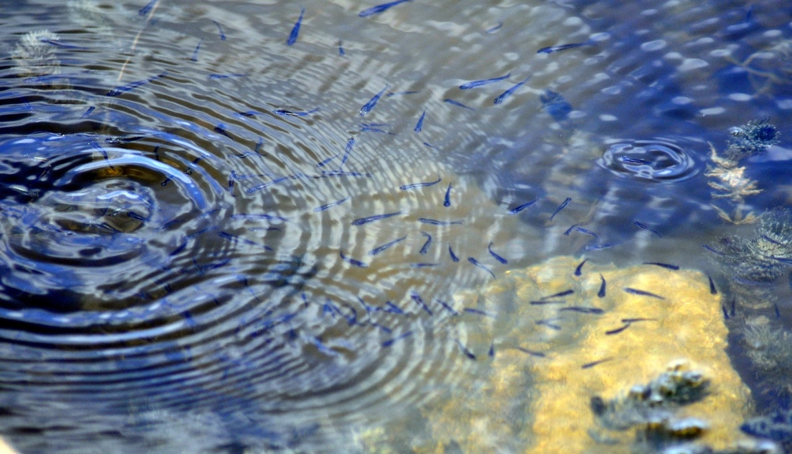
The Equations
Consider these overlapping constructive two-dimensional waves:
  It may seem that this is impossible to model
  Fortunately, it is the equation that defines the movement

Slide 11
Finite-Difference Equations
You have already approximated solutions in one dimension to both of these equations
  The significant difference is the approximation of the right-hand side in higher dimensions
In two and three dimensions, the Laplacian operator is defined as:

Slide 12
Finite-Difference Equations
Recall our approximations of the 2nd-order partial derivatives both in two dimensions
and in three

Slide 13
Finite-Difference Equations
In our implementations, we will always approximate our domain with a regular grid
and

Slide 14
Finite-Difference Equations
Substituting these into the 2-dimensional equations:
or

Slide 15
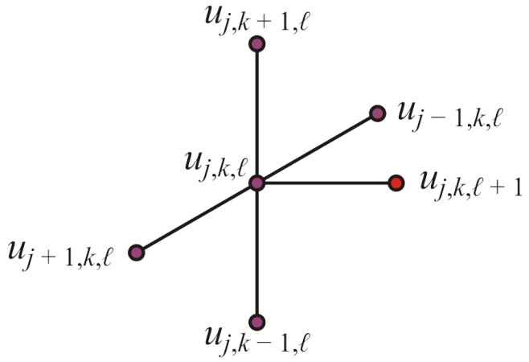
Finite-Difference Equations
For the heat-conduction/diffusion equation in two dimensions,
we use the states at time t_{ℓ} to approximate the state at time t_{ℓ + 1}:

Slide 16
Finite-Difference Equations
If a boundary value is insulated, then in calculating the future point, we consider the value equal to the adjacent value:
Thus, in calculating u_{j,k,ℓ + 1}, if u_{j – 1,k,ℓ}, u_{j + 1,k,ℓ}, u_{j,k – 1,ℓ} or
u_{j,k + 1,ℓ} is insulated, we assume that
respectively

Slide 17
Finite-Difference Equations
Thus, if u_{j,k – 1,ℓ} is insulated, the equation simplifies to
This has the potential of becoming complicated; however...
  What if two points are insulated?
  Instead, we will come up with a different solution

Slide 18
Finite-Difference Equations
Using the heat-conduction/diffusion equation as an example, rewrite
as
This may seem more complicated but we can now either choose to add a term or not, as appropriate

Slide 19
Finite-Difference Equations
Thus, if u_{j,k – 1,ℓ} is insulated, we would simply not add the third term in the equation:
0

Slide 20
Finite-Difference Equations
Note that we can always start with:

Slide 21
Finite-Difference Equations
We then iterate through the four adjacent entries:
  If that point has a value, add it:

Slide 22
Finite-Difference Equations
We then iterate through the four adjacent entries:
  If the point is insulated (NaN), do nothing...

Slide 23
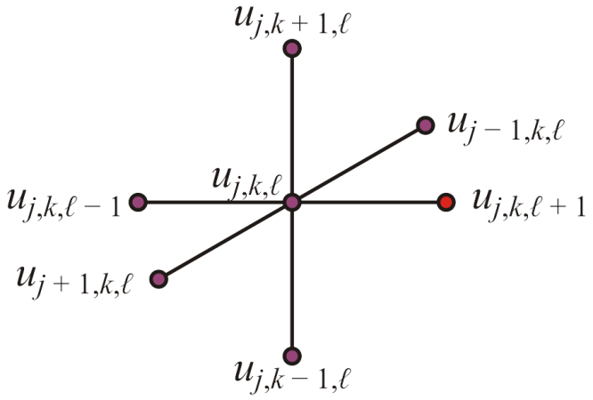
Finite-Difference Equations
For the wave equation in two dimensions,
we use the states at time t_{ℓ} and t_{ℓ – 1} to approximate the state at
time t_{ℓ + 1}:

Slide 24
Finite-Difference Equations
Without much imagination, the 3-dimensional equivalents are:

Slide 25
Finite-Difference Equations
Without much imagination, the 3-dimensional equivalents are:

Slide 26
Initial Conditions
In one dimension, the heat-conduction/diffusion and wave equations required an initial condition that was a 1-D array of initial values
As with the heat-conduction/diffusion and wave equations in one dimension, we must have an initial condition
  In two dimensions, we must have a 2-D array of initial values
  In three dimensions, we must have a 3-D array of initial values

Slide 27
Initial Conditions
In one dimension, we defined a function
u_{init}:[a, b] → R
This allowed us to choose the number of points n on [a, b]
In two and three dimensions, we will simply have the user pass an
n_{x} × n_{y} array or an n_{x} × n_{y} × n_{z} array as an initial condition:
  U6a_init = zeros( 11, 21 );
  U6b_init = zeros( 11, 11, 11 );

Slide 28
Initial Conditions
The initial rates of change for the wave equation will also be passed as an n_{x} × n_{y} array or an n_{x} × n_{y} × n_{z} array:
  dU6a_init = zeros( 11, 21 );
  dU6b_init = zeros( 11, 11, 11 );
The dimensions of this array must equal the dimensions of the array U_init

Slide 29
Boundary Conditions
With one dimension, it was reasonably easy to defined a function
function [u] = U_bndry(t)
where
u_{bndry}:R → R²
or

Slide 30
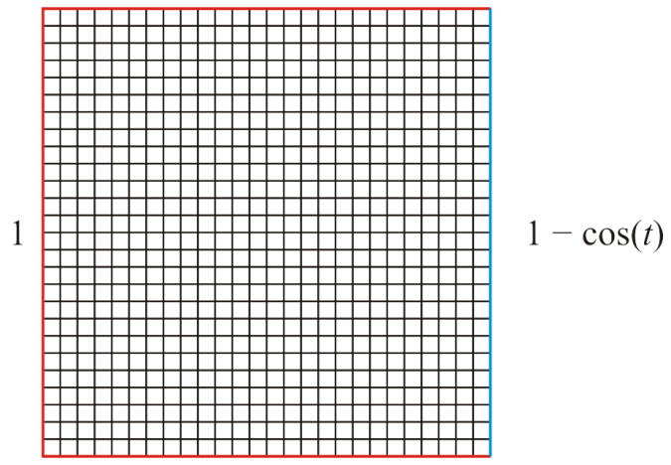
Boundary Conditions
In this case, because the boundary may not be two points, the function will have to return an array of the same dimensions as the initial condition
    function [U] = U6a_bndry( t, nx, ny )
    U = -Inf*ones( nx, ny );
    U([1, end], :) = 1;
    U(:, 1 ) = 1;
    U(:, end) = 1 - cos(t);
    end
U6a_init = zeros( 26, 26 );

Slide 31
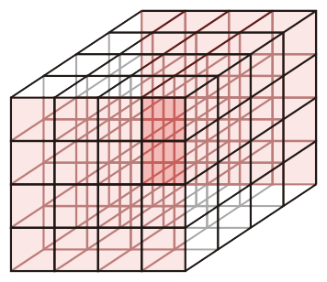
Boundary Conditions
In this case, because the boundary may not be two points, the function will have to return an array of the same dimensions as the initial condition
    function [U] = U6b_bndry( t, nx, ny, n_z )
    U = -Inf*ones( nx, ny, n_z );
    U([1, end], :, :) = 1;
    U(:, [1, end], :) = 1;
    U(:, :, 1) = 1;
    U(:, :, end) = 1 - cos(t);
    end
U6b_init = zeros( 5, 5, 5 );

Slide 32
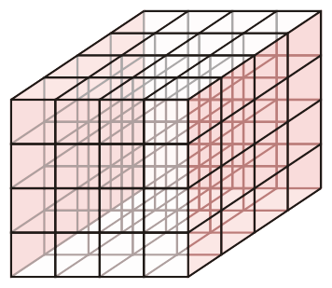
Boundary Conditions
In this case, because the boundary may not be two points, the function will have to return an array of the same dimensions as the initial condition
    function [U] = U6b_bndry( t, nx, ny, n_z )
    U = -Inf*ones( nx, ny, n_z );
    U([1, end], :, :) = 1;
    U(:, [1, end], :) = 1;
    U(:, :, 1) = 1;
    U(:, :, end) = 1 - cos(t);
    end
U6b_init = zeros( 5, 5, 5 );

Slide 33
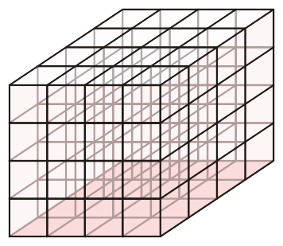
Boundary Conditions
In this case, because the boundary may not be two points, the function will have to return an array of the same dimensions as the initial condition
    function [U] = U6b_bndry( t, nx, ny, n_z )
    U = -Inf*ones( nx, ny, n_z );
    U([1, end], :, :) = 1;
    U(:, [1, end], :) = 1;
    U(:, :, 1) = 1;
    U(:, :, end) = 1 - cos(t);
    end
U6b_init = zeros( 5, 5, 5 );

Slide 34
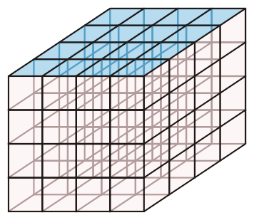
Boundary Conditions
In this case, because the boundary may not be two points, the function will have to return an array of the same dimensions as the initial condition
    function [U] = U6b_bndry( t, nx, ny, n_z )
    U = -Inf*ones( nx, ny, n_z );
    U([1, end], :, :) = 1;
    U(:, [1, end], :) = 1;
    U(:, :, 1) = 1;
    U(:, :, end) = 1 - cos(t);
    end
U6b_init = zeros( 5, 5, 5 );

Slide 35
Boundary Conditions
It will be an error condition if the dimensions of the array returned by the boundary function do not match the dimensions of the initial conditions
  You will be required to throw an exception

Slide 36
Parameters
Therefore, in two dimensions:
  U_init is an an n_{x} × n_{y} array of finite real values (the initial condition)
For the wave equation:
  dU_init is an n_{x} × n_{y} array of finite real values (the initial rates of change)

Slide 37
Parameters
For each time,
  function [U] = U_bndry( t, nx, ny )
  returns an n_{x} × n_{y} array of
    Finite real values for any Dirichlett boundary values
    NaN for any insulated (Neumann) boundary values
    -Inf for any unknown values that we must solve for
Then, our functions diffusion2d and wave2d returns an
n_{x} × n_{y} × n_{t} array of real values or NaN

Slide 38
Parameters
Therefore, in two dimensions:
  U_init is an an n_{x} × n_{y} array of finite real values (the initial condition)
For the wave equation:
  dU_init is an n_{x} × n_{y} array of finite real values (the initial rates of change)

Slide 39
Parameters
For each time,
  function [U] = U_bndry( t, nx, ny, n_z )
  returns an n_{x} × n_{y} × n_{z} array of
    Finite real values for any Dirichlett boundary values
    NaN for any insulated (Neumann) boundary values
    -Inf for any unknown values that we must solve for
Then, our functions diffusion3d and wave3d returns an
n_{x} × n_{y} × n_{z} × n_{t} array of real values or NaN

Slide 40
Function Signatures
Thus, we will write functions
function [t, U] = diffusion2d( kappa, h, U_init, U_bndry, t_int, nt )
function [t, U] = wave2d( c, h, U_init, dU_init, U_bndry, t_int, nt )
function [t, U] = diffusion3d( kappa, h, U_init, U_bndry, t_int, nt )
function [t, U] = wave3d( c, h, U_init, dU_init, U_bndry, t_int, nt )

Slide 41
Differences with Previous Functions
Recall that with previous functions
  diffusion1d crank_nicolson2d wave1d
the initial and boundary values were passed as vector-valued functions of either space or time:
  u_init( x ) du_init( x ) u_bndry( t )
the initial and boundary values were vector-valued functions of a vector x or t
In this case, we will adopt the easier approach of Lab 5:
  U_init and dU_init are a 2- or 3-dimensional array that contains the initial values
  U_bndry( t, nx, ny ) also returns a 2- or 3-dimensional array

Slide 42
Argument and Error Checking
The argument checking as we saw in previous functions:
  kappa, c and h must be scalars
  U_init and dU_unit must be 2-D or 3D arrays (as appropriate) and they must have the same dimensions
  U_bndry must be a function handle
  t_int must be a row vector of two values
  nt must be a positive integer
In two and three dimensions, we have stricter requirements to ensure convergence:
Two Dimensions Three Dimensions

Slide 43
The Heat-Conduction/
Diffusion Equation in 2-D
Thus, we will start with:
    function [t, U_soln] = diffusion2d( kappa, h, U_init, U_bndry, t_int, nt )
    ti = t_int(1);
    tf = t_int(2);
    dt = (tf - ti)/(nt - 1);
    t = linspace( ti, tf, nt );
    [nx, ny] = size( U_init );
    U_soln = zeros( nx, ny, nt );
    U_soln(:, :, 1) = U_init;
    r = kappa*dt/h^2;
This gives us our initialization
  You are provided with the bare code
  You will have to add comments and error checking

Slide 44
The Heat-Conduction/
Diffusion Equation in 2-D
We now iterate over time:
    for it = 2:nt
    U_soln(:, :, it) = U_bndry( t(it), nx, ny );
    for ix = 1:nx
    for iy = 1:ny
    if U_soln(ix, iy, it) == -Inf
    Utmp = U_soln(ix, iy, it - 1);
    U_soln(ix, iy, it) = Utmp;
    for dxy = [-1 1 0 0; 0 0 -1 1]
    dix = ix + dxy(1);
    diy = iy + dxy(2);
    if ~isnan( U_soln(dix, diy, it - 1) )
    U_soln(ix, iy, it) = U_soln(ix, iy, it) + ...
    r*( U_soln(dix, diy, it - 1) - Utmp );
    end
    end
    end
    end
    end
    end
    end % function

Slide 45
The Wave Equation in 2-D
The wave equation in 2D has only a few differences:
    U_soln(:, :, 2) = U_soln(:, :, 1) + dt*dU_init;
    for it = 3:nt
    U_soln(:, :, it) = U_bndry( t(it), nx, ny );
    for ix = 1:nx
    for iy = 1:ny
    if U_soln(ix, iy, it) == -Inf
    Utmp = U_soln(ix, iy, it - 1);
    U_soln(ix, iy, it) = 2*Utmp - U_soln(ix, iy, it - 2);
    for dxy = [-1 1 0 0; 0 0 -1 1]
    dix = ix + dxy(1);
    diy = iy + dxy(2);
    if ~isnan( U_soln(dix, diy, it - 1) )
    U_soln(ix, iy, it) = U_soln(ix, iy, it) + ...
    r*( U_soln(dix, diy, it - 1) - Utmp );
    end
    end
    end
    end
    end
    end
    end % function

Slide 46
Animations
In order to create animations, you will need to download all the files in the source directory for Laboratory 6:
  animate.m
  frames2gif.m
  isosurf.m
  rgb2gif8bit.m

Slide 47
Animations
The next step will be create animations in Matlab
  A function, animate( U, range ), converts the U-output of any of the functions
  diffusion1d wave1d
  crank_nicolson1d
  diffusion2d wave2d
  diffusion3d wave3d
  into an array of frames
The 2nd argument, range, is optional:
  In 1- and 2-D, it specifies the zlim of the plots
  In 3-D, the range of values over which the isosurfaces are plotted

Slide 48
Animations
The output can be passed to one of two functions:
  movie( frames ); % builtin
  frames2gif( frames, 'filename.gif' ); % download
The first creates a movie that runs in Matlab while the second saves the animation to a gif file
Standard process:
  >> [x2a, t2a, U2a] = diffusion1d( ... );
  >> frames2a = animate( U2a );
  >> frames2gif( frames2a, 'plot.2a.gif' );
  >> movie( frames2a );

Slide 49
2-D Heat-conduction/Diffusion
For example, consider the following example:
  A plate that is initially at 0 with a single point with a temperature 1
  The boundaries are all at 0
    U6a_init = zeros( 21, 21 );
    U6a_init(11, 11) = 1;
    function [U] = U6a_bndry( t, nx, ny )
    U = -Inf*ones( nx, ny );
    U([1, end], :) = 0;
    U(:, [1, end]) = 0;
    end

Slide 50
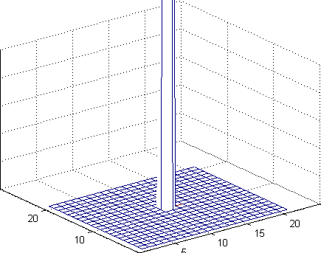
2-D Heat-conduction/Diffusion
Here we see how the heat is absorbed into the surroundings
    U6a_init = zeros( 21, 21 );
    U6a_init(11, 11) = 1;
    [t6a, U6a] = diffusion2d( 1, 1, U6a_init, @U6a_bndry, [0, 10], 100 );
    frames6a = animate( U6a, [0, 0.1] );
    % movie( frames6a );
    frames2gif( frames6a, 'plot6a.i.gif' );
We are restricting the
vertical to the range [0, 0.1]
0.1
0.08
0.06
0.04
0.02
0

Slide 51
2-D Heat-conduction/Diffusion
For example, consider the following example:
  A plate that is initially at 0 with two points of heat with temperatures 1 and 5
  The boundaries are all insulated
    U6a_init = zeros( 21, 21 );
    U6a_init(17, 13) = 5;
    U6a_init(4, 6) = 1;
    function [U] = U6a_bndry( t, nx, ny )
    U = -Inf*ones( nx, ny );
    U([1, end], :) = NaN;
    U(:, [1, end]) = NaN;
    end

Slide 52
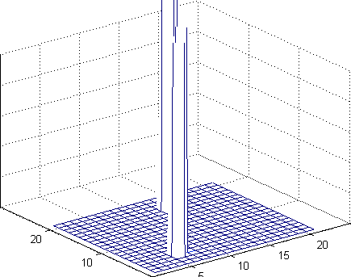
2-D Heat-conduction/Diffusion
Now we get a different solution
    [t6a, U6a] = diffusion2d( 1, 1, U6a_init, @U6a_bndry, [0, 10], 100 );
    frames6a = animate( U6a, [0, 0.1] );
    movie2gif( frames6a, 'plot6a.ii.gif' );
0.1
0.08
0.06
0.04
0.02
0

Slide 53
2-D Heat-conduction/Diffusion
If you get an ratio too close to 0.25, convergence is still shaky:
    [t6a, U6a] = diffusion2d( 1, 1, U6a_init, @U6a_bndry, [0, 10], 42 );
    frames6a = animate( U6a, [0, 0.1] );
    movie2gif( frames6a, 'plot6a.iii.gif' );
0.1
0.08
0.06
0.04
0.02
0

Slide 54
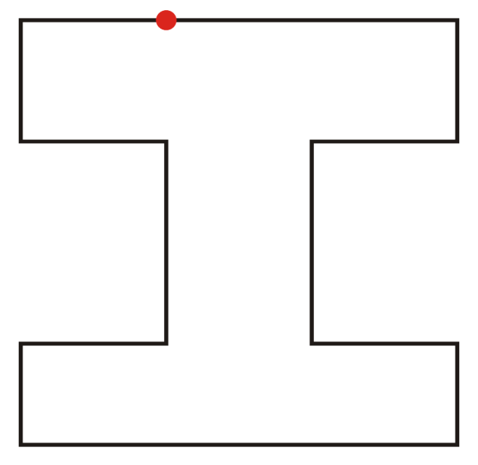
2-D Heat-conduction/Diffusion
Alternatively, suppose we have an insulated room where all points are at 0:
  At time t = 0, we will place a single heat source:
    U6a_init = zeros( 21, 21 );
    function [U] = U6a_bndry( t, nx, ny )
    U = -Inf*ones( nx, ny );
    bndry = NaN;
    a_x = ceil( nx/4 ); b_x = floor( 3*nx/4 );
    a_y = ceil( ny/3 ); b_y = floor( 2*ny/3 );
    U([1,end], :) = bndry;
    U(:, [1,end]) = bndry;
    U(a_x:b_x, 1:a_y) = bndry;
    U(a_x:b_x, b_y:end) = bndry;
    U(end, round(ny/3)) = 1;
    end

Slide 55
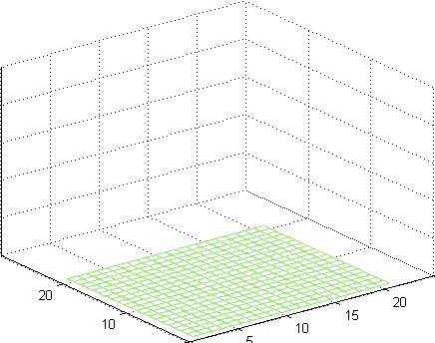
2-D Heat-conduction/Diffusion
You will see that the oddly shaped room does appear to heat as intuition may suggest
  [t6a, U6a] = diffusion2d( 1, 1, U6a_init, @U6a_bndry, [0, 100], 500 );
  frames6a = animate( U6a );
  movie2gif( frames6a, 'plot6a.iv.gif' );
1
0.8
0.6
0.4
0.2
0

Slide 56
2-D Heat-conduction/Diffusion
Consider an insulated room at 0:
  At time t = 0, there is a heat source at 20 and a heat sink at 0:
    function [U] = U6a_bndry( t, nx, ny )
    U = -Inf*ones( nx, ny );
    bndry = NaN;
    U([1, end], :) = NaN;
    U(:, [1, end]) = NaN;
    U( 7, 5 ) = 0;
    U( 9, 12 ) = 20;
    end

Slide 57
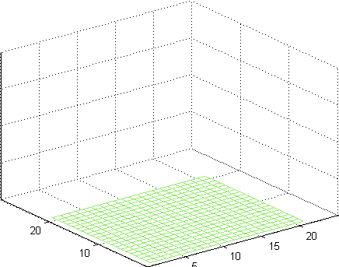
2-D Heat-conduction/Diffusion
Most of the room heats; however, the region around the cold sink remains cool
  [t6a, U6a] = diffusion2d( 1, 1, U6a_init, @U6a_bndry, [0, 100], 500 );
  frames6a = animate( U6a );
  movie2gif( frames6a, 'plot6a.v.gif' );
20
15
10
5
0

Slide 58
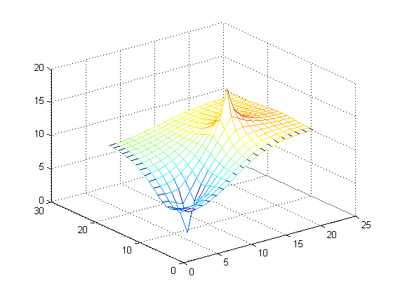
2-D Heat-conduction/Diffusion
In this case, the solution to Laplace’s equation is the following:
    >> U6a = laplace2d( U6a_bndry( 0, 21, 21 ) );
    >> mesh( U6a )

Slide 59
2-D Waves
As an example of a 2-D wave, consider a square region with a zero initial conditions, insulated boundaries and an oscillating source:
    U6b_init = zeros( 51, 51 );
    dU6b_init = zeros( 51, 51 );
    function [U] = U6b_bndry( t, nx, ny )
    U = -Inf*ones( nx, ny );
    U([1, end], :) = NaN;
    U(:, [1, end]) = NaN;
    U(26, 26) = sin(t);
    end

Slide 60
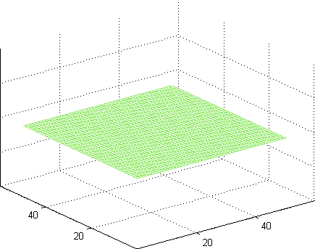
2-D Waves
We can solve this with:
  U6b_init = zeros( 51, 51 );
  dU6b_init = zeros( 51, 51 );
  [t6b, U6b] = wave2d( 1, 1, U6b_init, dU6b_init, @U6b_bndry, [0, 100], 210 );
  frames6b = animate( U6b );
  % movie( frames6b );
  frames2gif( frames6b, 'plot6b.i.gif' );
1
0.5
0
–0.5
–1

Slide 61
2-D Waves
Suppose we make one small change: ground the boundaries
    U6b_init = zeros( 51, 51 );
    dU6b_init = zeros( 51, 51 );
    function [U] = U6b_bndry( t, nx, ny )
    U = -Inf*ones( nx, ny );
    U([1, end], :) = 0;
    U(:, [1, end]) = 0;
    U(26, 26) = sin(t);
    end

Slide 62
2-D Waves
We can solve this with:
  U6b_init = zeros( 51, 51 );
  dU6b_init = zeros( 51, 51 );
  [t6b, U6b] = wave2d( 1, 1, U6b_init, dU6b_init, @U6b_bndry, [0, 100], 210 );
  frames6b = animate( U6b );
  % movie( frames6b );
  frames2gif( frames6b, 'plot6b.ii.gif' );
1
0.5
0
–0.5
–1

Slide 63
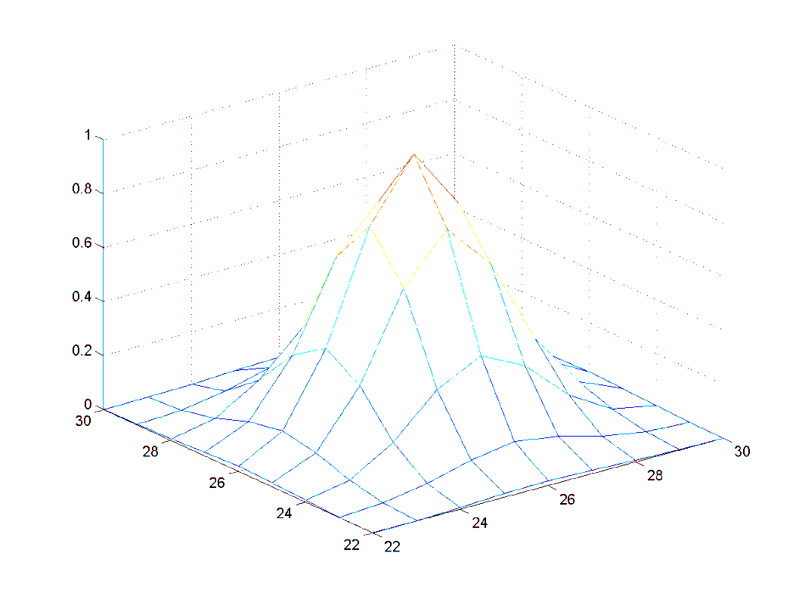
2-D Waves
Suppose we start with a mound of water and let watch it propagate with only insulating boundaries
    U6b_init = zeros( 51, 51 );
    for x = 1:51
    for y = 1:51
    U6b_init(x, y) = exp( -((x - 26)^2/4 + (y - 26)^2/4) );
    end
    end
    dU6b_init = zeros( 51, 51 );

Slide 64
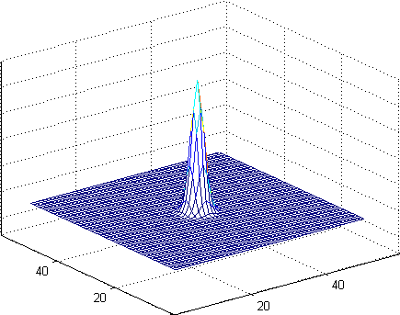
2-D Waves
Executing the command:
[t6b, U6b] = wave2d( 1, 1, U6b_init, dU6b_init, @U6b_bndry, [0, 100], 210 );
frames6b = animate( U6b );
% movie( frames6b );
frames2gif( frames6b, 'plot6b.iii.gif' );

Slide 65
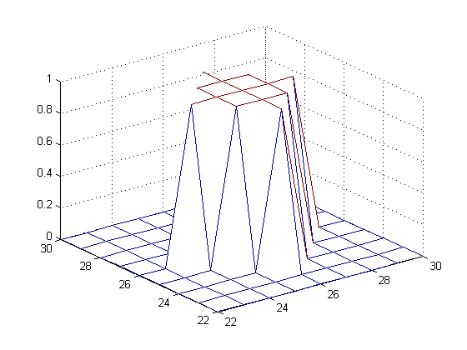
2-D Waves
Normally, we don’t see just a single pulse shooting out when a drop hits the water...
  There are usually secondary ripples
  Consider an initial pulse that is not so nice
  The volume under the surface is approximately the same
    U6b_init = zeros( 51, 51 );
    U6b_init(25:27, 25:27) = 1;
    U6b_init(26, 24:28) = 1;
    U6b_init(24:28, 26 ) = 1;
    dU6b_init = zeros( 51, 51 );

Slide 66
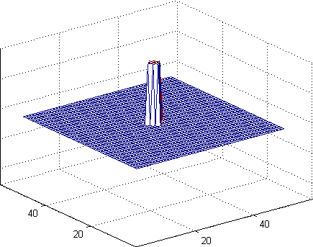
2-D Waves
With less pleasing initial conditions, smaller wavelets are produced
[t6b, U6b] = wave2d( 1, 1, U6b_init, dU6b_init, @U6b_bndry, [0, 100], 210 );
frames6b = animate( U6b );
% movie( frames6b );
frames2gif( frames6b, 'plot6b.iv.gif' );

Slide 67
2-D Waves
Suppose we have a circular boundary
  This can only be approximated on a grid
    function [U] = U6b_bndry( t, nx, ny )
    U = -Inf*ones( nx, ny );
    bndry = NaN;
    for ix = 1:nx
    for iy = 1:ny
    x = (ix - 1)/(nx - 1);
    y = (iy - 1)/(ny - 1);
    if sqrt( (x – 0.5)^2 + (y – 0.5)^2 ) >= 0.5
    U(ix, iy) = bndry;
    end
    end
    end
    end

Slide 68
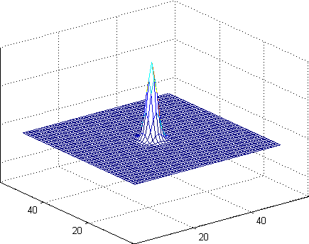
2-D Waves
The additional wavelets that appear after the outgoing wave crashes into the wall reflect the sub-optimal approximation of a circle using a grid
U6b_init = zeros( 51, 51 );
for ix = 1:51
for iy = 1:51
x = (ix - 1)/(nx - 1);
y = (iy - 1)/(ny - 1);
U6b_init(ix, iy) = exp( -625*((x – 0.5)^2 + (y – 0.5)^2) );
end
end
dU6b_init = zeros( 51, 51 );
[t6b, U6b] = wave2d( 1, 1, U6b_init, dU6b_init, @U6b_bndry, [0, 106], 223 );
frames6b = animate( U6b );
% movie( frames6b );
frames2gif( frames6b, 'plot6b.v.gif' );

Slide 69
3-D Heat Conduction/Diffusion
Suppose we have an insulated room and we place a heat source at one wall; should we:
  Have a single point source
  A line source
  A wall source
The integrated temperature will be the same...

Slide 70
3-D Heat Conduction/Diffusion
Suppose we have a point source
    function [U] = U6c_bndry( ~, ~, ~, ~ )
    U = -Inf*ones( 21, 21, 21 );
    U([1,end],:,:) = NaN;
    U(:,[1,end],:) = NaN;
    U(:,:,[1,end]) = NaN;
    U( 11, 11, 1 ) = 81;
    end

Slide 71
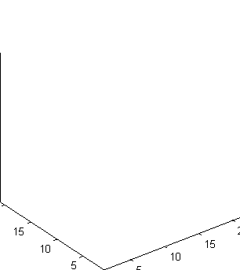
3-D Heat Conduction/Diffusion
We will only plot temperatures between 0 and 1:
  Temperatures greater than 1 follow the front
U6c_init = zeros( 21, 21, 21 );
[t6c, U6c] = diffusion3d( 1, 1, U6c_init, @U6c_bndry, [0, 30], 200 );
frames6c = animate( U6c, [0, 1] );
% movie( frames6c );
frames2gif( frames6c, 'plot6c.i.gif' );

Slide 72
3-D Heat Conduction/Diffusion
Suppose a line of point sources
    function [U] = U6c_bndry( ~, ~, ~, ~ )
    U = -Inf*ones( 21, 21, 21 );
    U([1,end],:,:) = NaN;
    U(:,[1,end],:) = NaN;
    U(:,:,[1,end]) = NaN;
    U( 11, 3:2:19, 1 ) = 9;
    end

Slide 73
3-D Heat Conduction/Diffusion
We will only plot temperatures between 0 and 1:
  Temperatures greater than 1 follow the front
U6c_init = zeros( 21, 21, 21 );
[t6c, U6c] = diffusion3d( 1, 1, U6c_init, @U6c_bndry, [0, 30], 200 );
frames6c = animate( U6c, [0, 1] );
% movie( frames6c );
frames2gif( frames6c, 'plot6c.ii.gif' );

Slide 74
3-D Heat Conduction/Diffusion
Suppose we have a grid of point sources
    function [U] = U6c_bndry( ~, ~, ~, ~ )
    U = -Inf*ones( 21, 21, 21 );
    U([1,end],:,:) = NaN;
    U(:,[1,end],:) = NaN;
    U(:,:,[1,end]) = NaN;
    U(3:2:19, 3:2:19, 1) = 1;
    end

Slide 75
3-D Heat Conduction/Diffusion
We will only plot temperatures between 0 and 1:
U6c_init = zeros( 21, 21, 21 );
[t6c, U6c] = diffusion3d( 1, 1, U6c_init, @U6c_bndry, [0, 30], 200 );
frames6c = animate( U6c, [0, 1] );
% movie( frames6c );
frames2gif( frames6c, 'plot6c.iii.gif' );

Slide 76
3-D Heat Conduction/Diffusion
Viewing all three side-by-side:

Slide 77
3-D Waves
Suppose we have a resonance chamber:
  A sphere where we control the value on the exterior
    function [U] = U6d2_bndry( t, nx, ny, n_z)
    U = -Inf*ones( 21, 21, 21 );
    for ix = 1:21
    for iy = 1:21
    for iz = 1:21
    x = (ix - 1)/(nx - 1);
    y = (iy - 1)/(ny - 1);
    z = (iz - 1)/(n_z - 1);
    dist = sqrt( (x – 0.5)^2 + (y - 0.5)^2 + (z - 0.5)^2 );
    if dist >= 1.1
    U(ix, iy, iz) = NaN;
    elseif dist >= 0.5
    U(ix, iy, iz) = sin( 1.72*t );
    end
    end
    end
    end
    end

Slide 78
3-D Waves
Over time, the waves bounce back and forth in the chamber
  U6d_init = zeros( 21, 21, 21 );
  dU6d_init = zeros( 21, 21, 21 );
  [t6d, U6d] = wave3d( 1, 1, U6d_init, dU6d_init, @U6d2_bndry, [0, 50], 500 );
  frames6d = animate( U6d, [0, 65] );
  % movie( frames6d );
  frames2gif( frames6d, 'plot6d.i.gif' );
Source: sin(1.72 t)
Maximum amplitude after 50 s: > 60

Slide 79
3-D Waves
We can examine the interior by removing half the points:
  U6d(:, :, 12:end, :) = NaN;
  frames6d = animate( U6d, [0, 65] );
  % movie( frames6d );
  frames2gif( frames6d, 'plot6d.ii.gif' );
Source: sin(1.72 t)
Maximum amplitude after 50 s: > 60

Slide 80
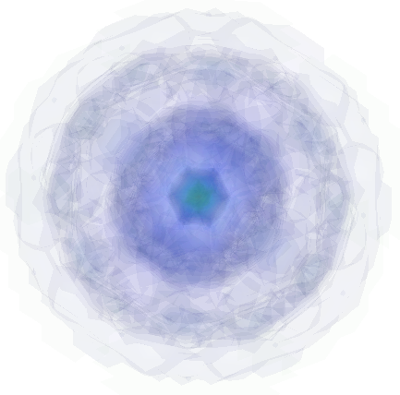
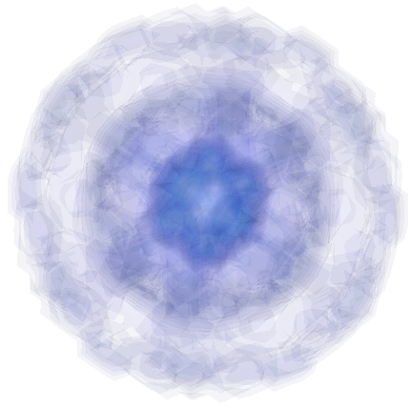
3-D Waves
Note: gif is restricted to 256 colours
  The actual Matlab plots are much more beautiful

Slide 81
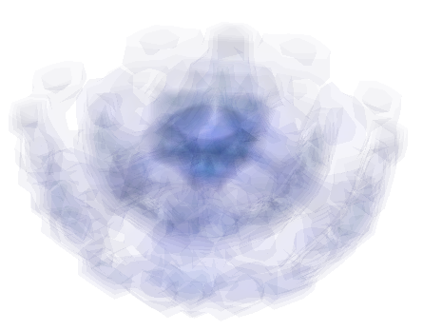
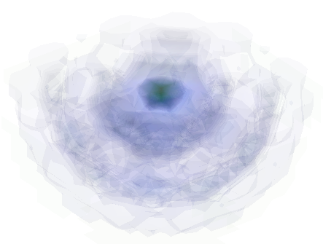
3-D Waves
Note: gif is restricted to 256 colours
  The actual Matlab plots are much more beautiful
Frame 443
Frame 459

Slide 82
3-D Waves
Suppose we have a resonance chamber:
  A sphere where we control the value on the exterior
    function [U] = U6d2_bndry( t, nx, ny, n_z)
    U = -Inf*ones( 21, 21, 21 );
    for ix = 1:21
    for iy = 1:21
    for iz = 1:21
    x = (ix - 1)/(nx - 1);
    y = (iy - 1)/(ny - 1);
    z = (iz - 1)/(n_z - 1);
    dist = sqrt( (x – 0.5)^2 + (y - 0.5)^2 + (z - 0.5)^2 );
    if dist >= 0.55
    U(ix, iy, iz) = NaN;
    elseif dist >= 0.5
    U(ix, iy, iz) = sin( 3.08*t );
    end
    end
    end
    end
    end

Slide 83
3-D Waves
Over time, the waves bounce back and forth in the chamber
  U6d_init = zeros( 21, 21, 21 );
  dU6d_init = zeros( 21, 21, 21 );
  [t6d, U6d] = wave3d( 1, 1, U6d_init, dU6d_init, @U6d2_bndry, [0, 50], 500 );
  frames6d = animate( U6d, [0, 65] );
  % movie( frames6d );
  frames2gif( frames6d, 'plot6d.iii.gif' );
Source: sin(3.08 t)
Maximum amplitude after 50 s: ≈ 2

Slide 84
3-D Waves
We can, again, examine the interior by removing half the points:
  U6d(:, :, 12:end, :) = NaN;
  frames6d = animate( U6d, [0, 65] );
  % movie( frames6d );
  frames2gif( frames6d, 'plot6d.iv.gif' );
Source: sin(3.08 t)
Maximum amplitude after 50 s: ≈ 2

Slide 85
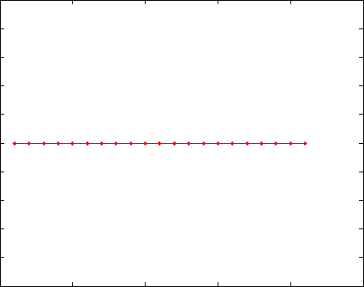
3-D Waves
This is the same effect that we see in one dimension:
function [u] = u6e_bndry( t, alpha )
u = [sin(alpha*t); sin(alpha*t)];
end
sin(0.76 t)
sin(0.64 t)
10
8
6
4
2
0

Slide 86
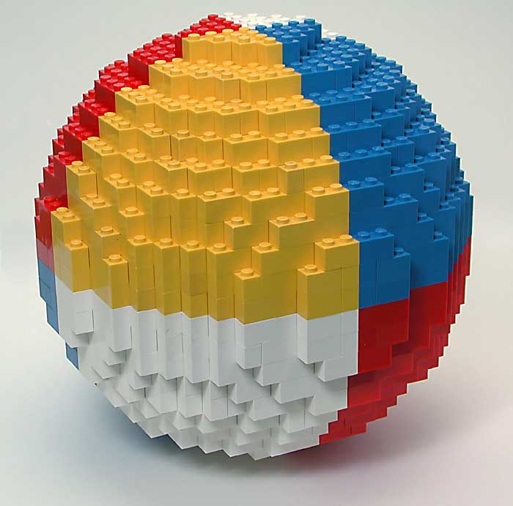
Finite Differences and Finite Elements
Remember also that we are approximating a sphere using a grid:
  Essentially, it’s the same as using Lego to make a sphere...
Philippe “Philo” Hurbain
http://www.philohome.com/sphere/sphere.htm

Slide 87
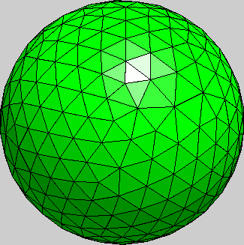
Finite Differences and Finite Elements
Nanotechnology engineering students will see finite-element methods in 3rd year:
http://nmag.soton.ac.uk/nmag/current/manual/html/manual.html

Slide 88
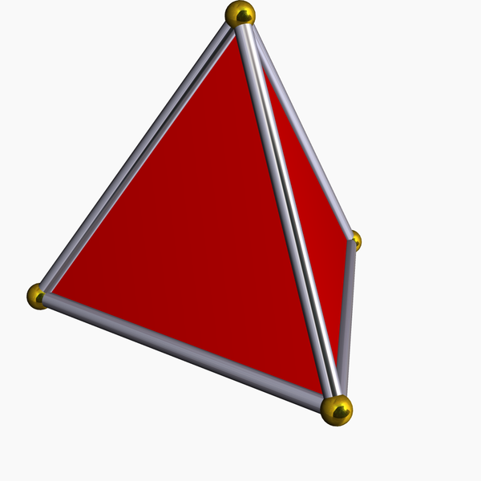
Finite Differences and Finite Elements
The interior is completely filled with tetrahedral elements
Robert Webb's Great Stella software http://www.software3d.com/Stella.html.
http://nmag.soton.ac.uk/nmag/current/manual/html/manual.html

Slide 89
Why h?
Compare the signatures for the function laplace2d and diffusion2d:
  function [U_soln] = laplace2d( U );
  function [x, t, U] = diffusion2d( kappa, h, U_init, U_bndry, t_int, nt );
Laplace, while solving in space, did not require any information about the spatial dimenion:
  Solutions to Laplace’s equation are scale invariant
  A bar that has one end at 0 °C and the other at 100 °C will, in equilibrium, be a straight line
  The heat-conduction/diffusion and wave equations are not...
  A bar that is at 0 °C and has one end placed in contact with a heat source at 100 °C will take longer to approach equilibrium if it is 10 m long than if it were 1 cm long

Slide 90
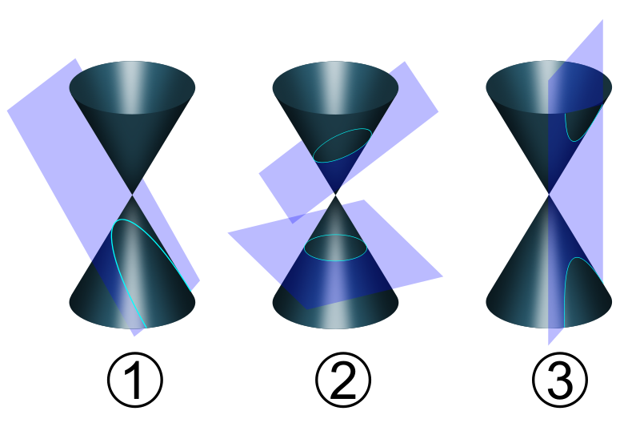
Conic Sections
The laboratory requires you to understand conic sections:
  The intersection of a cone and a plane will produce one of
  a parabolas, an ellipse, a circle or a hyperbola
User:Pbroks13

Slide 91
Conic Sections
The algebraic form of conic sections include:
  It is, however, often easier to use the definitions using the focuses and, in the case of the parabola, the directrix

Slide 92
Summary
We have looked at solving the heat-conduction/diffusion equation in two and three dimensions
  Learned how to use higher-dimensional arrays in Matlab
  Found the finite difference equation for the various equations
  Dealt with insulated boundary conditions
  Created movies and animated gifs to demonstrate the output

Slide 93
References
[1] Glyn James, Advanced Modern Engineering Mathematics, 4th Ed., Prentice Hall, 2011, §§9.2-3.

