Slide 1
The Wave Equation
Douglas Wilhelm Harder, M.Math. LEL
Department of Electrical and Computer Engineering
University of Waterloo
Waterloo, Ontario, Canada
ece.uwaterloo.ca
dwharder@alumni.uwaterloo.ca
© 2012 by Douglas Wilhelm Harder. Some rights reserved.

Slide 2
Outline
This topic discusses numerical solutions to the wave equation:
  Discuss the physical problem and properties
  Examine the equation
  Approximate solutions using a finite-difference equation
    Consider numerical stability
    Examples
  What about Crank-Nicolson?

Slide 3
Outcomes Based Learning Objectives
By the end of this laboratory, you will:
  Understand the wave equation
  Understand how to approximate partial differential equations using finite-difference equations
  Set up solutions in one spatial dimension
  Deal with insulated boundary conditions

Slide 4
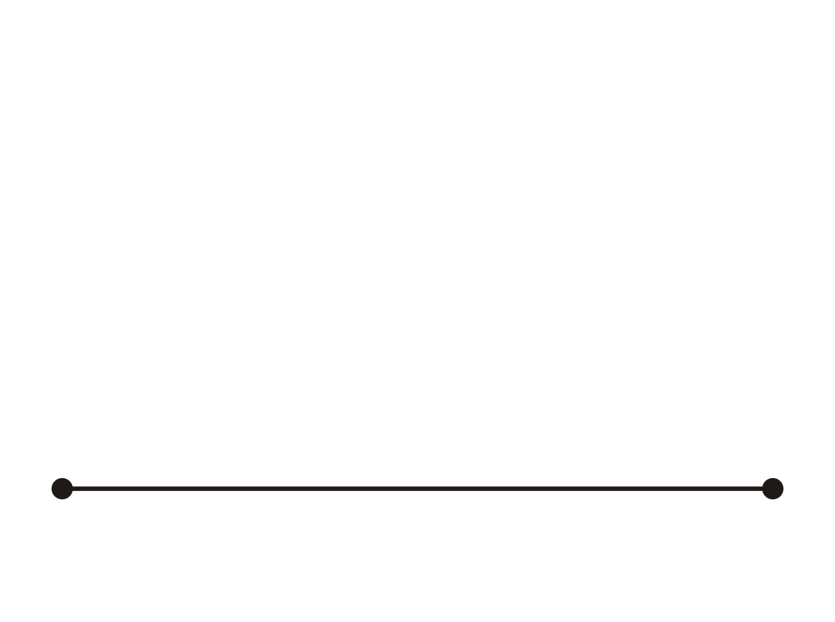
Motivating Example
Suppose we start with a string at rest

Slide 5
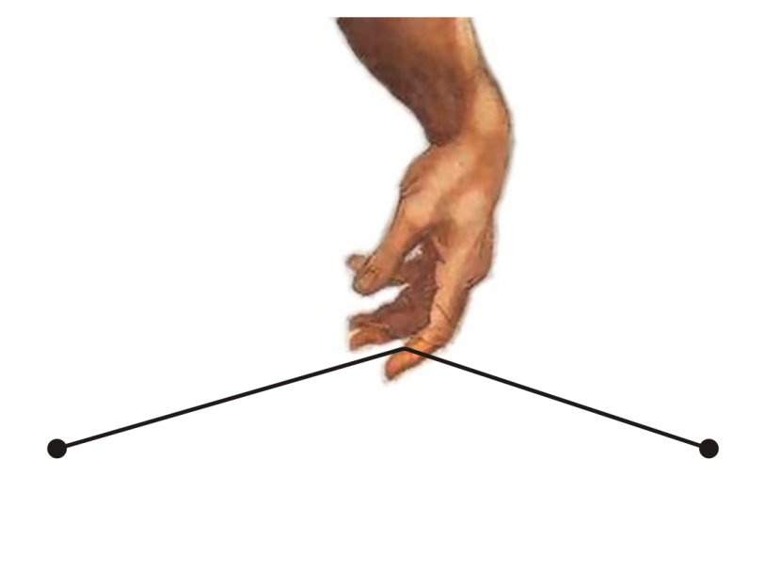
Motivating Example
Someone comes along and plucks the string

Slide 6
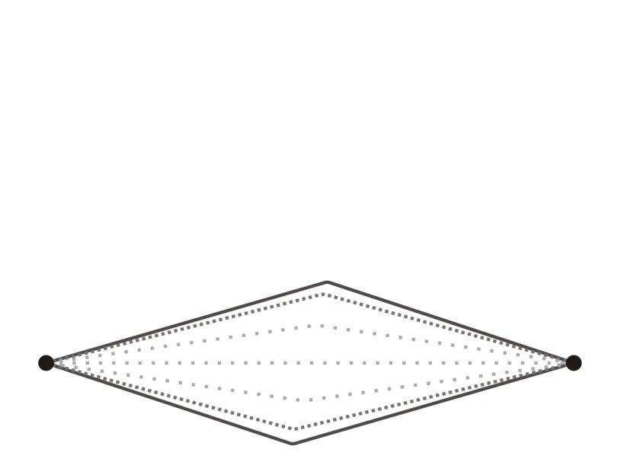
Motivating Example
After letting go, the string begins to vibrate
  Energy is transferred to the air producing sound

Slide 7
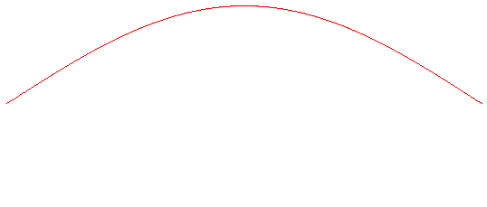
Motivating Example
Some things to note: The string
  Is at rest when it is a solution to Laplace’s equation
  Acceleration is towards the solution of Laplace’s equation

Slide 8
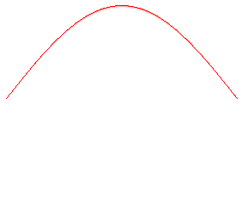
Motivating Example
In addition, if we reduce the length of a string, the vibrations increase:
  Halve the length of a string, double the frequency
  If a string of a certain length is middle C, a string of half the length is one octave higher

Slide 9
Motivating Example
Waves are not restricted to strings:
  The vibrations on the face of a drum
  The ripples on the surface of a pond
  The movement of light (microwaves, radio waves, etc.)

Slide 10
The Wave Equation
The equation that describes the propagation of waves under somewhat ideal circumstances is given by the partial differential equation
where u(x, t) is a real-valued function of space and time and c is the propagation speed of the wave
  Sound in air at 20 ºC c ≈ 343 m/s = 1234.8 km/h ≈ 1 km/3 s
  Light c = 299 792 458 m/s

Slide 11
The Wave Equation
For water in a deep ocean, the speed is proportional to the square root of the wave length:
Wavelength (m) | Speed (m/s)
1 | 2.5
10 | 4
100 | 12.5
1000 | 39
140 km/h

Slide 12
The Laplacian Operator
Notice if that u(x, t) already satisfies Laplace’s equation,
then
or
That is, if a solution already satisfies Laplace’s equation, it will not be accelerating
  In one dimension, if the string is already tight (a straight line), it will not begin vibrating
  If it’s not moving, either, it will remain fixed

Slide 13
Acceleration Proportional to Concavity
In one dimension, what does this equation mean?

Slide 14
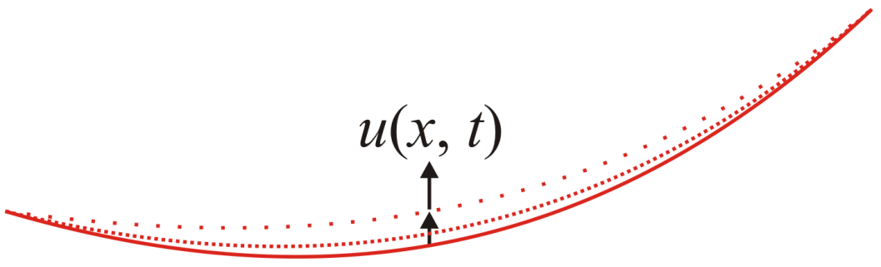
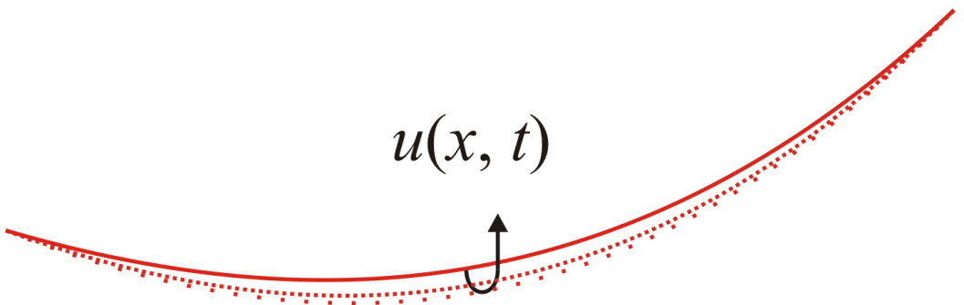
Acceleration Proportional to Concavity
We can see this visually:
  If the function u is concave up at (x, t), the acceleration of u over time will be positive

Slide 15
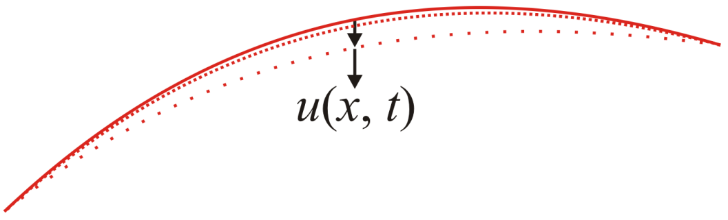
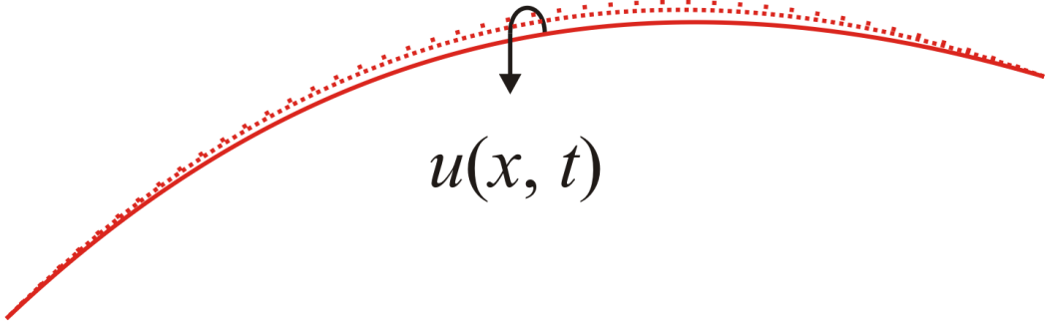
Acceleration Proportional to Concavity
We can see this visually:
  If the function u is concave down at (x, t), the acceleration of u over time will be negative

Slide 16
Initial and Boundary Conditions
For a 2nd-order ODE, we require either two initial conditions
or a boundary condition:
Time variables are usually
associated with initial conditions
Space variables are usually
associated with boundary conditions

Slide 17
Initial and Boundary Conditions
For the wave equation,
we have two second partial derivatives:
  One in time
  One in space

Slide 18
Initial and Boundary Conditions
For the wave equation,
we require
  For each space coordinate:
    An initial value at each point, and
    An initial velocity at each point
  For each time coordinate
    Boundary conditions at the end points in space

Slide 19
The Wave Equation
Given the wave equation
and the two approximations of the second partial derivatives
we will substitute the approximations into the equation

Slide 20
The Wave Equation
This gives us our finite-difference equation

Slide 21
The Wave Equation
This gives us our finite-difference equation
Note that there is only one term in the future: u(x, t + Δt)
  We assume we have approximations for t and t – Δt
  Solve for u(x, t + Δt)

Slide 22
The Wave Equation
This gives us our finite-difference equation
Substituting
we get

Slide 23
The Wave Equation
As before, we will substitute
and recognize that
to get

Slide 24
Initial and Boundary Conditions
The boundary conditions will be given by the functions
  u_{init}(x) The initial value of the function u(x, t₀)
  Δu_{init}(x) The initial rate of change u(x, t₀)
  a_{bndry}(t) The boundary value of the function u(a, t)
  b_{bndry}(t) The boundary value of the function u(b, t)
As with the previous cases, we will define the latter two as a single vector-valued function

Slide 25
Initial and Boundary Conditions
We will define two functions
u_init( x ) du_init( x ) u_bndry( t )
where
  u_init and u_bndry are the same as before
  du_init takes an n-dimensional column vector x as an argument and returns an n-dimensional vector of the initial
  speeds

Slide 26
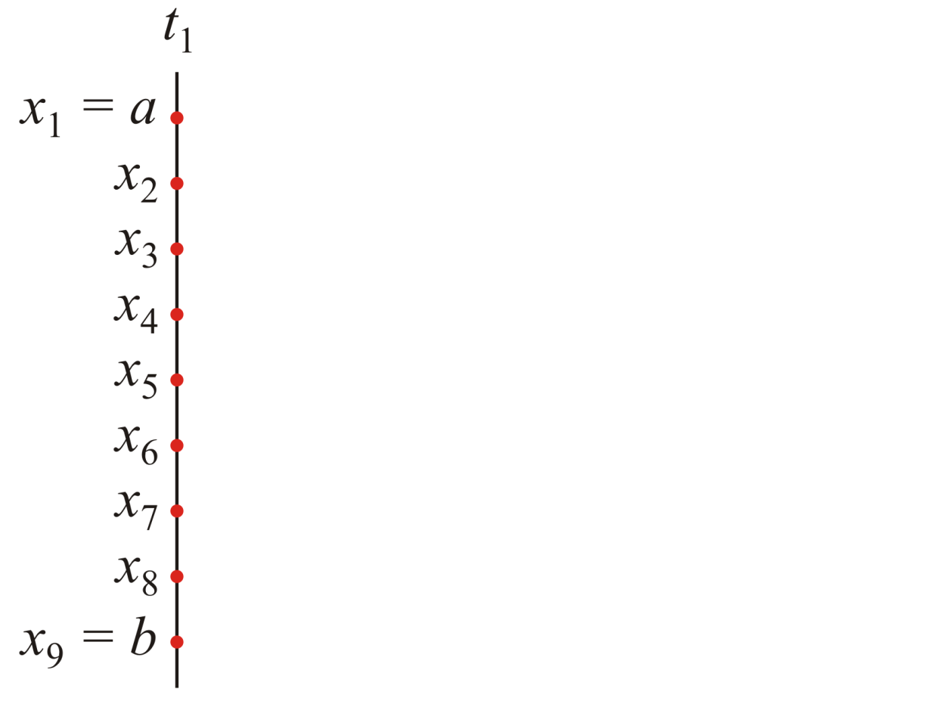
Approximating the Solution
Just as we did with BVPs and the heat-conduction/diffusion equation, we will divide the spacial interval [a, b] into n_{x} points or n_{x} – 1 sub-intervals

Slide 27
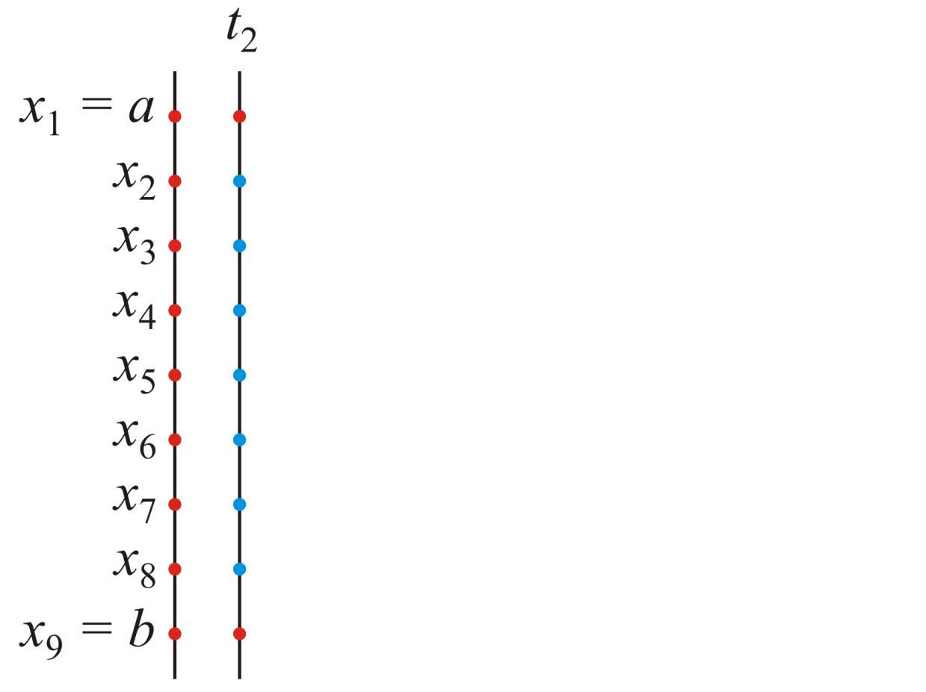
Approximating the Solution
  We want to approximate the state at time t = t₂ but consider the formula with k = 1:
We don’t have access to u_{i,0}

Slide 28
Approximating the Solution
  To solve this, we will use the initial conditions:
  u_{i,2} = u_{i,1} + Δt Δu_{i,1}
  – This is simply an application of Euler’s method

Slide 29
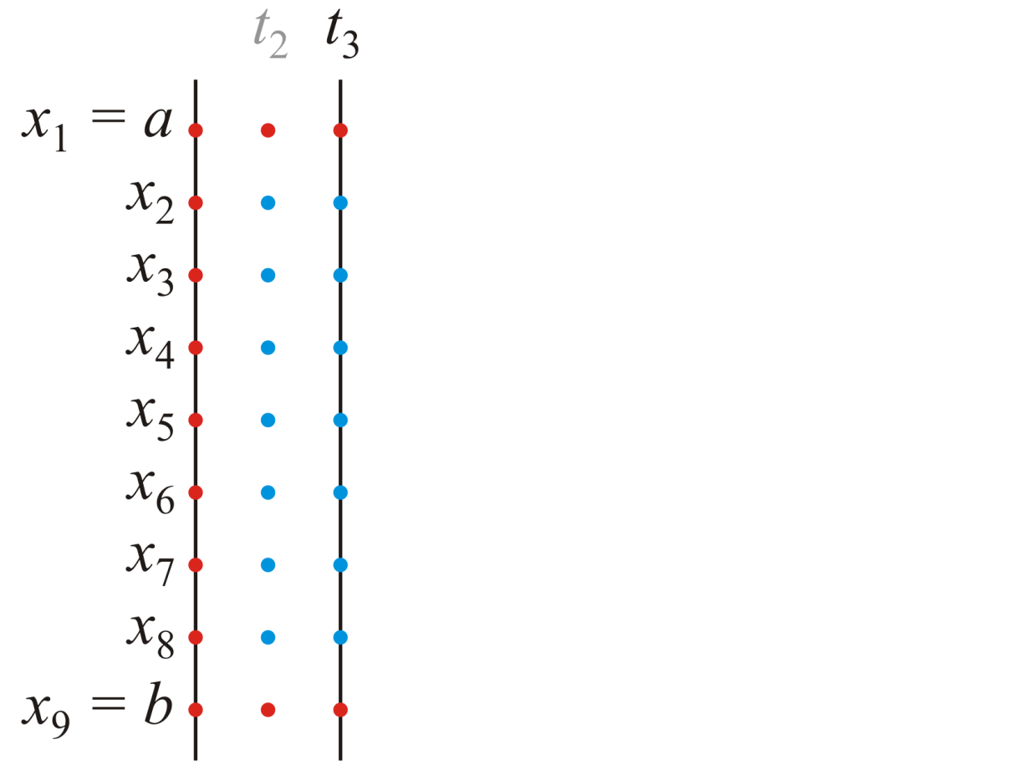
Approximating the Solution
  For the next point, t = t₃ , however, we can go back to using the finite-difference formula:

Slide 30
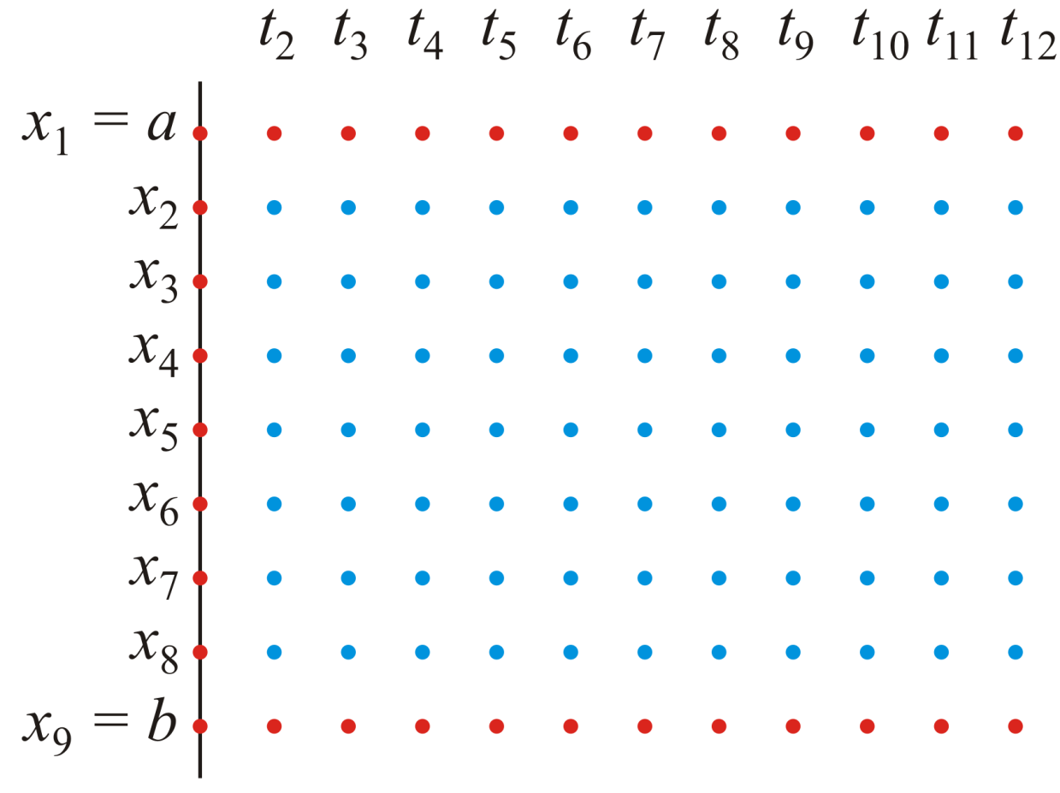
Approximating the Solution
  And from here on, we can continue using the formula

Slide 31
Insulated Boundaries
As this is a forward solving algorithm, if we have insulated boundaries, it is straight forward
  Insulated boundaries reflect waves
We will solve for the values at times k = 1, …, n_{t} – 1
  We will first solve for the values u_{2, k} through u_{n – 1, k} ,
  If u_{1, k} is marked as insulated (NaN), we will replace it with u_{2, k}
  If u_{n , k} is marked as insulated (NaN), we will replace it with u_{n – 1, k}
x
x
x

Slide 32
Steps to the Problem
Previously, the steps were:
  Error checking (if necessary)
  Initialization
  Solving the problem
When we solve BVPs, Step 3. was broken into:
  Generate the matrix and vector for solving Mu_{intr} = b
  Modify the first and last entries of b
  Solve the system of linear equations
  Add u_{a} and u_{b} back to the result

Slide 33
Steps to the Problem
Previously, the steps were:
  Error checking (if necessary)
  Initialization
  Solving the problem
When we solve the heat-conduction/diffusion equation, Step 3. was broken into:
  For each time step k = 1, 2, …, n_{t} – 1
  Apply the formula to approximate u_{i, k + 1}

Slide 34
Steps to the Problem
Previously, the steps were:
  Error checking (if necessary)
  Initialization
  Solving the problem
When we applied the Crank-Nicolson method, Step 3. was broken into:
  For each time step k = 1, 2, …, n_{t} – 1
  Generate the matrix and vector for solving Mu_{intr} = b
  Modify the first and last entries of b
  Solve the system of linear equations to approximate u_{i, k + 1}

Slide 35
Steps to the Problem
Previously, the steps were:
  Error checking (if necessary)
  Initialization
  Solving the problem
When we applied the Crank-Nicolson method adding insulated boundary conditions, Step 3. was broken into:
  For each time step k = 1, 2, …, n_{t} – 1
  Generate the matrix and vector for solving Mu_{intr} = b
  Modify, as appropriate, the vector b or the matrix M
  Solve the system of linear equations to approximate u_{i, k + 1}
  As appropriate, update any insulated boundary conditions

Slide 36
Steps to the Problem
Now we are solving the wave equation:
  Error checking:
  Initialization
  Solve for the special case at time t₂
  Solving the problem for the general case
When we solved the adding insulated boundary conditions, Step 4 was broken into:
  For each time step k = 2, 3, …, n_{t} – 1
  Apply the formula to approximate u_{i, k + 1}
  As appropriate, update any insulated boundary conditions

Slide 37
Step 1: Error Checking
Once the parameters are validated, the next step is to ensure
If this condition is not met, we should exit and provide a useful error message to the user:
  For example,
  The ratio (c*dt/h)^2 = ??? >= 1, consider using nt = ???
  where
    The first ??? is replaced by the calculated ratio, and
    The second ??? is found by calculating the smallest integer for n_{t} that would be acceptable to bring this ratio under 1
  You may wish to read up on the floor and ceil commands

Slide 38
Step 1: Error Checking
Essentially, given c, t₀, t_{final} and h, find an appropriate value (that is, the smallest integer value) of n_{t}* to ensure that
Very similar to constraints on for the heat-
conduction/diffusion equation

Slide 39
Step 2: Initialization
It would still be useful to initialize the matrix U and then use the values as appropriate
n_{t}
n_{x}

Slide 40
Step 3: Solving at time t₂
We then proceed to evaluate the next column using the straight-forward application of Euler’s method
n_{t}
n_{x}

Slide 41
Step 4: Solving
Thus, we have approximations for the values u_{2, 2} through u_{n – 1, 2}
  We may have to adjust these if we have insulated boundary conditions
x
n_{t}
n_{x}

Slide 42
Step 4: Solving
As with the previous case, we will find solutions for the interior points for t₂ through t_{n}
t
n_{t}
n_{x}

Slide 43
Step 4: Solving
As with the previous case, we will find solutions for the interior points for t₂ through t_{n}
  Again, at each step, we may have to adjust any boundary values indicating insulated boundary conditions
t
n_{t}
n_{x}

Slide 44
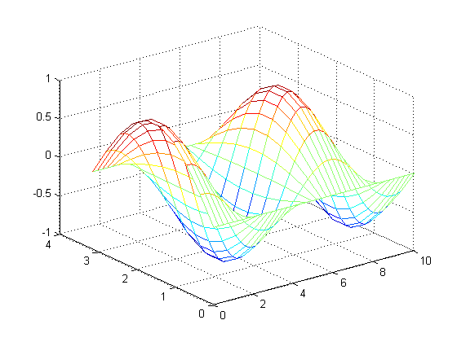
Example 1
As a first example:
  [x4a, t4a, U4a] = wave1d( 1, [0, pi], 10, [0, 10], 42, @u4a_init, @du4a_init, @u4a_bndry );
  size(x4a)
  ans =
  10 1
  >> size(t4a)
  ans =
  1 30
  >> size(U4a)
  ans =
  10 30
  >> mesh( t4a, x4a, U4a )
c = 1.0
b_{4a,bndry} (t) = 0.0
u_{4a,init}(x) = sin(x)
Δu_{4a,init}(x) = 0
a_{4a,bndry} (t) = 0.0
b = π
x
t_{final} = 10
n_{x} = 10
t
n_{t} = 42
a = 0
t₀ = 0

Slide 45
Example 1
As a first example:
  [x4a, t4a, U4a] = wave1d( 1, [0, pi], 10, [0, 10], 42, @u4a_init, @du4a_init, @u4a_bndry );
  mesh( t4a, x4a, U4a )
c = 1.0
b_{4a,bndry} (t) = 0.0
u_{4a,init}(x) = sin(x)
Δu_{4a,init}(x) = 0
a_{4a,bndry} (t) = 0.0
function [u] = u4a_init(x)
u = sin(x);
end
function [u] = du4a_init(x)
u = 0*x;
end
function [u] = u4a_bndry(t)
u = [0*t; 0*t];
end
b = π
x
t_{final} = 10
n_{x} = 10
t
n_{t} = 42
a = 0
t₀ = 0

Slide 46
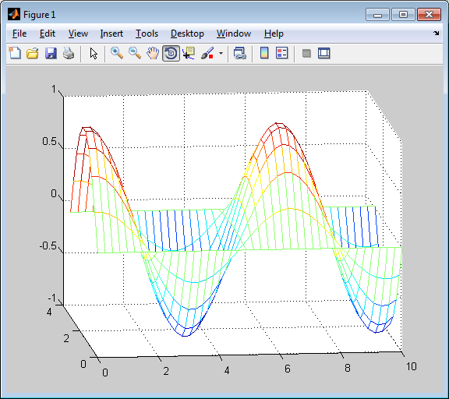
Example 1
Selecting the Rotate 3D icon allows you to rotate the image

Slide 47
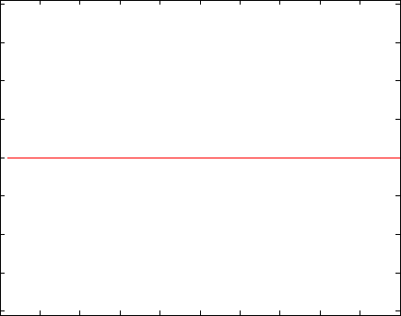
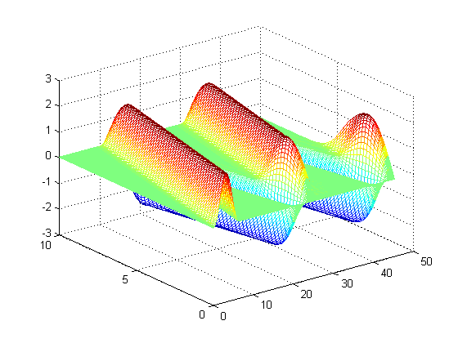
Example 2
If we start with a straight line and create a pulse (like
with slinkies), we get the following wave
  [x4b, t4b, U4b] = wave1d( 1, [0, 10], 50, [0, 45], 350, @u4b_init, @du4b_init, @u4b_bndry );
  mesh( t4b, x4b, U4b );
  frames4b = animate( U4b );
  frames2gif( frames4b, 'plot4b.i.gif' );
1
0
t
–1
x
function [u] = u4c_bndry(t)
u = [(1 - cos(t)).*(t <= 2*pi); 0*t];
end

Slide 48
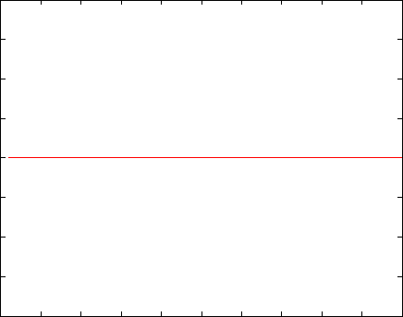
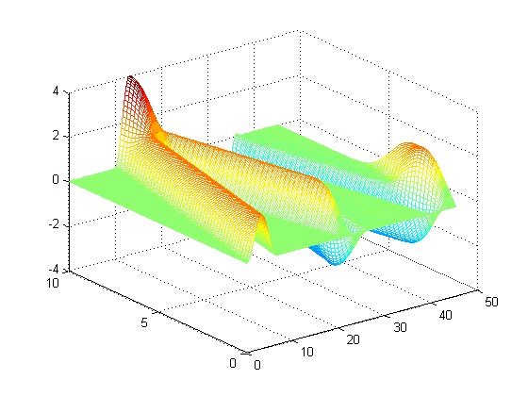
Example 2
Suppose we allow the one end to move freely:
  This would represent an insulated boundary
  [x4b, t4b, U4b] = wave1d( 1, [0, 10], 50, [0, 45], 350, @u4b_init, @du4b_init, @u4b_bndry );
  mesh( t4b, x4b, U4b );
  frames4b = animate( U4b );
  frames2gif( frames4b, 'plot4b.ii.gif' );
2
1
0
–1
t
–2
x
function [u] = u4c_bndry(t)
u = [(1 - cos(t)).*(t <= 2*pi); NaN*t];
end

Slide 49
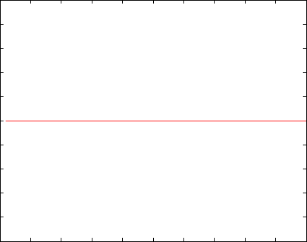
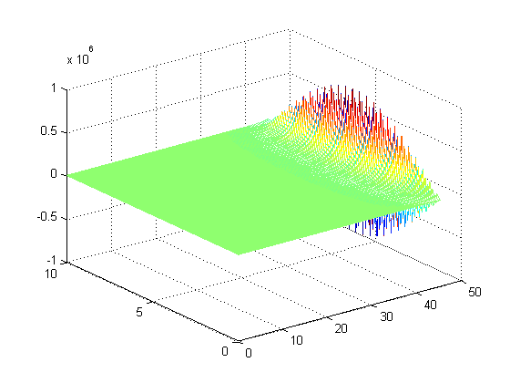
Example 3
If we exceed 1, the approximation diverges:
[x4b, t4b, U4b] = wave1d( 1, [0, 10], 50, [0, 45], 221, @u4b_init, @du4b_init, @u4b_bndry );
  mesh( t4b, x4b, U4b );
  frames4b = animate( U4b, [-3, 3] );
  frames2gif( frames4c, 'plot4b.iii.gif' );
3
0
–3
x
t

Slide 50
Crank-Nicolson and Implicit Methods?
What about using the ideas from the Crank-Nicolson approach
  Without justification, I tried to incorporate the method
  The method, however, did not decrease the error—it significantly
  increased it

Slide 51
Summary
We have looked at the wave equation
  Considered the physical problem
  Considered the effects in one dimension
  Found a finite-difference equation approximating the wave equation
    Saw that
    Examples
  We considered insulated boundaries

Slide 52
References
[1] Glyn James, Modern Engineering Mathematics, 4th Ed., Prentice Hall, 2007, p.778.
[2] Glyn James, Advanced Modern Engineering Mathematics, 4th Ed., Prentice Hall, 2011, p.164.

