Slide 1
The Crank-Nicolson Method and
Insulated Boundaries
Douglas Wilhelm Harder, M.Math. LEL
Department of Electrical and Computer Engineering
University of Waterloo
Waterloo, Ontario, Canada
ece.uwaterloo.ca
dwharder@alumni.uwaterloo.ca
© 2012 by Douglas Wilhelm Harder. Some rights reserved.

Slide 2
Outline
This topic discusses numerical approximations to solutions to the heat-conduction/diffusion equation:
  Consider the Crank-Nicolson method for approximating the heat-conduction/diffusion equation
  This is an implicit method
    Uses Matlab from Laboratories 1 and 2
    Unconditionally stable
  Defines the characteristics of insulated boundaries
  Implement insulated boundaries into the Crank-Nicolson method

Slide 3
Outcomes Based Learning Objectives
By the end of this laboratory, you will:
  Understand the Crank-Nicolson method
  Understand the definition and approximations of insulated boundaries

Slide 4
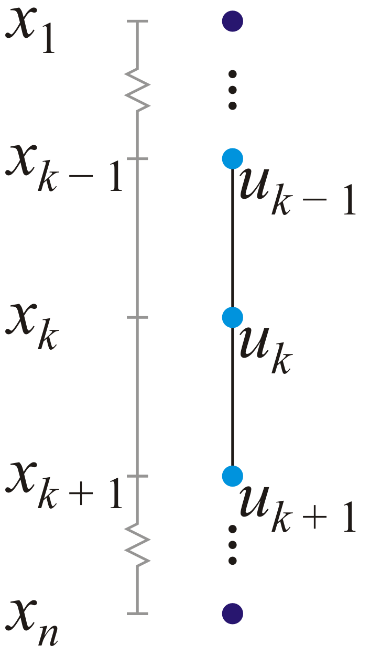
Review
In Laboratory 1, you solved a boundary-value problem:
  Given the finite-difference equation
  d⁺u_{k − 1} + du_{k} + d⁻u_{k + 1} = g(x_{k}),
  there are three unknowns:
  u_{k – 1} u_{k} u_{k + 1}
  This requires us to set up a system
  of n – 2 linear equations which must be
  solved
  The boundary values give us u₁ and u_{n}

Slide 5
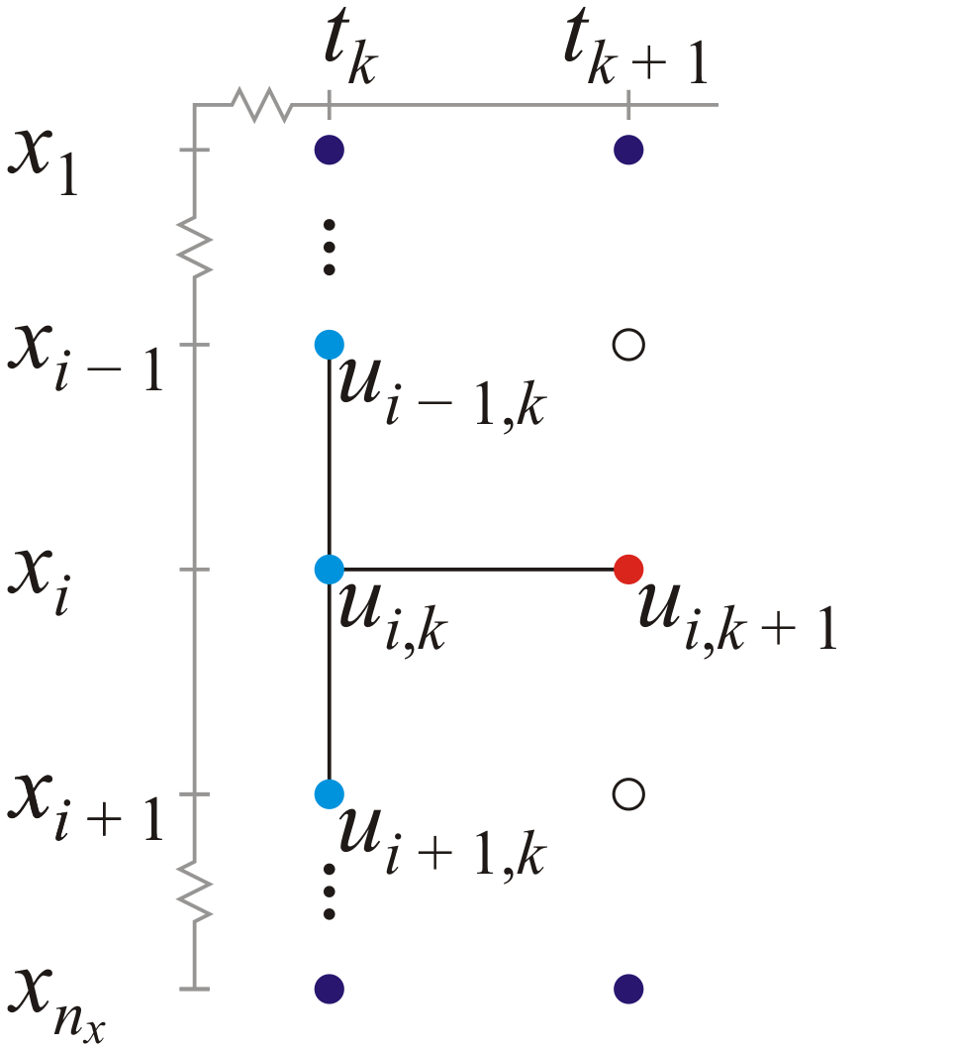
Review
In Laboratory 2, we used an explicit method:
  Given the finite-difference equation
  All the values on the right-hand side
  are known, we need only evaluate this
  for u_{2, k + 1} through u_{n − 1 , k + 1}
x

Slide 6
Review
We found the finite-difference equation
by substituting
into
Both focus on (x_{i}, t_{k})

Slide 7
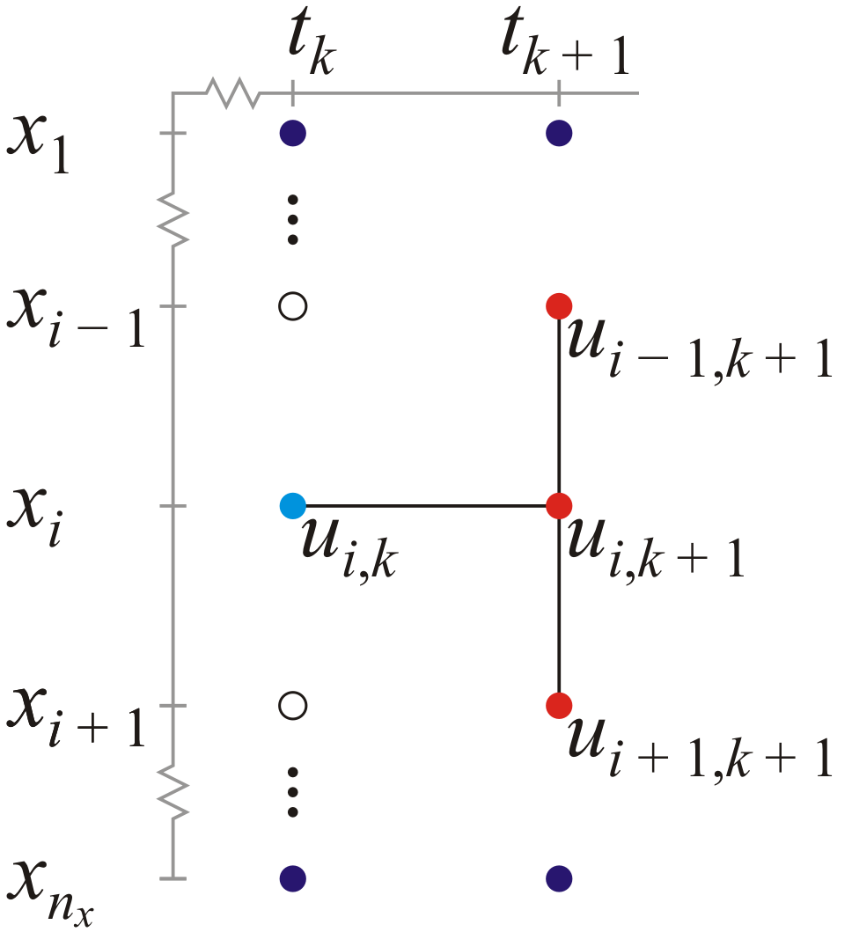
The Crank-Nicolson Method
What happens if we focus on the point (x_{i}, t_{k + 1})?
These focus on (x_{i}, t_{k + 1})

Slide 8
The Crank-Nicolson Method
This gives us the finite-difference equation
The linear equation now has:
  One known u_{i, k}
  Three unknowns u_{i – 1,k + 1}, u_{i,k + 1}, u_{i + 1, k + 1}

Slide 9
The Crank-Nicolson Method
Compare the two:

Slide 10
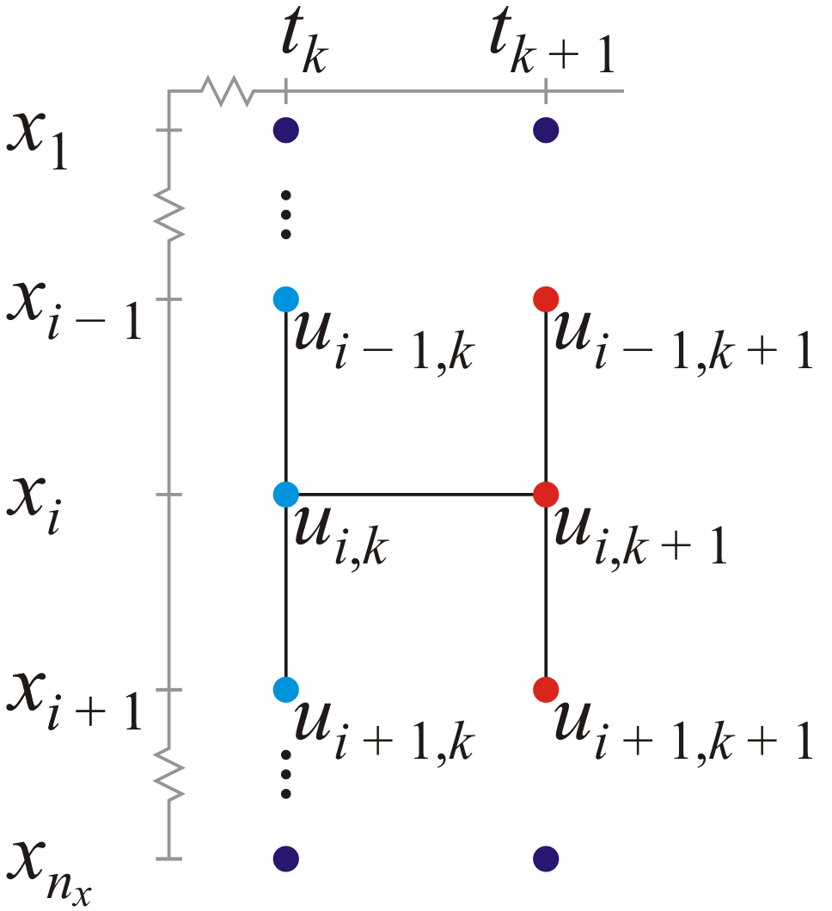
The Crank-Nicolson Method
Given two equations, we can add them:
+

Slide 11
The Crank-Nicolson Method
First, substitute

Slide 12
The Crank-Nicolson Method
Next, collect similar terms and bring
  All unknowns to the left, and
  All knowns to the right

Slide 13
The Crank-Nicolson Method
We now have a new finite-difference equation:
Unknowns
Knowns

Slide 14
The Crank-Nicolson Method
As we did in Laboratory 1, we could then write n_{x} – 2 equations
.
.
.
n_{x} – 2
.
Unknowns
Knowns

Slide 15
The Crank-Nicolson Method
Again, there appear to be n_{x} unknowns; however, the boundary conditions provide two of those values:
.
.
.
.
Unknowns
Knowns

Slide 16
The Crank-Nicolson Method
That is: u_{1, k + 1} = a_{bndry}(t_{k + 1})
u_{n , k + 1} = b_{bndry}(t_{k + 1})
Bring them to the right-hand side....
x
.
.
.
.
Unknowns
Knowns

Slide 17
The Crank-Nicolson Method
We now have n_{x} – 2 linear equations and n_{x} – 2 unknowns
.
.
.
.
Unknowns
Knowns

Slide 18
The Crank-Nicolson Method
This can be written in the form Mx = b:
Unknowns
Knowns

Slide 19
The Crank-Nicolson Method
Note the structure of b:
diff

Slide 20
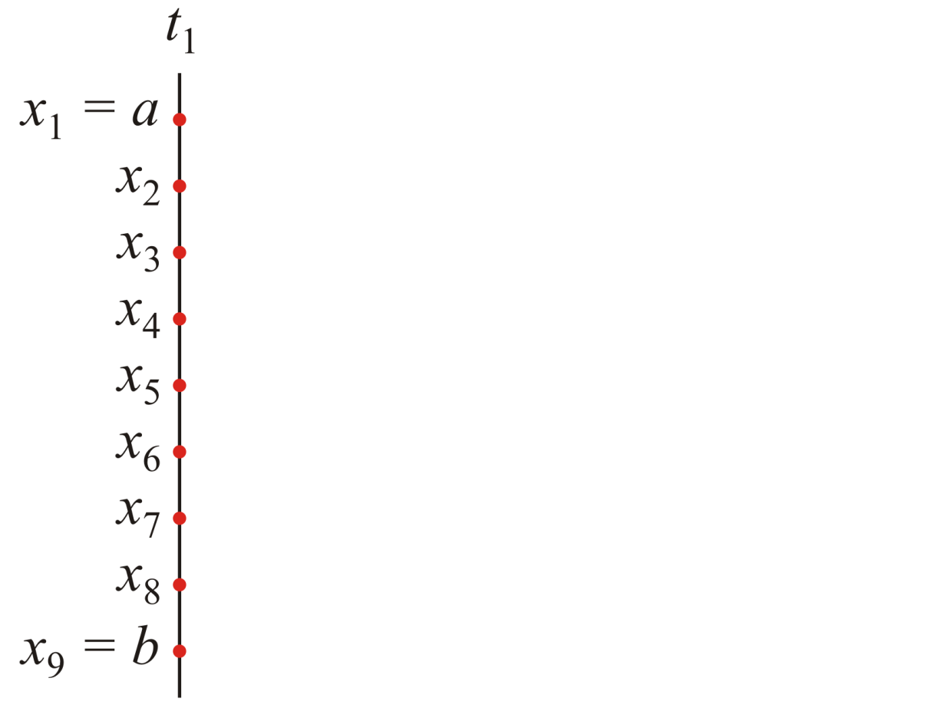
Approximating the Solution
Thus, given the initial state at time t₁, we create a system of equations with k = 1 to solve for u_{2, 2} through u_{n – 1, 2}
x

Slide 21
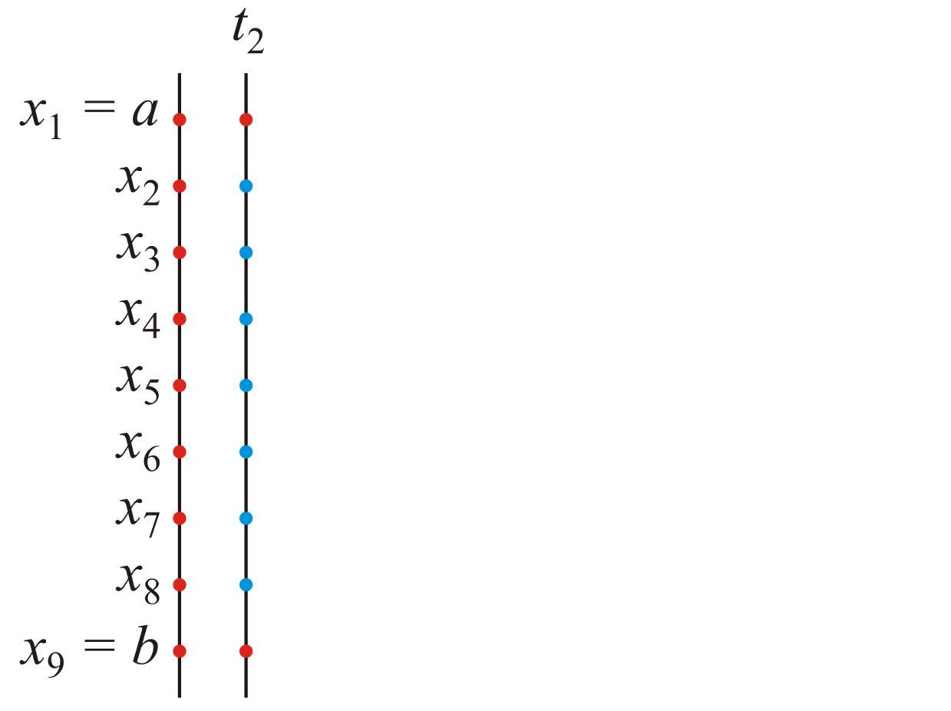
Approximating the Solution
  We will simultaneously solve for these values and assign them to our solution matrix U

Slide 22
Approximating the Solution
  Given the initial state at time t₂, we will create the system of equations with k = 2 to solve for u_{2, 3} through u_{n – 1, 3}
x

Slide 23
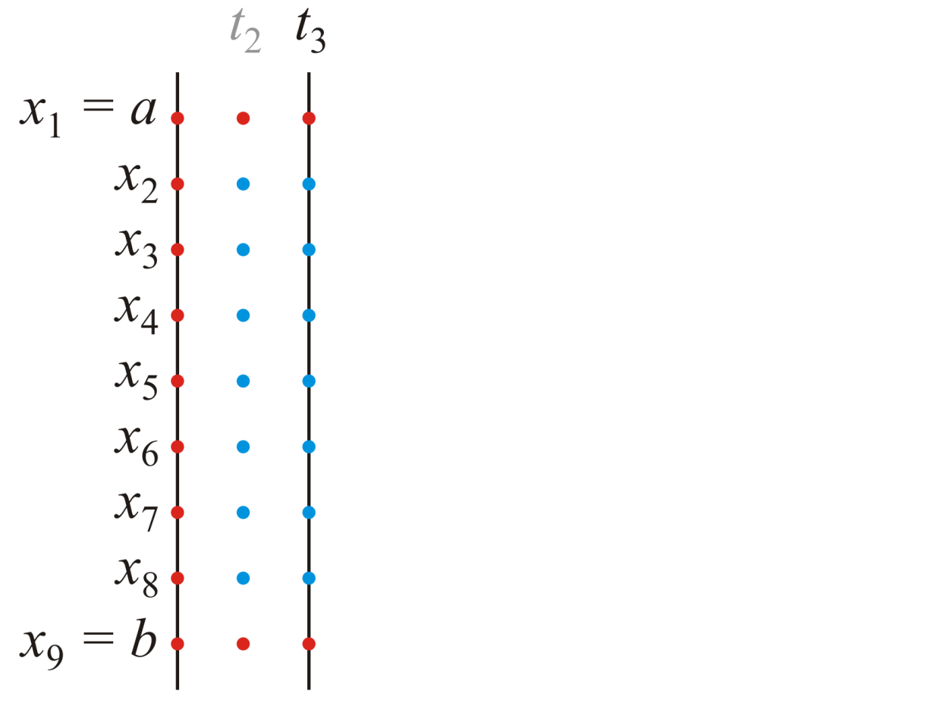
Approximating the Solution
  Again, having solved for the values u_{2, 3} through u_{n – 1, 3}, we assign those entries to our matrix U
x

Slide 24
Approximating the Solution
  In general, at time t_{k}, we will create the system of equations with k and then solve for u_{2, k + 1} through u_{n – 1, k + 1}
x

Slide 25
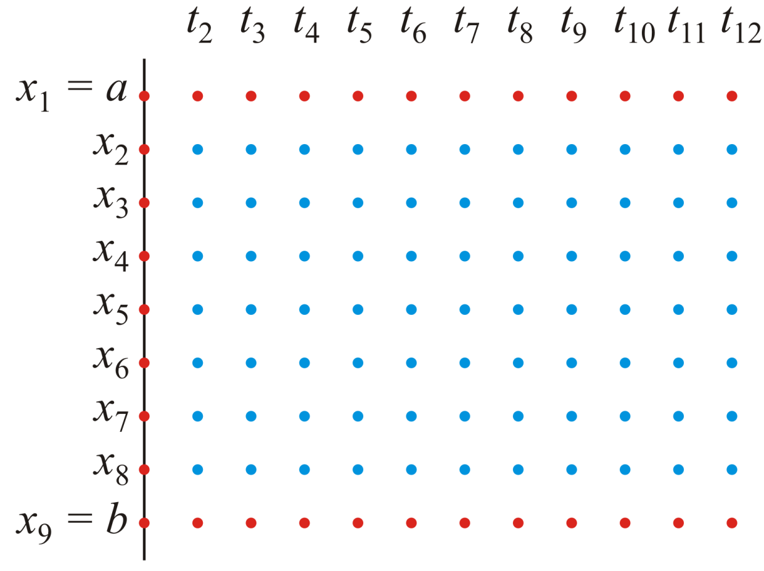
Approximating the Solution
Doing this, we will fill in the balance of the matrix

Slide 26
The diffusion1d Function
The signature will be
  function [x_out, t_out, U_out] = ...
  crank_nicolson1d( kappa, x_rng, nx, t_rng, nt, u_init, u_bndry )
where
kappa the diffusivity coefficient
x_rng the space range [a, b]
nx the number of points into which we will divide [a, b]
t_rng the time interval [t₀, t_{final}]
nt the number of points into which we will divide [t₀, t_{final}]
u_init a function handle giving the initial state u_{init}:[a, b] → R
u_bndry a function handle giving the two boundary conditions
u_{bndry}:[t₀, t_{final}] → R² where

Slide 27
Step 1: Error Checking
Unlike the previous method we used which was subject to a catastrophic error if
the Crank-Nicolson method is unconditionally stable
  There are no values which will cause the divergence we saw using the previous technique
Never-the-less, if , there may be decaying osillations

Slide 28
Step 1: Error Checking
Rather than throwing an exception, issue a warning:
  warning( 'MATLAB:questionable_argument', ...
  'the arguments of %d and %d are sub-optimal', ...
  a, b )
This warning will be seen by the user; however,
it will not terminate the execution of the function

Slide 29
Step 2: Initialization
It would still be useful to initialize the matrix U and then use the values as appropriate
n_{t}
n_{x}

Slide 30
Step 3: Solving
As with the previous case, we will find solutions for the interior points for t₂ through t
t
n_{t}
n_{t}
n_{x}

Slide 31
Step 3: Solving
For each time step from 1 to n_{t} – 1, we will, however, have to perform the following:
  3a. Set up the system of linear equations
  3b. Solve the system of linear equations, and
  3c. Assign the values to the next column of the solution matrix

Slide 32
Useful Matlab Commands
There are no new additional Matlab commands for the Crank-Nicolson method that you have not already been introduced to in Laboratories 1 and 2

Slide 33
Examples
Consider the following example:
  The initial temperature of the bar is 1 ºC
  The bar is placed in contact with two barriers at –1 ºC and 2 ºC
    function [u] = u3a_init( x )
    u = x*0 + 1;
    end
    function [u] = u3a_bndry( t )
    u = [t*0 - 1; t*0 + 2];
    end

Slide 34
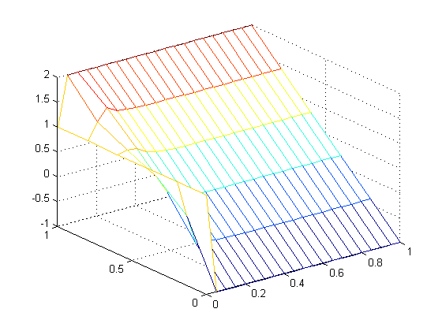
Examples
[xs, ts, Us] = crank_nicolson1d( 1.5, [0 1], 6, [0 1], 21, @u3a_init, @u3a_bndry );
mesh( ts, xs, Us )

Slide 35
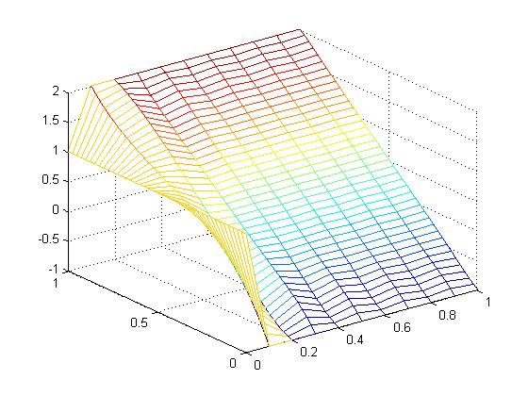
Examples
[xs, ts, Us] = crank_nicolson1d( 1.5, [0 1], 41, [0 1], 11, @u3a_init, @u3a_bndry );
mesh( ts, xs, Us )
Note the transient oscillations

Slide 36
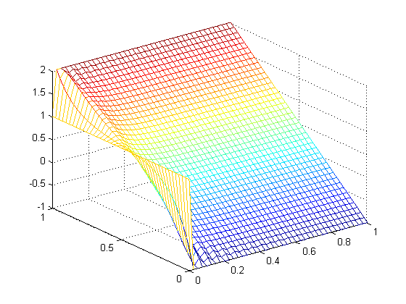
Examples
[xs, ts, Us] = crank_nicolson1d( 1.5, [0 1], 41, [0 1], 41, @u3a_init, @u3a_bndry );
mesh( ts, xs, Us )
Note the transient oscillations

Slide 37
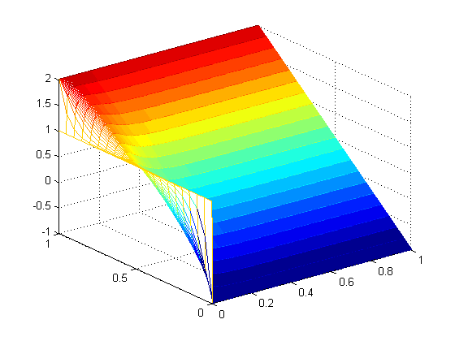
Examples
[xs, ts, Us] = crank_nicolson1d( 1.5, [0 1], 21, [0 1], 301, @u3a_init, @u3a_bndry );
mesh( ts, xs, Us )

Slide 38
Examples
Consider an alternate example:
  The initial temperature of the bar is 0 ºC
  The bar is placed in contact with two barriers at 1 ºC and 4 ºC
    function [u] = u3b_init( x )
    u = x*0;
    end
    function [u] = u3b_bndry( t )
    u = [t*0 + 1; t*0 + 4];
    end

Slide 39
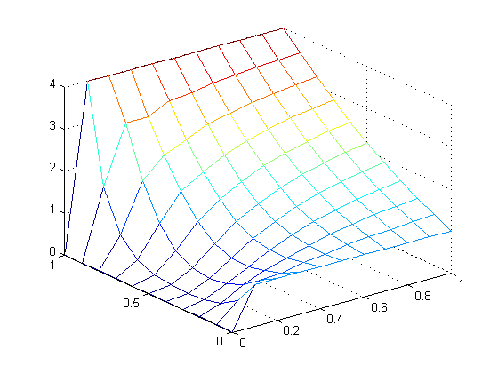

Examples
[x3b, t3b, U3b] = crank_nicolson1d( 0.25, [0 1], 11, [0 1], 11, @u3b_init, @u3b_bndry );
mesh( t3b, x3b, U3b );
frames3b = animate( U3b );
frames2gif( frames3b, 'plot3b.i.gif' );

Slide 40
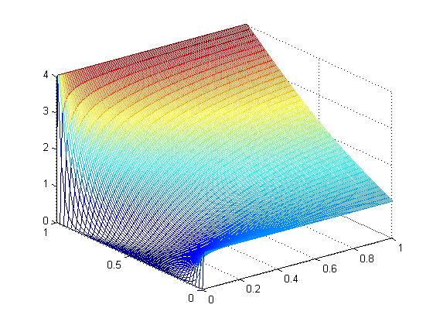

Examples
[x3b, t3b, U3b] = crank_nicolson1d( 0.25, [0 1], 41, [0 1], 161, @u3b_init, @u3b_bndry );
mesh( t3b, x3b, U3b );
frames3b = animate( U3b );
frames2gif( frames3b, 'plot3b.ii.gif' );

Slide 41
Insulated Boundaries
We have looked at situations where we have known temperatures or concentrations at each end of the bar; however, what happens if one end of the bar is insulated?

Slide 42
Terminology
Up to this point, we have discussed boundary values where the value of the function is specified
  These are termed Dirichlet boundary condition
Alternatively, one can specify the value of the derivative at the boundary points
  These are termed Neumann boundary conditions
Specifically, we will focus on insulated boundary conditions where the derivative at the boundaries are zero

Slide 43

Insulated Boundaries
Suppose you have a metal bar in contact with a body at 100 ºC
  If the bar is insulated, over time, the entire length of the bar will be at 100 ºC
0 ºC
100 ºC

Slide 44

Insulated Boundaries
At time t = 0, one end of the bar is brought in contact with a heat sink at 0 ºC; the other end is insulated
0 ºC
100 ºC

Slide 45

Insulated Boundaries
Over time, the bar continues to cool
0 ºC
100 ºC

Slide 46

Insulated Boundaries
The cooling process will be much slower
0 ºC
100 ºC

Slide 47

Insulated Boundaries
Even the furthest end, however, will begin to cool after some time
0 ºC
42 ºC

Slide 48

Insulated Boundaries
Until, ultimately, the entire bar is at 0 ºC
0 ºC
0 ºC

Slide 49
Insulated Boundaries
The mathematical property of an insulated boundary is that there is no transfer w.r.t. space of the property (temperature or concentration) across that boundary:
or

Slide 50
Insulated Boundaries
We could use the O(h) approximations:
However, as other approximations of the 2nd derivative are O(h²), we will use:

Slide 51
Insulated Boundaries
Thus, our approximations of the insulated boundary conditions
are

Slide 52
Insulated Boundaries
First multiply by 2h:
Next, substitute
Finally, solve for u_{1,k + 1} and u_{n ,k + 1} :
x

Slide 53
Insulated Boundaries
The first and last linear equations we prepared use both u_{1, k + 1} and u_{n , k + 1}, respectively
x

Slide 54
Insulated Boundaries
Applying our substitutions:

Slide 55
Insulated Boundaries
Thus, the first and last equations simplify to:

Slide 56
Insulated Boundaries
Recall our original system Mx = b

Slide 57
Insulated Boundaries
Two changes are required if the left boundary is insulated:
  m_{1,1} and m_{1,2} are modified
  The original change to b₁ is no longer necessary

Slide 58
Insulated Boundaries
Two changes are required if the right boundary is insulated:
  m_{n – 2, n – 2} and m_{n – 2, n – 3} are modified
  The original change to b_{n – 2} is no longer necessary
x
x
x
x
x

Slide 59
Insulated Boundaries
How do we indicate an insulated boundary?
  One of the best ideas I have found is to have the boundary function return NaN
  Recall that NaN is the result of floating-point operations such as 0/0:
    >> 0/0
    ans =
    NaN
  It is also appropriate: an insulated boundary has an undefined temperature

Slide 60
Insulated Boundaries
For example, the following would implement an insulated boundary at the left-hand end point:
  function u = u3c_bndry(t)
  u = [0*t + NaN;
  0*t + 2];
  end

Slide 61
Insulated Boundaries
Problem: IEEE 754 standard requires that NaN ≠ NaN:
  >> NaN == NaN
  ans =
  0
  >> NaN ~= NaN
  ans =
  1
  Solution: use the isnan command:
  >> isnan( NaN )
  ans =
  1

Slide 62
Insulated Boundaries
Suppose that our system begins as follows:
>> [x3c, t3c, U3c] = crank_nicolson1d( 1.5, [0 2], 6, [0 1], 9, @u3c_init, @u3c_bndry );
1 NaN NaN NaN NaN NaN NaN NaN NaN
1 0 0 0 0 0 0 0 0
1 0 0 0 0 0 0 0 0
1 0 0 0 0 0 0 0 0
1 0 0 0 0 0 0 0 0
1 2 2 2 2 2 2 2 2

Slide 63
Insulated Boundaries
Suppose that our system begins as follows:
>> [x3c, t3c, U3c] = crank_nicolson1d( 1.5, [0 2], 6, [0 1], 9, @u3c_init, @u3c_bndry );
The first system of equations yields the solution
1.0070
1.0250
1.0858
1.2929
1 NaN NaN NaN NaN NaN NaN NaN NaN
1 0 0 0 0 0 0 0 0
1 0 0 0 0 0 0 0 0
1 0 0 0 0 0 0 0 0
1 0 0 0 0 0 0 0 0
1 2 2 2 2 2 2 2 2

Slide 64
Insulated Boundaries
These values are assigned to the 2nd column:
The first system of equations yields the solution
1.0070
1.0250
1.0858
1.2929
1 NaN NaN NaN NaN NaN NaN NaN NaN
1 1.0070 0 0 0 0 0 0 0
1 1.0250 0 0 0 0 0 0 0
1 1.0858 0 0 0 0 0 0 0
1 1.2929 0 0 0 0 0 0 0
1 2 2 2 2 2 2 2 2

Slide 65
Insulated Boundaries
Now we reuse the formula:
The first system of equations yields the solution
1.0070
1.0250
1.0858
1.2929
1 1.0010 NaN NaN NaN NaN NaN NaN NaN
1 1.0070 0 0 0 0 0 0 0
1 1.0250 0 0 0 0 0 0 0
1 1.0858 0 0 0 0 0 0 0
1 1.2929 0 0 0 0 0 0 0
1 2 2 2 2 2 2 2 2

Slide 66
Insulated Boundaries
Repeating the process...
The second system of equations yields the solution
1.0404
1.1077
1.2735
1.6133
1 1.0010 NaN NaN NaN NaN NaN NaN NaN
1 1.0070 0 0 0 0 0 0 0
1 1.0250 0 0 0 0 0 0 0
1 1.0858 0 0 0 0 0 0 0
1 1.2929 0 0 0 0 0 0 0
1 2 2 2 2 2 2 2 2

Slide 67
Insulated Boundaries
Copy the values:
The second system of equations yields the solution
1.0404
1.1077
1.2735
1.6133
1 1.0010 NaN NaN NaN NaN NaN NaN NaN
1 1.0070 1.0404 0 0 0 0 0 0
1 1.0250 1.1077 0 0 0 0 0 0
1 1.0858 1.2735 0 0 0 0 0 0
1 1.2929 1.6133 0 0 0 0 0 0
1 2 2 2 2 2 2 2 2

Slide 68
Insulated Boundaries
And use the formula:
The second system of equations yields the solution
1.0404
1.1077
1.2735
1.6133
1 1.0010 1.0179 NaN NaN NaN NaN NaN NaN
1 1.0070 1.0404 0 0 0 0 0 0
1 1.0250 1.1077 0 0 0 0 0 0
1 1.0858 1.2735 0 0 0 0 0 0
1 1.2929 1.6133 0 0 0 0 0 0
1 2 2 2 2 2 2 2 2

Slide 69
Insulated Boundaries
If the insulated boundary condition is at the other end,
we would use the formula:
to calculate the missing entry

Slide 70
Step 3: Solving
We only need two small changes:
  First, in the argument checking, n_{x} ≥ 4
  Second, for each time step from 1 to n_{t} – 1, we will, however, have to perform the following:
    3a. Set up the system of linear equations and modify:
      The vector if it is a Dirichlet boundary condition
      The matrix if it is an insulated boundaries
    3b. Solve the system, and
    3c. Copy the values back to U in the next column
      If the boundaries are insulated in that column, use the appropriate formula to find the end points

Slide 71
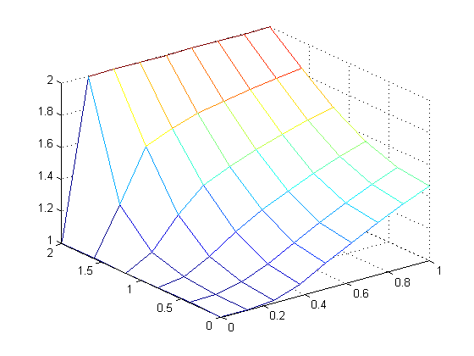
Examples
Ultimately, we get the image:
[x3c, t3c, U3c] = crank_nicolson1d( 1.5, [0 2], 6, [0 1], 9, @u3c_init, @u3c_bndry );
mesh( t3c, x3c, U3c )

Slide 72
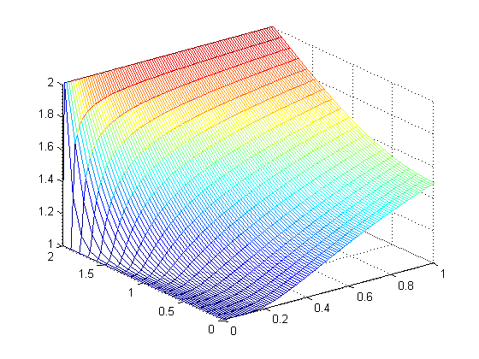
Examples
If we increase the resolution:
[x3d, t3d, U3d] = crank_nicolson1d( 1.5, [0 2], 20, [0 1], 100, @u3c_init, @u3c_bndry );
mesh( t3d, x3d, U3d )

Slide 73

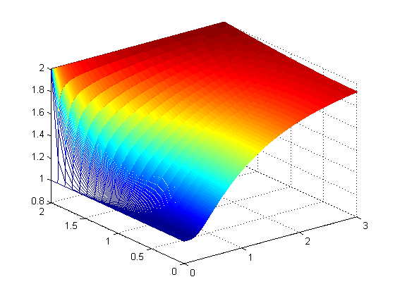
Examples
After three seconds, the temperature near the insulated boundary has increased significantly
[x3e, t3e, U3e] = crank_nicolson1d( 1.5, [0 2], 20, [0 3], 600, @u3c_init, @u3c_bndry );
mesh( t3e, x3e, U3e )
  frames = animate( U3e );
  frames2gif( frames, 'U3e.gif' );

Slide 74
Summary
We have looked at the heat-conduction/diffusion equation
  We developed the Crank-Nicolson method
  You will implement the algorithm
  Unlike the previous implementation, there are less
  restrictions on
    Large values of this ratio may cause transient oscillations
  We defined insulated boundaries
    Considered their approximation using Matlab

Slide 75
References
[1] Glyn James, Modern Engineering Mathematics, 4th Ed., Prentice Hall, 2007, p.782.
[2] Glyn James, Advanced Modern Engineering Mathematics, 4th Ed., Prentice Hall, 2011, p.164.

