Slide 1
Heat-conduction/Diffusion Equation
Douglas Wilhelm Harder, M.Math. LEL
Department of Electrical and Computer Engineering
University of Waterloo
Waterloo, Ontario, Canada
ece.uwaterloo.ca
dwharder@alumni.uwaterloo.ca
© 2012 by Douglas Wilhelm Harder. Some rights reserved.

Slide 2
Outline
This topic discusses numerical solutions to the heat-conduction/ diffusion equation:
  Background
  Discuss the physical problem and properties
  Examine the equation
  Approximate solutions using a finite-difference equation
    Consider numerical stability
    Examples

Slide 3
Outcomes Based Learning Objectives
By the end of this laboratory, you will:
  Understand the heat-conduction/diffusion equation
  Understand how to approximate partial differential equations using finite-difference equations
  Set up solutions in one spatial dimension

Slide 4
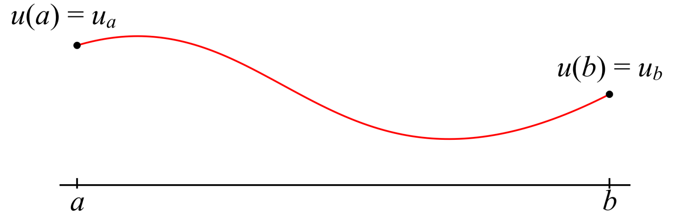
Background
In the last laboratory, we looked finding solutions to boundary-value problems where we were given:
  An ordinary-differential equation,
  An interval [a, b], and
  Two boundary conditions

Slide 5
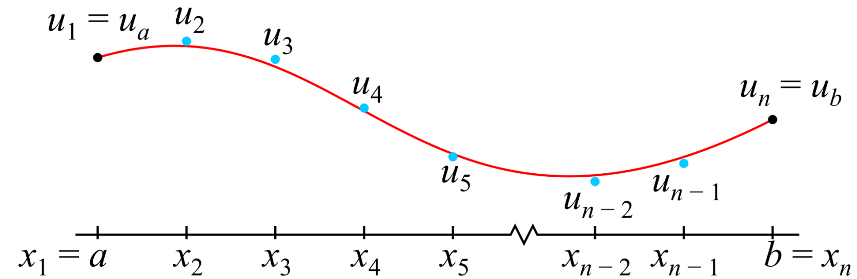
Background
To approximate the solution:
  We broke the interval interval [a, b] into n points x_{i}
  We approximated u_{i} ≈ u(x_{i})
  We used a finite-difference equation to create a system of linear equations in the unknowns u₂, u₃, ..., u_{n – 1}

Slide 6
The Heat-conduction/Diffusion Equation
The conduction of heat or diffusion of a material depends both on space and time
  We have a partial differential equation in both space and time
  In one dimension, this simplifies to
Here κ > 0 is the diffusivity coefficient

Slide 7

Motivating Examples
Suppose a metal bar is in contact with a body at 80 ºC
  If the bar is insulated, over time, the entire length of the bar will be at 80 ºC
5 ºC
80 ºC

Slide 8

Motivating Examples
At time t = 0, one end of the bar is brought in contact with a heat sink at 5 ºC
5 ºC
80 ºC

Slide 9

Motivating Examples
At the end closest to the heat sink, the bar will cool rapidly; however, the cooling is not uniform
5 ºC
80 ºC

Slide 10

Motivating Examples
Over time, however, the temperature will drop linearly from 80 ºC to 5 ºC across the bar
5 ºC
80 ºC
The description of this will be a function u(x, t)

Slide 11
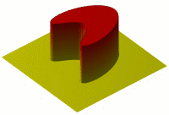
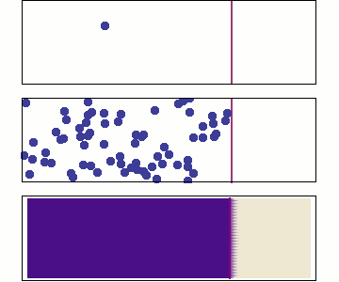
Motivating Examples
Other applications—often in higher dimensions—include:
  Heat equation
  Fick’s laws of diffusion
  Thermal diffusivity in polymers
Oleg Alexandrov
Steven Byrnes

Slide 12
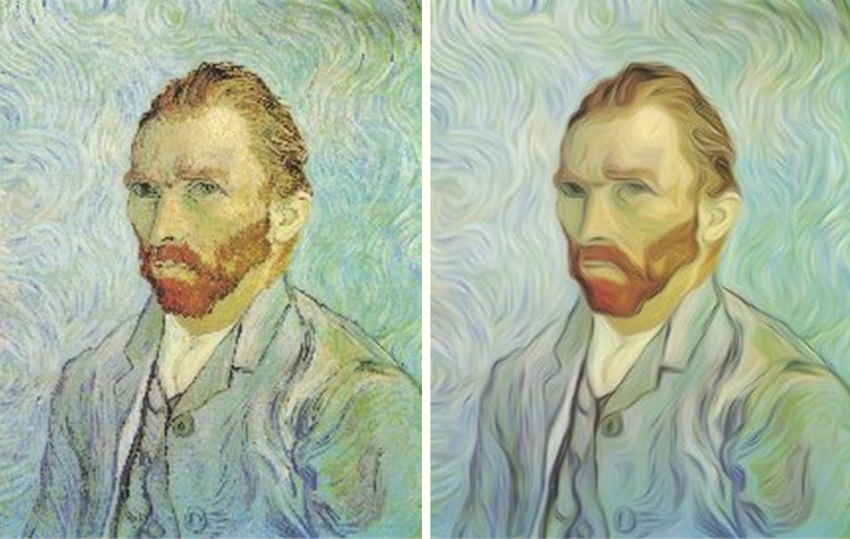
Motivating Examples
It can even be used in modeling human vision
  Diffusion is used for enhancing coherence in images
  Scale space
J. Weickert and ter Haar Romeny

Slide 13
Laplace’s Equation
Last week, we saw a related ordinary-differential equation:
This is the one-dimensional version of Laplace’s equation:

Slide 14
Laplace’s Equation
In Laboratory 1, we saw that the only solution to Laplace’s equation in one dimension with boundary values is a straight line

Slide 15
Laplace’s Equation
Now, suppose that u(x, t) satisfies Laplace’s equation with respect to x:
What does this say about heat-conduction or diffusion?
That is, the solution is in a steady state
  It does not change with respect to time

Slide 16
Rate of Change
Proportional to Concavity
Suppose, however, that our function u(x, t) does not satisfy Laplace’s equation…
In one dimension, what does the equation
mean?
  Recall we assumed that κ > 0

Slide 17
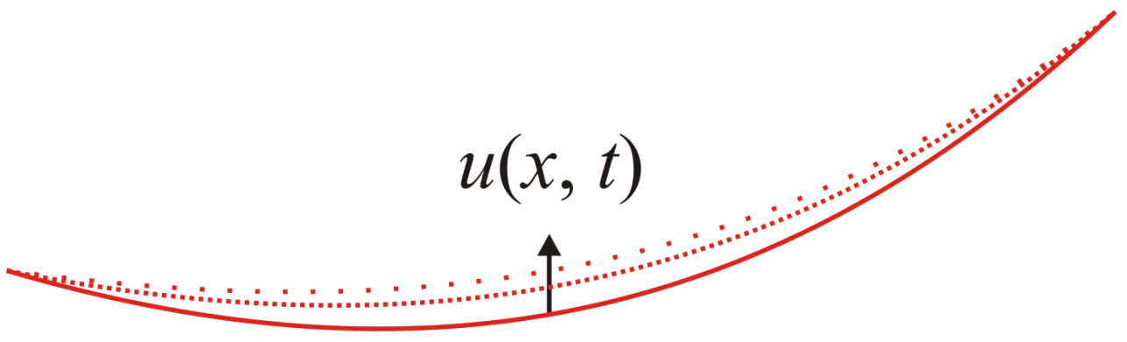
Rate of Change
Proportional to Concavity
Visually:
  Where u is concave up, the rate of change over time will be positive

Slide 18
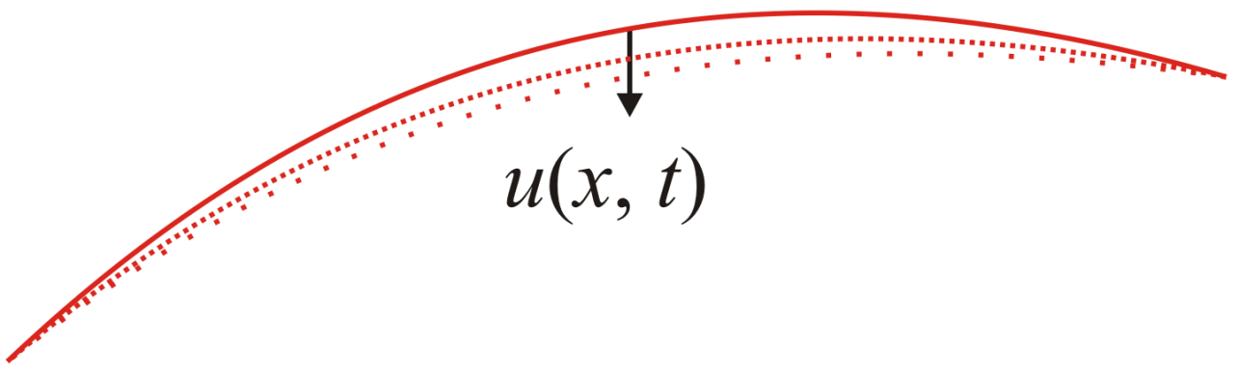
Rate of Change
Proportional to Concavity
Visually:
  Where u is concave down, the rate of change over time is negative

Slide 19
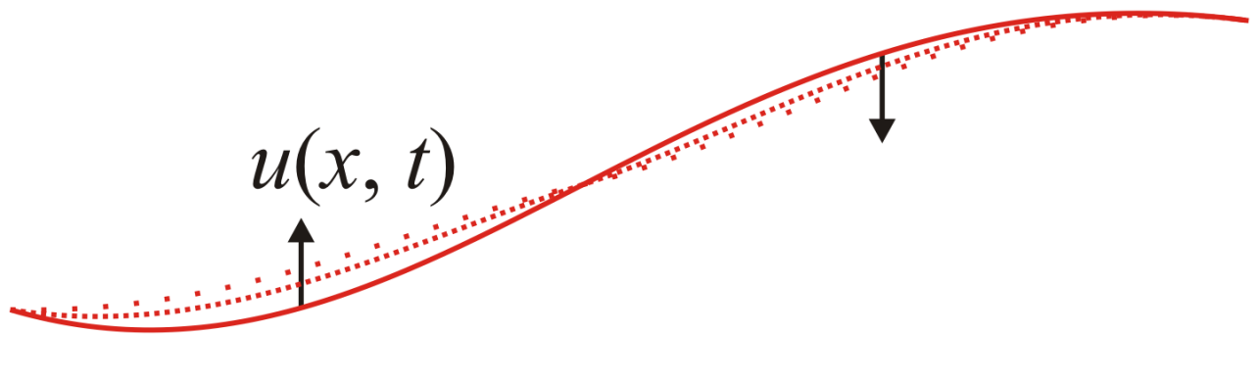
Rate of Change
Proportional to Concavity
Visually:
  Of course, a function may be concave up and down in different regions
Ultimately, the concavity tends to disappear—that is, as time goes to infinity, u(x, t) becomes a straight line…

Slide 20

Examples
Consider heat conduction problem:
  A bar initially at 5 ºC with one end touching a heat sink also at 5 ºC
  At time t = 0, the other end is placed in contact with a heat source at 80 ºC

Slide 21

Examples
As time passes, the bar warms up

Slide 22
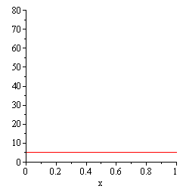
Examples
A plot of the temperature over time across the bar is given by this solution:
  The end placed in contact with the 80 ºC heats up faster than points closer to the heat sink
  As the concavity becomes smaller, the rate of change also gets smaller

Slide 23

Examples
Consider another example:
  A bar initially at 100 ºC is placed at time t = 0 in contact with a heat source of 80 ºC at one end and a heat sink at 5 ºC

Slide 24
Examples
The ultimate temperature will be no different:
  A uniform change from 80 ºC down to 5 ºC

Slide 25
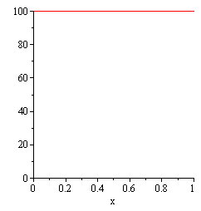
Examples
A plot of the temperature over time across the bar is given by this solution:
  Both ends drop from 100 ºC however, the centre cools slower than does the bar at either end point

Slide 26
Rate of Change
Proportional to Concavity
Ultimately, the concavity tends to disappear—that is, as
t → ∞, u(x, t) becomes a straight line…
Important note:
  This statement is only true in one spacial dimension
  In higher spacial dimensions, u(x, t) will approach a solution to Laplace’s equation in the given region, but it won’t be so simple

Slide 27
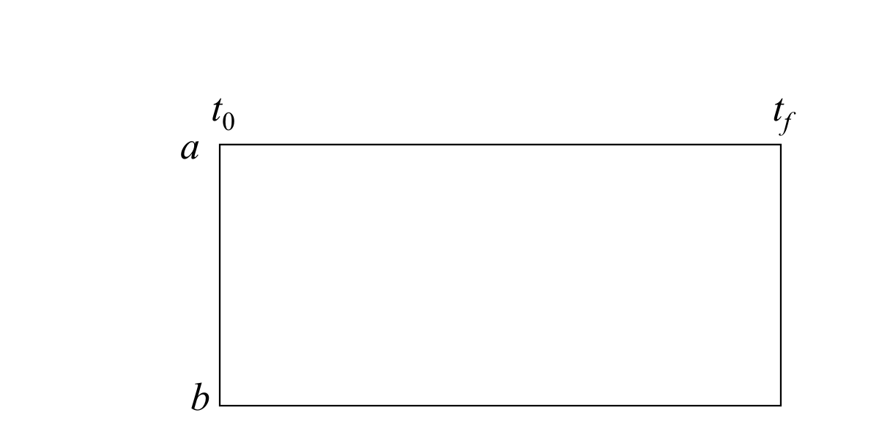
The Problem
For any such problem, we know the initial state:
we would like to find a function u(x, t) that satisfies the partial differential equation up to some point t_{final}
t_{final}

Slide 28
The Problem
To do this, we must also know the boundary values:
t_{final}

Slide 29
Approximating the Solution
As with the BVP, we will divide the space interval into discrete points
We are interested, however, also in how u(x, t) changes over time
  Just like the IVPs, we will divide time into discrete steps

Slide 30
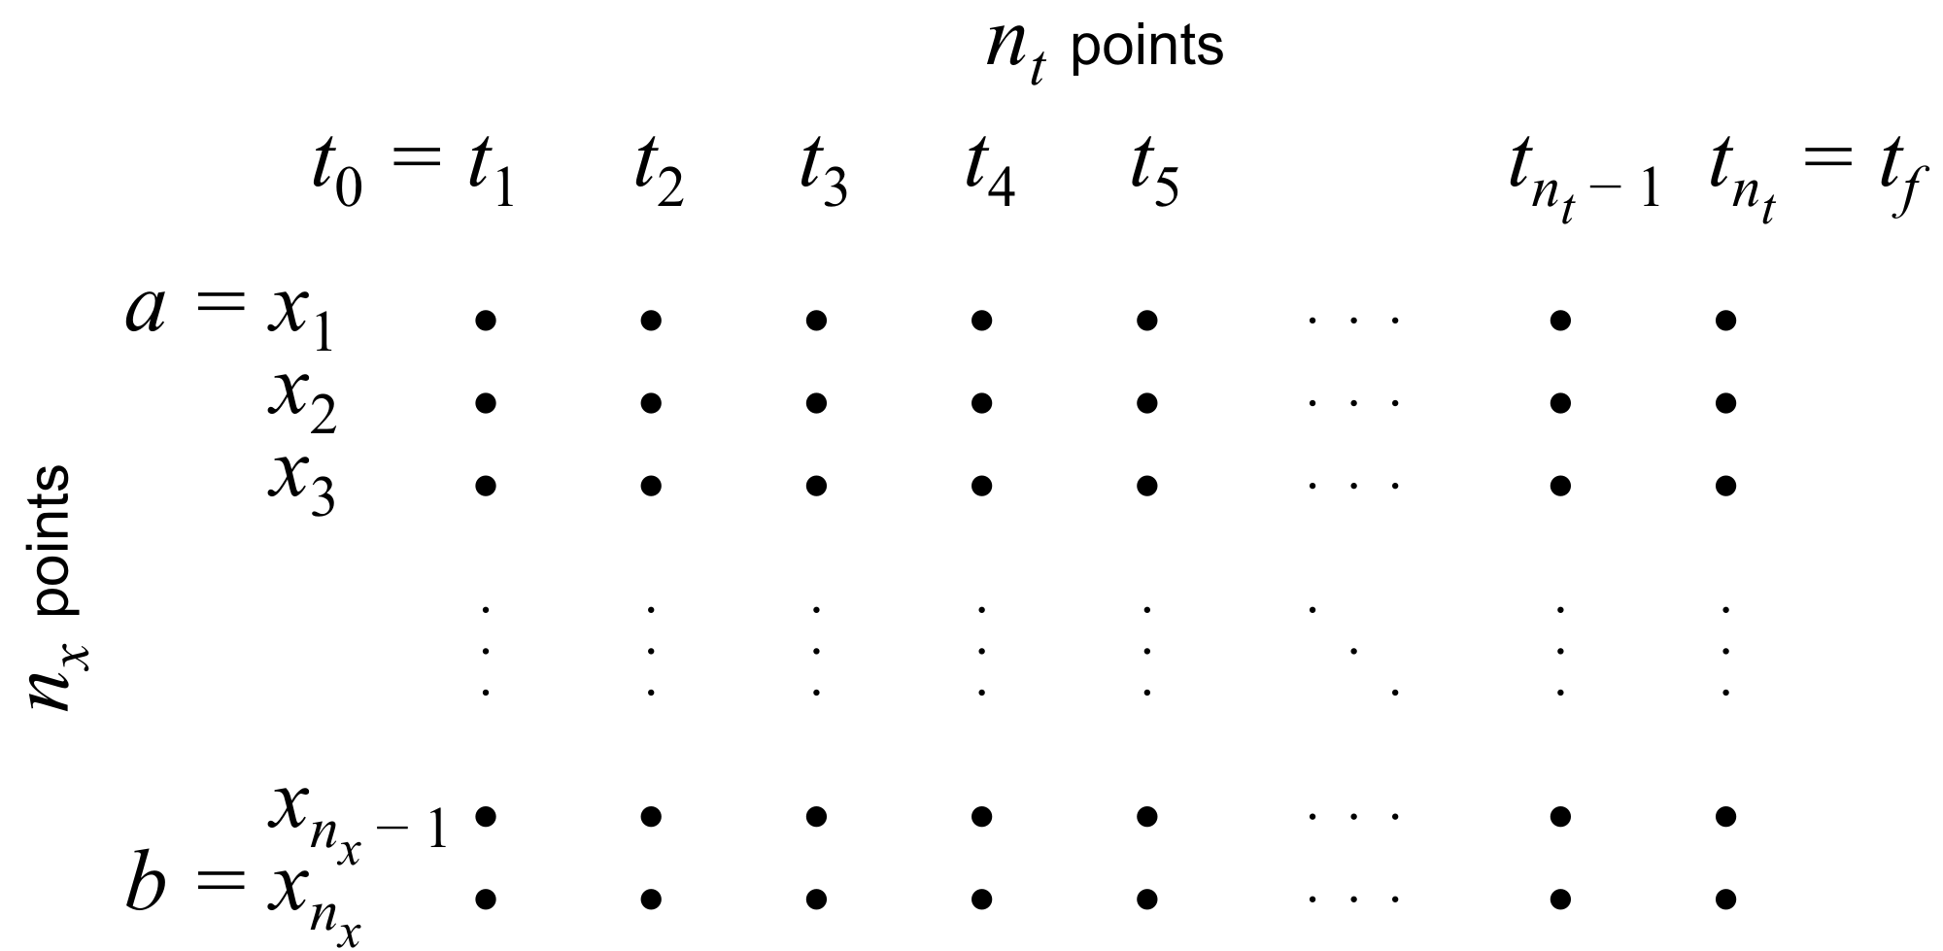
Approximating the Solution
This creates an n_{x} × n_{t} grid
  We will approximate u(x_{i}, t_{k}) ≈ u_{i,k}
t_{final}

Slide 31
Approximating Partial Derivatives
Questions:
  How do we approximate partial derivatives?
  What are the required conditions?

Slide 32
Approximating Partial Derivatives
Recall our approximations of the derivatives:
In this case, however, we are dealing with partial derivatives

Slide 33
Approximating Partial Derivatives
If you recall the definition of the partial derivative, we focus on one variable and leave the other variables constant
To ensure clarity:
  h is used to indicate small steps in space
  Δt is used to indicate a small step in time

Slide 34
Approximating Partial Derivatives
The obvious extension is to define
or
Forward divided-
difference formulas
Centred divided-
difference formulas

Slide 35
Approximating Partial Derivatives
Recall, however, that we will be approximating the solution on a grid u(x_{i}, t_{k}) ≈ u_{i,k} where
Thus, our formulas turn out to be
Recall that x_{i} ± h = x_{i ±1} and t_{k} ± Δt = t_{k ± 1}

Slide 36
Approximating Partial Derivatives
Thus, our approximations are:
Similarly,

Slide 37
Approximating Partial Derivatives
Problem:
  We are only given the state at a single initial time t₀
  Thus, we cannot use three unknowns in time:
  u_{i,k – 1} u_{i,k} u_{i,k + 1}
  Thus, we will use the formula

Slide 38
Approximating Partial Derivatives
If we substitute the second into the heat-conduction/ diffusion equation, we have
Solving for the event in the future, u_{i, k + 1}:

Slide 39
Similarity with IVPs
If this looks familiar to you, it should:
Recall Euler’s method: if y⁽¹⁾(t) = f (t, y(t)) and y(t₀) = y₀, it follows that
The slope at (t_{k}, y_{k})

Slide 40
Approximating the
Second Partial Derivative
The next step is to approximate the concavity
We will use our 2nd-order formula:
to get
What if this value is very large? E.g., h is small

Slide 41
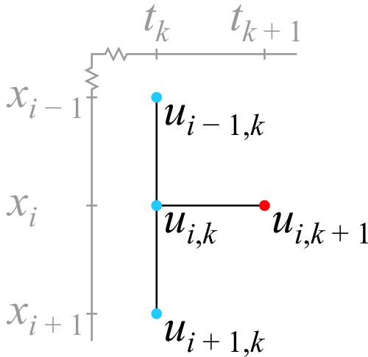
Approximating the
Second Partial Derivative
This is our finite-difference equation approximating our partial-differential equation:
Graphically, we see
that u_{i,k + 1} depends on
three previous values:

Slide 42
Initial and Boundary Conditions
For a 1st-order ODE, we require a single initial condition

Slide 43
Initial and Boundary Conditions
For a 2nd-order ODE, we require either two initial conditions
or a boundary condition:
Time variables are usually
associated with initial conditions
Space variables are usually
associated with boundary conditions

Slide 44
Initial and Boundary Conditions
For the heat-conduction/diffusion equation,
we have:
  A first-order partial derivative with respect to time
  A second-order partial derivative with respect to space

Slide 45
Initial and Boundary Conditions
For the heat-conduction/diffusion equation,
we require:
  For each space coordinate, we require an I.C. for the time
  For each time coordinate, we require a B.C. for the space

Slide 46
Initial and Boundary Conditions
In this case, we will require an initial value for each space coordinate
  Keeping in the spirit of one dimension:
    If we were monitoring the progress of the temperature of a bar, we would know the initial temperature at each point of the bar at
    time t = t₀
    If we were monitoring the diffusion of a gas , we would have to know the initial concentration of the gas

Slide 47
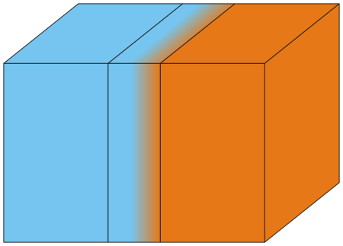
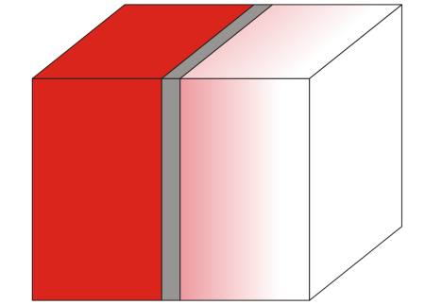
Initial and Boundary Conditions
Is a one-dimensional system restricted to bars and thin tubes?
  Insulated wires, impermeable tubes, etc.
May systems have symmetries that allow us to simplify the model of the system
  Consider the effect of a thin insulator between two
  materials that have approximately uniform
  temperature
  Consider the diffusion of particles across a
  membrane separating liquids with different
  concentrations

Slide 48
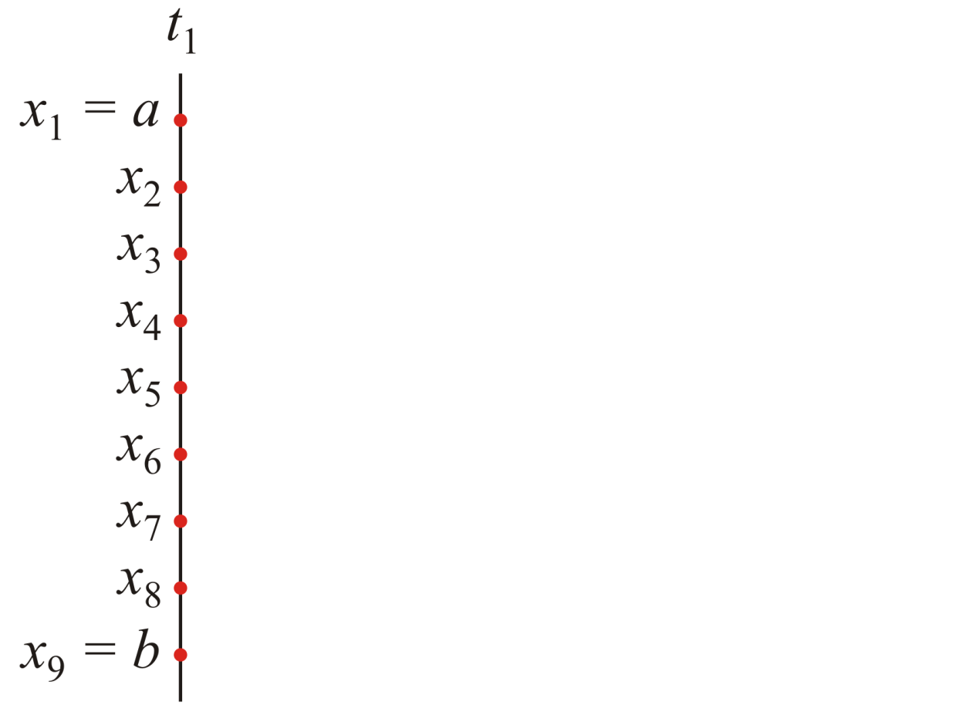
Approximating the Solution
Just as we did with BVPs, we will divide the spacial interval [a, b] into n_{x} points or n_{x} – 1 sub-intervals

Slide 49
Approximating the Solution
Just as we did with BVPs, we will divide the spacial interval [a, b] into n_{x} points or n_{x} – 1 sub-intervals
  The initial state at time t₀ would be defined by a function u_{init}(x) where
  u_{init}:[a, b] → R

Slide 50
Approximating the Solution
As with Euler’s method and other IVP solvers, we divide the time interval [t₀, t_{final}] into n_{t} points or n_{t} – 1 sub-intervals
  Thus, our t-values will be t = (t₁, t₂, t₃, ..., t_{n} )
_{t}

Slide 51
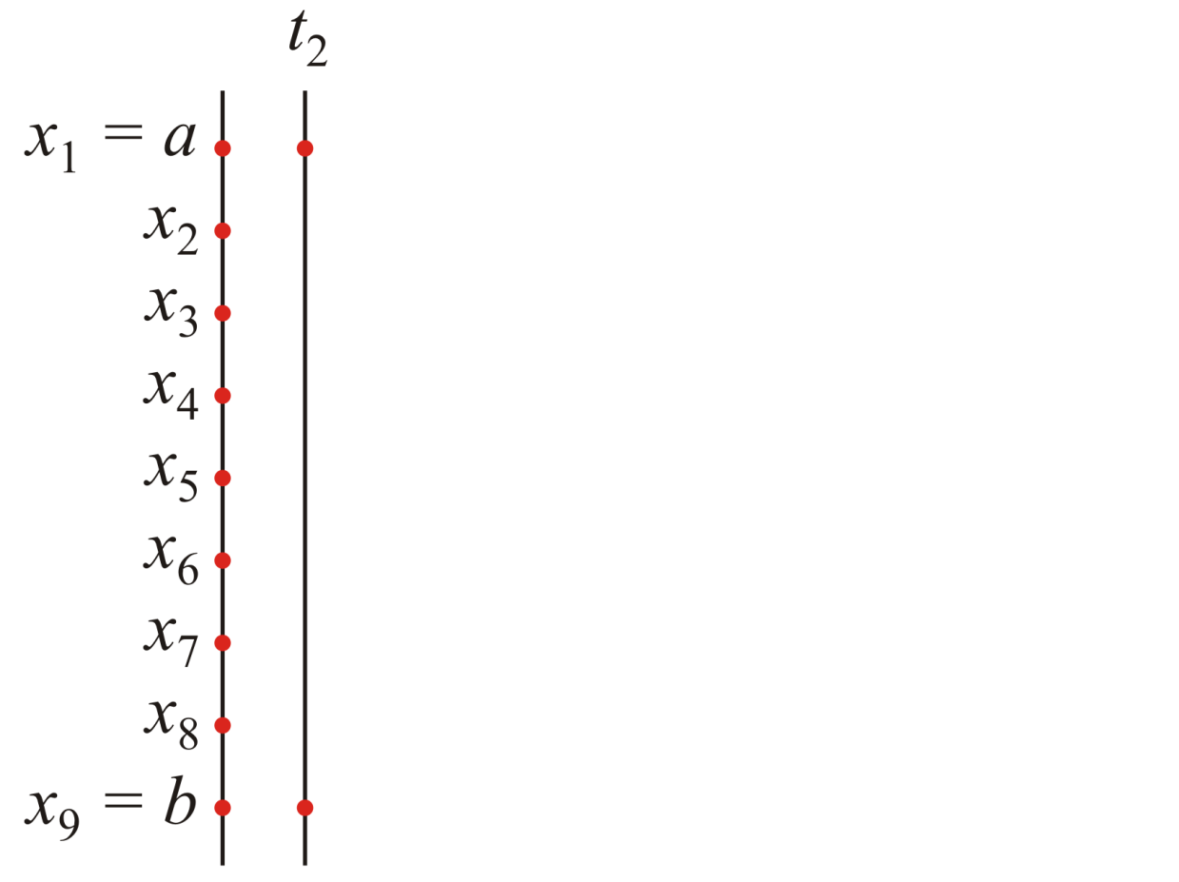
Approximating the Solution
As with Euler’s method, we will attempt to approximate the solution u(x, t) at discrete times in the future
  Given the state at time t₁, approximate the solution at time t₂

Slide 52
Approximating the Solution
Never-the-less, we must still determine the 2nd-order
component
  This requires two boundary values at a and b

Slide 53
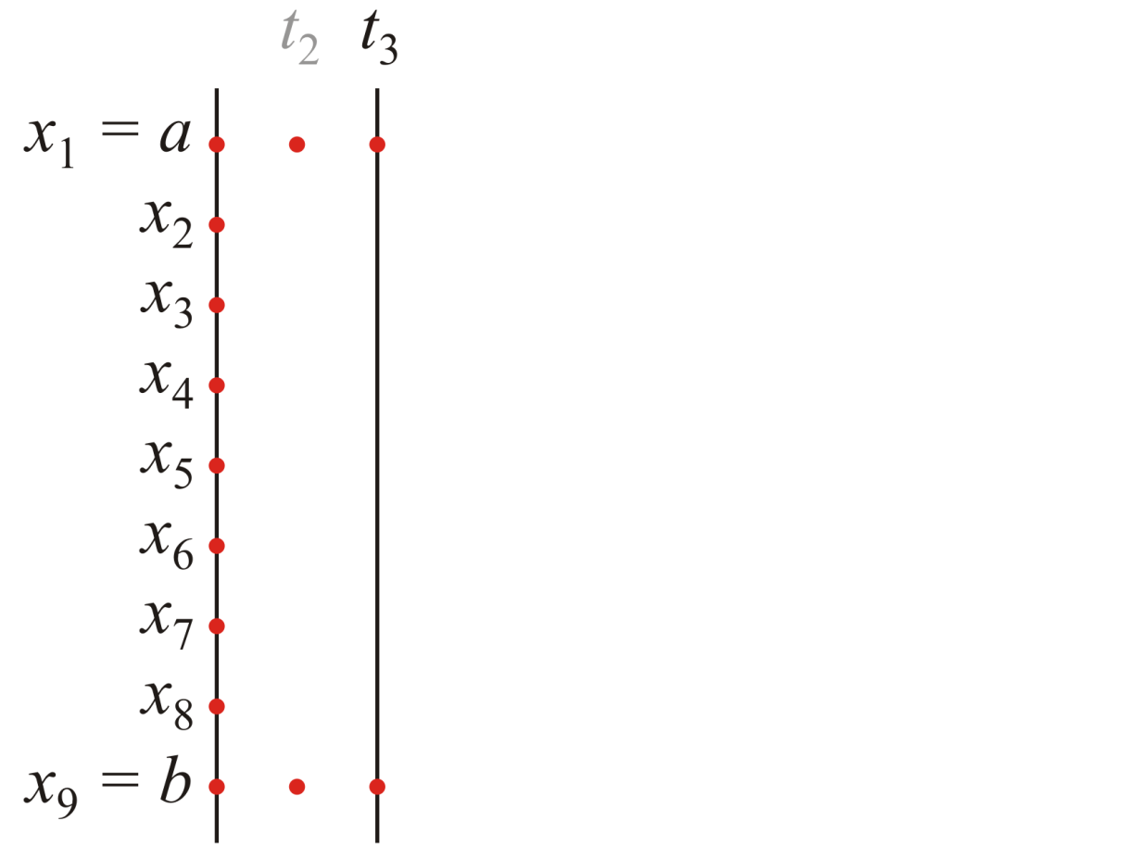
Approximating the Solution
Indeed, at each subsequent point, we will require the boundary values
  Over time, the boundary values could change

Slide 54
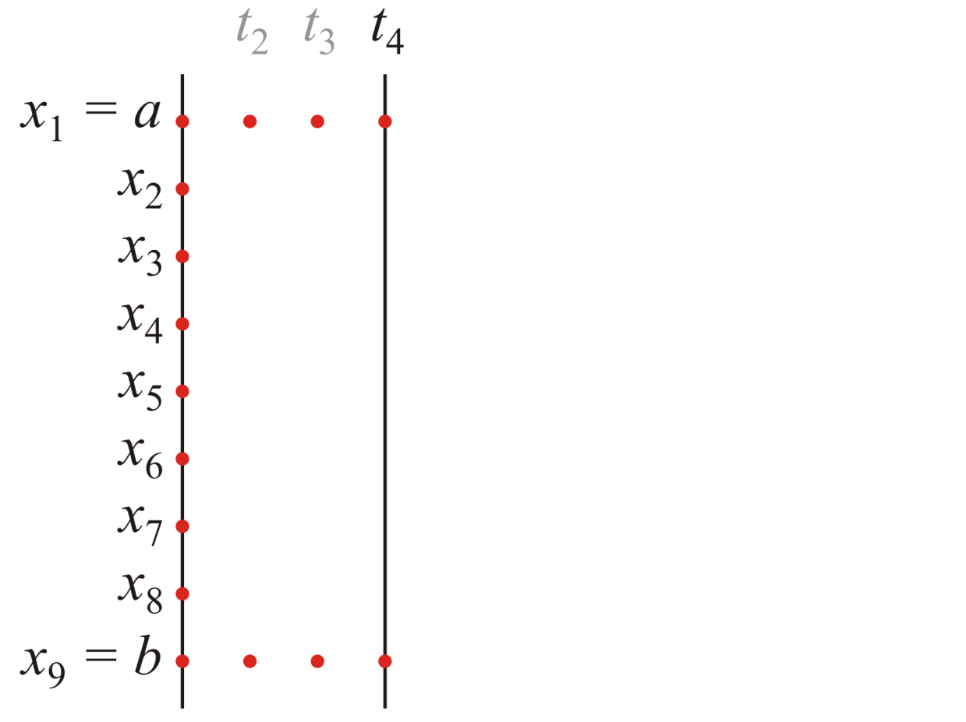
Approximating the Solution
Therefore, we will need two functions a_{bndry}(t) and b_{bndry} (t)
  At each step, we would evaluate and determine two the boundary conditions

Slide 55
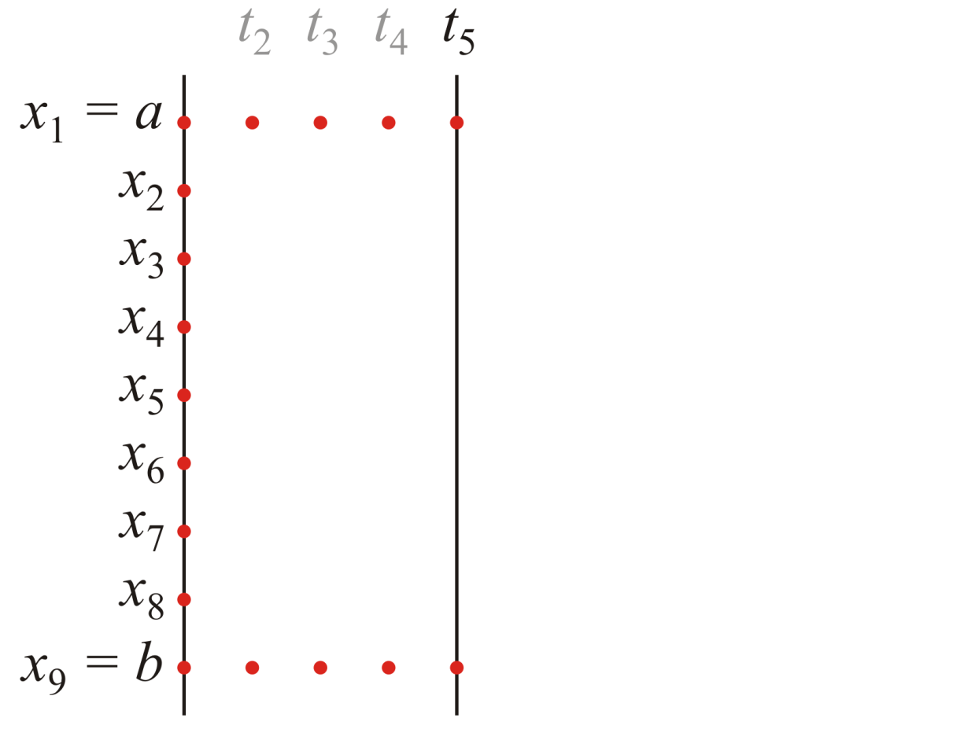
Approximating the Solution
Therefore, we will need two functions a_{bndry}(t) and b_{bndry} (t)
  We would continue from our initial time t₀ and continue to a final time t_{final}

Slide 56
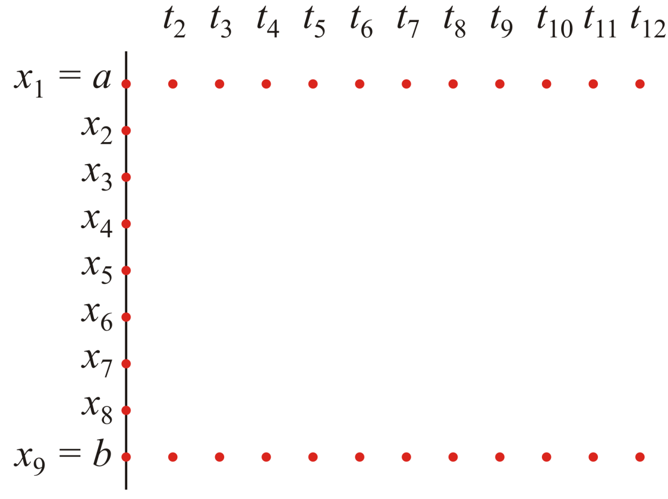
Approximating the Solution
Therefore, we will need two functions a_{bndry}(t) and b_{bndry} (t)
  We would continue from our initial time t₀ and continue to a final time t_{f}

Slide 57
Approximating the Solution
Now that we have functions that define both the initial conditions and the boundary conditions, we must solve how the heat conducts or the material diffuses

Slide 58
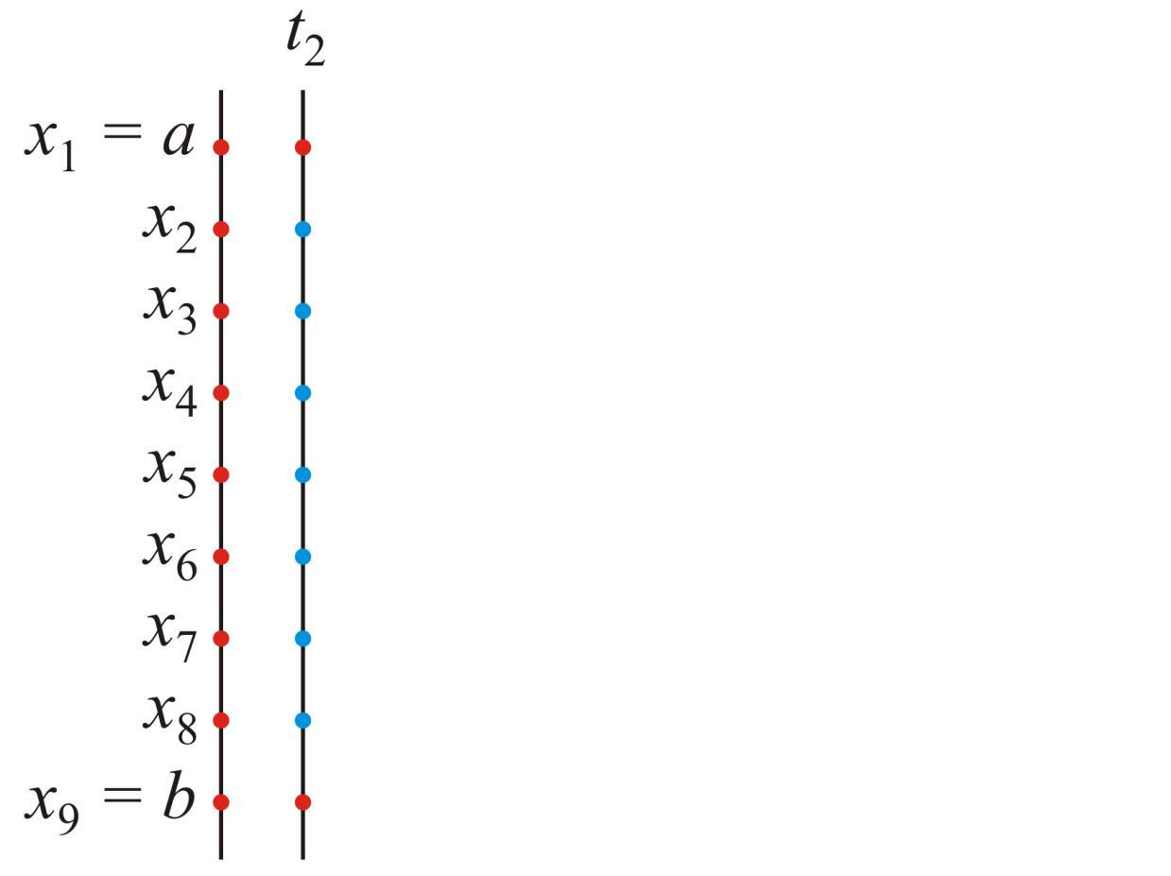
Approximating the Solution
  Given the state at time t₁, we approximate the state at time t₂

Slide 59
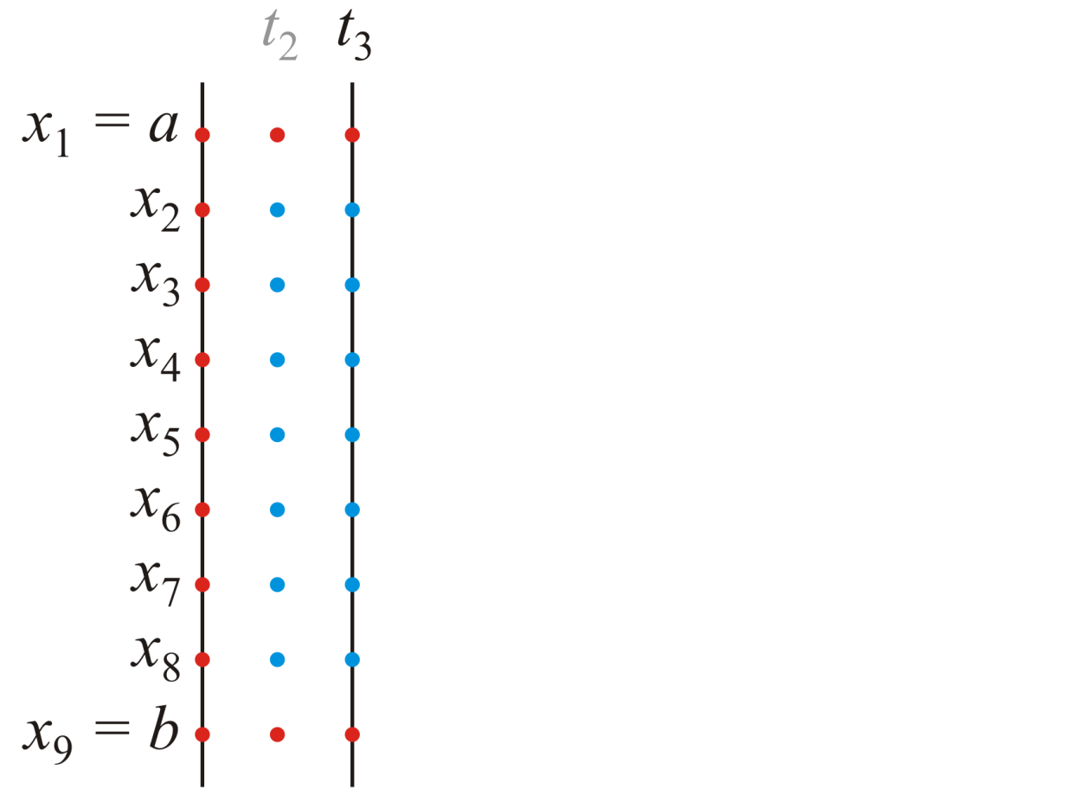
Approximating the Solution
  Given the state at time t₂, we approximate the state at time t₃

Slide 60
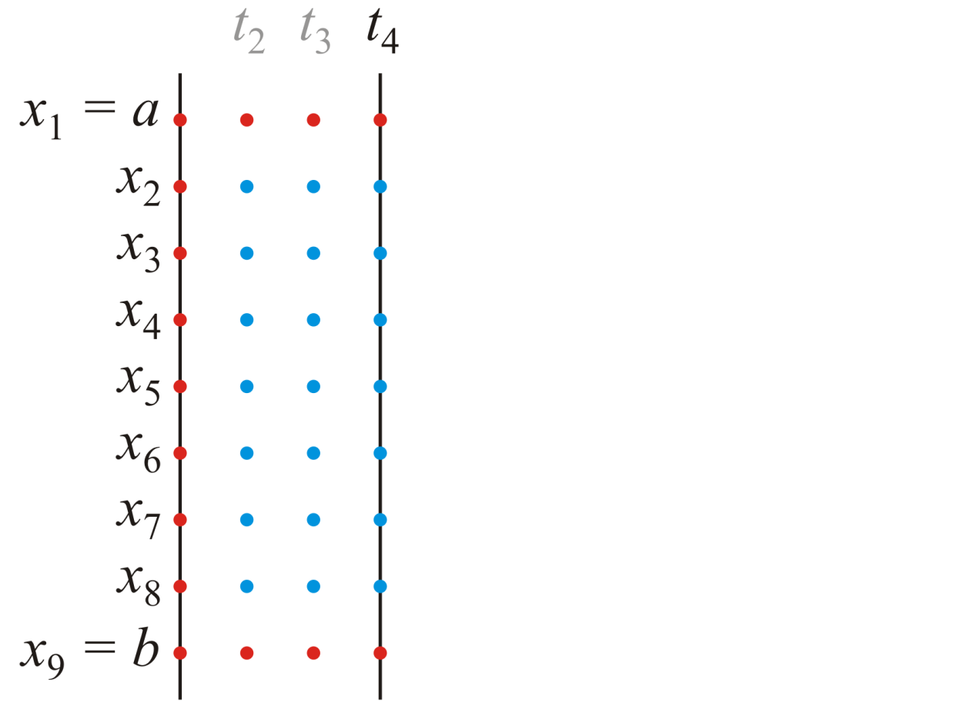
Approximating the Solution
  Given the state at time t₃, we approximate the state at time t₄

Slide 61
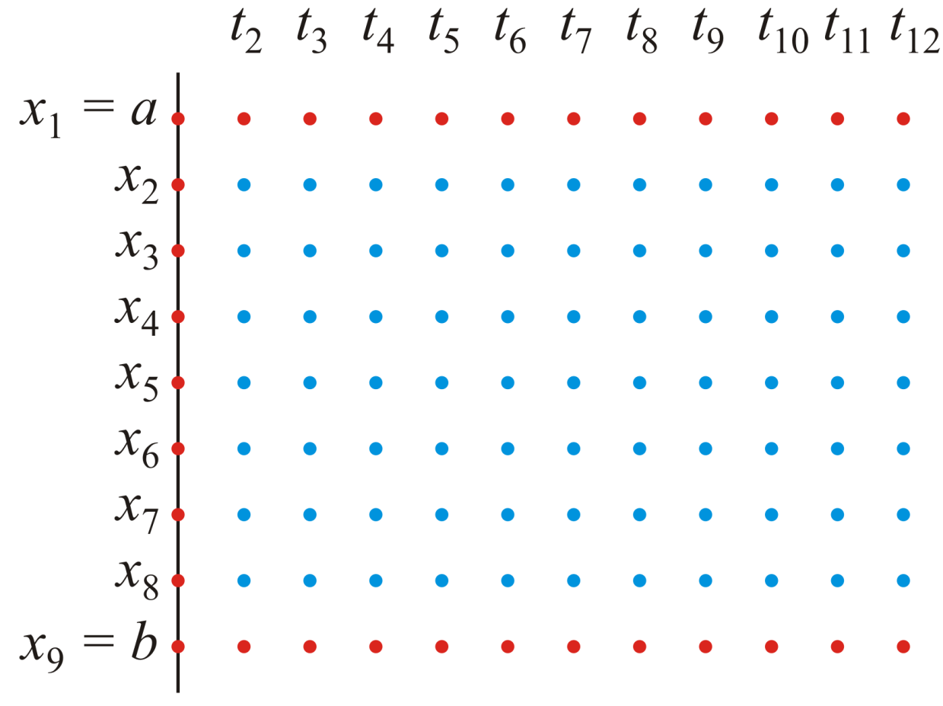
Approximating the Solution
We continue this process until we have approximated the solution at each of the desired times

Slide 62
Approximating the Solution
This last image suggests strongly that our solution will be a matrix
  Given the heat-conduction/diffusion equation
  we will approximate the solution u(x, t) where
  a < x < b and t₀ < t ≤ t_{final}
  by finding an n_{x} × n_{t} matrix U where U(i, k) (that is, u_{i, k}) will approximate the solution at time (x_{i}, t_{k}) with
x_{i} = a + (i – 1)h
t_{k} = t₀ + (k – 1)Δt

Slide 63
The diffusion1d Function
The signature will be
  function [x_out, t_out, U_out] = ...
  diffusion1d( kappa, x_rng, nx, t_rng, nt, u_init, u_bndry )
where
kappa the diffusivity coefficient
x_rng the space range [a, b]
nx the number of points into which we will divide [a, b]
t_rng the time interval [t₀, t_{final}]
nt the number of points into which we will divide [t₀, t_{final}]
u_init a function handle giving the initial state u_{init}:[a, b] → R
u_bndry a function handle giving the two boundary conditions
u_{bndry}:[t₀, t_{final}] → R² where

Slide 64
Step 1: Error Checking
As with the previous laboratories, you will have to validate the types and the values of the arguments
Recall, however, that we also asked:
  What happens if
  is too large?
  A large coefficient could magnify any error in our approximation:

Slide 65
Step 1: Error Checking
To analyze this, consider the total sum:
  The two approximations of the slope have an O(h) error
  To eliminate the contribution from both these errors, we will therefore require that

Slide 66
Step 1: Error Checking
Once the parameters are validated, the next step is to ensure
If this condition is not met, we should exit and provide a useful error message to the user:
  For example,
  The ratio kappa*dt/h^2 = ??? >= 0.5, consider using n_t = ???
  where
    The first ??? is replaced by the calculated ratio, and
    The second ??? is found by calculating the smallest integer for n_{t} that would be acceptable to bring this ratio under 0.5
  You may wish to read up on the floor and ceil commands

Slide 67
Step 1: Error Checking
Essentially, given κ, t₀, t_{final} and h, find an appropriate value (that is, the smallest integer value) of n_{t}* to ensure that
  Hint: solve for n_{t}* and choose the next largest integer...
  You may wish to review the floor and ceil commands

Slide 68
Step 2: Initialization
In order to calculate both the initial and boundary values, we will require two vectors:
  A column vector of x values, and
  A row vector of t values
Both of these can be constructed using linspace
  Both of these will be returned to the user
We will begin by creating the n_{x} × n_{t} matrix
  The zeros command is as good as any

Slide 69
Step 2: Initialization
Next, we assign the initial values to the first column
n_{x}

Slide 70
Step 2: Initialization
Next, assign the boundary values in the first and last rows
n_{t}
n_{x}
n_{t} – 1

Slide 71
Step 3: Solving
We still have to calculate the interior values
n_{t}
n_{x}

Slide 72
Step 3: Solving
For this, we go back to our formula:

Slide 73
Step 3: Solving
Using this formula
we can first calculate u_{2,2} through u_{n – 1,2}
x

Slide 74
Step 3: Solving
Using this formula
and then u_{2, 3} through u_{n – 1, 3} and so on
x

Slide 75
Useful Matlab Commands
Recall that you can both access and assign to sub-matrices of a given matrix:
    >> U = [1 2 3 4 5; 6 7 8 9 10; 11 12 13 14 15; 16 17 18 19 20]
    U =
    1 2 3 4 5
    6 7 8 9 10
    11 12 13 14 15
    16 17 18 19 20
    >> U(:,1) = [0 0 0 0]';
    >> U(1,2:end) = [42 42 42 42];
    >> U(2:end - 1,3) = [91 91]'
    U =
    0 42 42 42 42
    0 7 91 9 10
    0 12 91 14 15
    0 17 18 19 20

Slide 76
Useful Matlab Commands
Matlab actually gives you a lot of power when it comes to assigning entries by row or by column:
    >> U = [1 2 3 4 5; 6 7 8 9 10; 11 12 13 14 15; 16 17 18 19 20]
    U =
    1 2 3 4 5
    6 7 8 9 10
    11 12 13 14 15
    16 17 18 19 20
    >> U([1, 3], 2:end) = [42 42 42 42; 91 91 91 91]
    U =
    1 42 42 42 42
    6 7 8 9 10
    11 91 91 91 91
    16 17 18 19 20

Slide 77
Useful Matlab Commands
The throw command in Matlab allows the user to format its message in a manner similar to the sprintf command in Matlab (and C)
  function [] = error_example( a, b )
  throw( MException( 'MATLAB:invalid_argument', ...
  'the argument %f (%d) and %f (%d) were passed', ...
  a, round(a), b, round(b) ) );
  end
When run, the output is:
    >> error_example( 3, pi )
    ??? Error using ==> ff at 2
    the argument 3.000000 (3) and 3.141593 (3) were passed

Slide 78
Useful Matlab Commands
You can, of course, modify this:
  function [] = error_example( a, b )
  throw( MException( 'MATLAB:invalid_argument', ...
  'the ratio of %d and %d is %f', a, b, a/b ) );
  end
When run, the output is:
    >> error_example( 3, 5 )
    ??? Error using ==> error_example at 2
    the ratio of 3 and 5 is 0.600000
See
    >> help sprintf

Slide 79
Useful Matlab Commands
A very useful command is the diff command:
    >> v = [1 3 6 7 5 4 2 0]
    v =
    1 3 6 7 5 4 2 0
    >> diff( v )
    ans =
    2 3 1 -2 -1 -2 -2
    >> v(2:end) - v(1:end - 1)
    ans =
    2 3 1 -2 -1 -2 -2
    >> diff( v, 2 )
    ans =
    1 -2 -3 1 -1 0
    >> v(3:end) - 2*v(2:end - 1) + v(1:end - 2)
    ans =
    1 -2 -3 1 -1 0

Slide 80
Useful Matlab Commands
Why use diff instead of a for loop?
  We could simply use two nested for loops:
    >> for k = 2:nt
    for ix = 2:(nx - 1)
    % calculate U(i, k)
    end
    end
  however, it would be better to use:
    >> for k = 2:nt
    % calculate U(2:(nx – 1), k) using diff
    end
In Matlab
  Most commands call compiled C code
  For loops and while loops are interpreted

Slide 81
Useful Matlab Commands
How slow is interpreted code?
  This function implements matrix-matrix-multiplication
    function [M_out] = multiplication( M1, M2 )
    [m, n1] = size( M1 );
    [n2, p] = size( M2 );
    if n1 ~= n; error( 'dimensions must agree' ); end;
    M_out = zeros( m, p );
    for i=1:m
    for j=1:n1
    for k = 1:p
    M_out(i, k) = M12(i, k) + M1(i, j)*M2(j, k);
    end
    end
    end
    end

Slide 82
Useful Matlab Commands
Now, consider:
    >> M = rand( 1300, 1000 );
    >> N = rand( 1000, 1007 );
    >> tic; M*N; toc
    Elapsed time is 0.196247 seconds.
    >> tic; multiplication( M, N ); toc
    Elapsed time is 35.530549 seconds.
    >> 35.530549/0.196247
    ans =
    181.0502
  What’s two orders of magnitude between you and your employer?

Slide 83
Useful Matlab Commands
Also, what is faster? Using diff or calculating it explicitly?
    >> v = rand( 1, 1000000 );
    >> tic; diff( v, 2 ); toc
    Elapsed time is 0.009948 seconds.
    >> tic; v(3:end) - 2*v(2:end - 1) + v(1:end - 2); toc
    Elapsed time is 0.039661 seconds.
At this point, it’s only a factor of four...

Slide 84
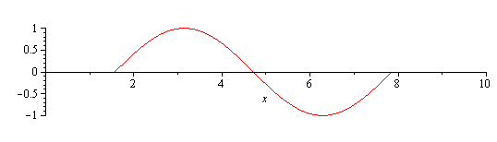
Useful Matlab Commands
Suppose we want to implement a function which is only turned on for, say, one period
In Matlab, you could use the following:
    function [y] = f( x )
    y = -cos(x) .* ((x >= 0.5*pi) & (x <= 2.5*pi ));
    end

Slide 85
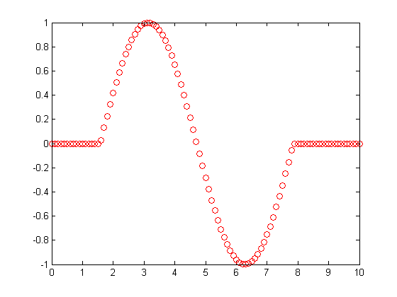
Useful Matlab Commands
The output of
    >> x = linspace( 0, 10, 101 );
    >> plot( x, f( x ), 'ro' )
In order to understand the output, consider
    >> x = linspace( 0, 10, 11 );
    >> x >= 0.5*pi
    ans =
    0 0 1 1 1 1 1 1 1 1 1
    >> x <= 2.5*pi
    ans =
    1 1 1 1 1 1 1 1 0 0 0
    >> (x >= 0.5*pi) & (x <= 2.5*pi)
    ans =
    0 0 1 1 1 1 1 1 0 0 0

Slide 86
Useful Matlab Commands
Functions may be defined in one of two ways
    Functions, and
    Anonymous functions
Create a new file with File→New→Function:
    function [u] = u2a_init( x )
    u = (x >= 0.5).*(1 + 0*x);
    end
Saving this function to a file u2a_init.m:
    >> x = linspace( 0, 1, 11 )
    x =
    0 0.1 0.2 0.3 0.4 0.5 0.6 0.7 0.8 0.9 1.0
    >> u2a_init ( x )
    ans =
    0 0 0 0 0 1 1 1 1 1 1
    >> isa( @u2a_init, 'function_handle' );
    ans =
    1

Slide 87
Useful Matlab Commands
Functions may be defined in one of two ways
    Functions, and
    Anonymous functions
Anonymous functions may be defined as follows:
    >> u2b_init = @(x)((x >= 0.5).*(1 + 0*x))
    u2b_init =
    @(x)((x>=0.5).*(1+0*x))
>> x = linspace( 0, 1, 11 )
    x =
    0 0.1 0.2 0.3 0.4 0.5 0.6 0.7 0.8 0.9 1.0
    >> u2b_init ( x )
    ans =
    0 0 0 0 0 1 1 1 1 1 1
    >> isa( u2b_init, 'function_handle' );
    ans =
    1

Slide 88
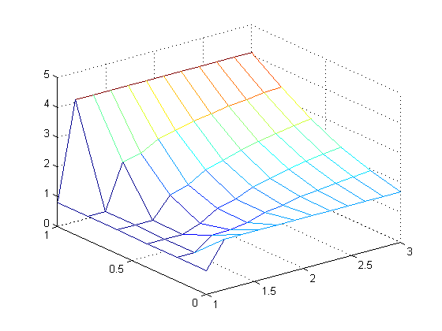
Example 1
As a first example:
  >> [x1, t1, U1] = diffusion1d( 0.1, [0,1], 6, [1, 3], 12, @u2a_init, @u2a_bndry );
  >> mesh( t1, x1, U1 )
  >> size(x1)
  ans =
  6 1
  >> size(t1)
  ans =
  1 12
  >> size(U1)
  ans =
  6 12
κ = 0.1
b_{bndry} (t) = 4.1
a_{bndry} (t) = 1.7
u_{init} (x) = 0.9
b = 1
t_{final} = 3
x
n_{x} = 6
a = 0
t
t₀ = 1
n_{t} = 12

Slide 89
Example 1
The boundary conditions are specified by functions:
  >> [x1, t1, U1] = diffusion1d( 0.1, [0,1], 6, [1, 3], 12, @u2a_init, @u2a_bndry );
function [u] = u2a_init ( x )
  u = x*0 + 0.9;
  end
  function [u] = u2a_bndry ( t )
  u = [t*0 + 1.7; t*0 + 4.1];
  end
κ = 0.1
b_{bndry} (t) = 4.1
a_{bndry} (t) = 1.7
u_{init} (x) = 0.9
b = 1
t_{final} = 3
x
n_{x} = 6
a = 0
t
t₀ = 1
n_{t} = 12

Slide 90
Example 1
The boundary conditions are specified by functions:
  >> [x1, t1, U1] = diffusion1d( 0.1, [0,1], 6, [1, 3], 12, @u2a_init, @u2a_bndry );
  >> x = linspace( 0, 1, 6 )';
  >> u2a_init ( x )
  ans =
  0.9
  0.9
  0.9
  0.9
  0.9
  0.9
  >> t = linspace( 1, 3, 12 );
  >> u2a_bndry( t(2:end) )
  ans =
  1.7 1.7 1.7 1.7 1.7 1.7 1.7 1.7 1.7 1.7 1.7
  4.1 4.1 4.1 4.1 4.1 4.1 4.1 4.1 4.1 4.1 4.1

Slide 91
Example 1
Because the large size of both h and Δt, there is still some numeric fluctuations
x
t

Slide 92
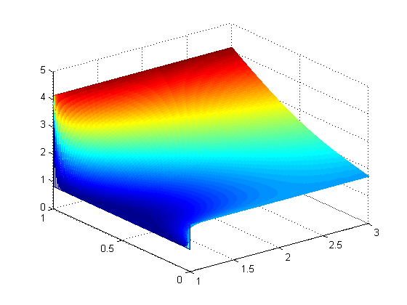
Example 2
Decreasing h and Δt produces a better result
  >> [x2, t2, U2] = diffusion1d( 0.1, [0,1], 100, [1, 3], 4000, @u2a_init, @u2a_bndry );
  >> size(x2)
  ans =
  100 1
  >> size(t2)
  ans =
  1 4000
  >> size(U2)
  ans =
  100 4000
  >> mesh( t2, x2, U2 )
x
h = 0.01
t
Δt = 0.0005

Slide 93
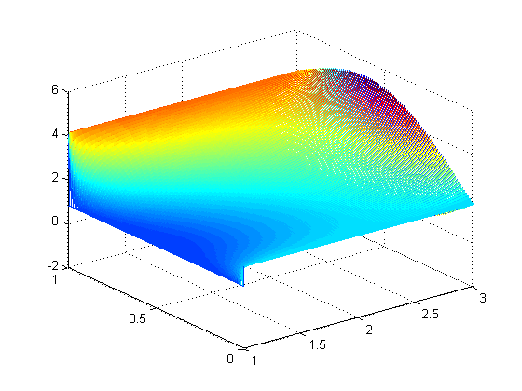
Example 3
Stable when n_{t} = 4000
If we exceed 0.5, the approximation begins to fail
  >> [x2, t2, U2] = diffusion1d( 0.1, [0,1], 100, [1, 3], 3916, @u2a_init, @u2a_bndry );
  >> mesh( t2, x2, U2 )
x
t

Slide 94
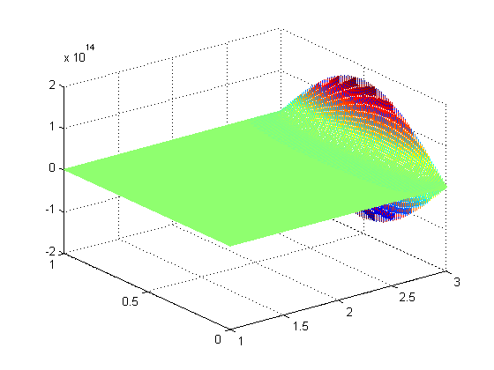
Example 4
Stable when n_{t} = 4000
As the ratio exceeds 0.5, it quickly breaks down:
  >> [x2, t2, U2] = diffusion1d( 0.1, [0,1], 100, [1, 3], 3900, @u2a_init, @u2a_bndry );
  >> mesh( t2, x2, U2 )
2 × 10¹⁴
x
t

Slide 95
Animations
Now, these images show us u(x, t), but what about visualizing how the temperature changes over time?
In the source directory of the laboratory, you will find:
  animate.m frames2gif.m isosurf.m rgb2gif8bit.m
  >> [x3, t3, U3] = diffusion1d( 0.1, [0,1], 20, [1, 3], 150, ...
  @u2a_init, @u2a_bndry );
  >> frames = animate( U3 ); % Animate the output file
  >> frames2gif( frames, 'U3.gif' ); % Save it as an animated gif

Slide 96
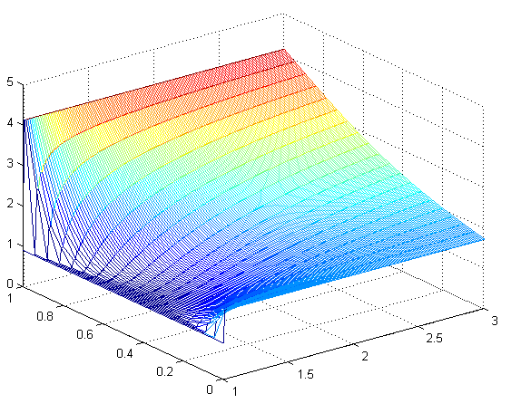
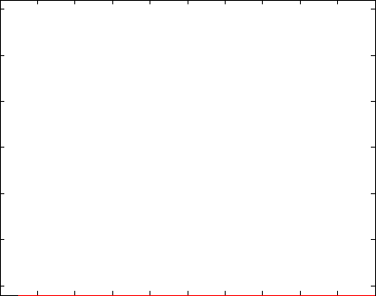
Animations
Now we can visualize the state as it changes over time:
mesh( t3, x3, U3 );
frames = animate( U3 );
frames2gif( frames, 'U3.gif' );

Slide 97
Summary
We have looked at the heat-conduction/diffusion equation
  Considered the physical problem
  Considered the effects in one dimension
  Found a finite-difference equation approximating the PDE
    Saw that
  Examples
  Animations

Slide 98
References
[1] Glyn James, Modern Engineering Mathematics, 4th Ed., Prentice Hall, 2007, p.778.
[2] Glyn James, Advanced Modern Engineering Mathematics, 4th Ed., Prentice Hall, 2011, p.164.

