Slide 1
Boundary-value Problems and
Finite-difference Equations
Douglas Wilhelm Harder, M.Math. LEL
Department of Electrical and Computer Engineering
University of Waterloo
Waterloo, Ontario, Canada
ece.uwaterloo.ca
dwharder@alumni.uwaterloo.ca
© 2012 by Douglas Wilhelm Harder. Some rights reserved.

Slide 2
Outline
This topic discusses numerical solutions to BVPs:
  Divided-difference approximations of the 1st and 2nd derivatives
  Boundary-value Problems (BVPs)
  Approximations of linear ordinary differential equations (ODEs) using finite-difference equations
  Numerical approximations to BVPs
    Examples
  Laplace’s equation

Slide 3
Outcomes Based Learning Objectives
By the end of this laboratory, you will:
  Understand the divided-difference approximation of the derivative and the second derivative
  Understand how to convert a linear 2nd-order ODE into a finite-difference equation
  Understand how to convert a BVP into a system of linear equations
  Consider Laplace’s equation in one dimension

Slide 4
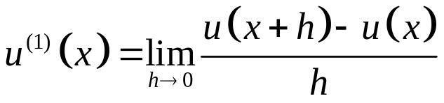
Approximating the Derivative
Suppose we want to approximate the derivative

Slide 5
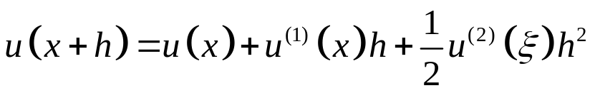

Approximating the Derivative
How good is this approximation?
  Recall Taylor’s approximation:
  where

Slide 6
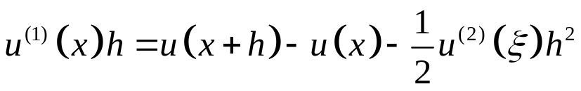

Approximating the Derivative
How good is this approximation?
  Rearrange the equation
  by isolating

Slide 7
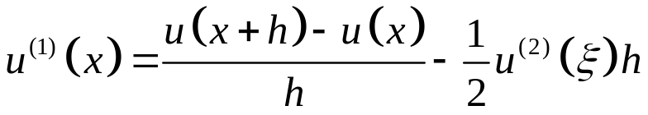
Approximating the Derivative
How good is this approximation?
  Divide each side by h and we find:
  where

Slide 8


Approximating the Derivative
What is the error?
  Recall that if a is an approximation of x with the error e, that is,
  we may subtract a and take the absolute value to find that

Slide 9
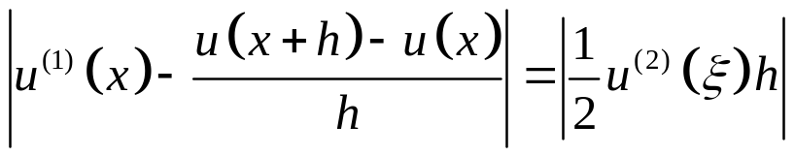
Approximating the Derivative
What is the error?
  Doing the same with this equation,
  we get

Slide 10

Approximating the Derivative
What is the error?
  Suppose that we know the function is not too wild, that is,
  for all values of
  This says that the 2nd derivative is bounded

Slide 11
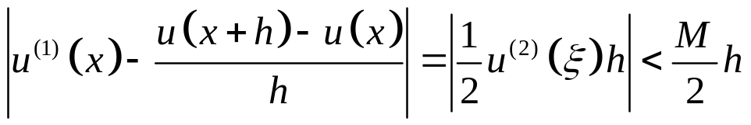
Approximating the Derivative
What is the error?
  Thus, we have the inequality:
  Recall that we can choose h to be arbitrarily small

Slide 12
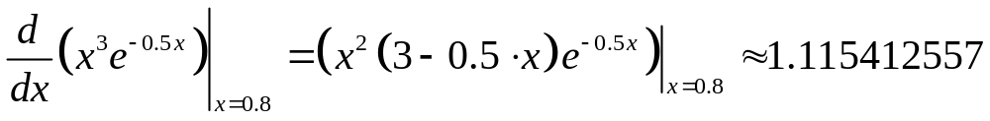
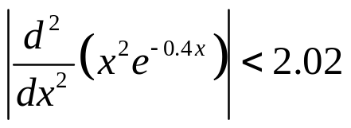
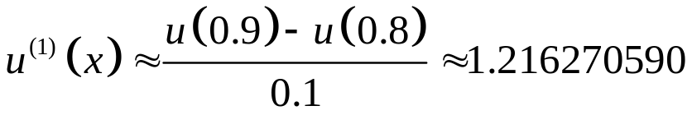
Approximating the Derivative
An example: consider approximating the derivative of u(x) = x³ e^{–0.5x} at the point x = 0.8
  We know that
  We also know that for x > 0,
  If h = 0.1, it follows that
Correct value rounded to 10 decimal digits
Our approximation

Slide 13
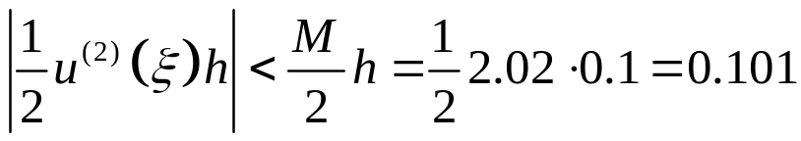
Approximating the Derivative
Therefore, our error is
The maximum error is given by

Slide 14
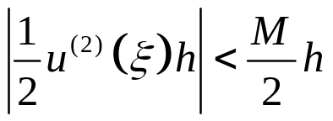
Approximating the Derivative
Now, take a look at the error term:
This says that if we halve h, the error should also drop by approximately half…
  Let’s try again with h = 0.05

Slide 15
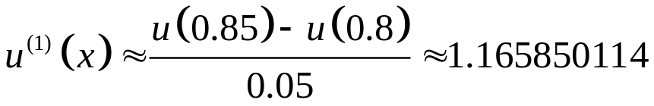
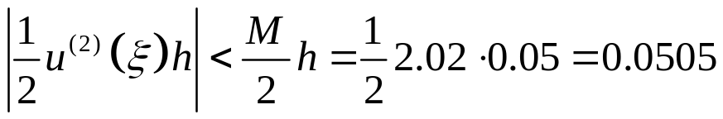
Approximating the Derivative
Again, consider approximating the derivative of
u(x) = x³ e^{–0.5x}
  If h = 0.05, it follows that
Therefore, our error is
The maximum error is given by
We halved h
The error was also approximately halved
With h = 0.1, the error was 0.100858033

Slide 16
Approximating the Derivative
Let’s try it on a real problem:
  Let’s write a Matlab function for u₁(x) = x³ e^{–0.5x} :
  function [y] = u1(x)
  y = x.^3 .* exp(-0.5*x);
  end

Slide 17
Approximating the Derivative
The correct answer u⁽¹⁾(0.8) = 1.115412556603304
    >> format long
    >> (u1(0.9) - u1(0.8))/0.1 % h = 0.1
    ans =
    1.216270589620254
    >> (u1(0.85) - u1(0.8))/0.05 % h = 0.05
    ans =
    1.165850114452400
    >> (u1(0.81) - u1(0.8))/0.01 % h = 1e-2
    ans =
    1.125495976919111
    >> (u1(0.800001) - u1(0.8))/0.000001 % h = 1e-6
    ans =
    1.115413564678480

Slide 18
Approximating the Derivative
The correct answer u⁽¹⁾(0.8) = 1.115412556603304
    >> (u1(0.800001) - u1(0.8))/0.000001 % h = 1e-6
    ans =
    1.115413564678480
    >> (u1(0.8000000001) - u1(0.8))/0.0000000001 % h = 1e-10
    ans =
    1.115412207042255
    >> (u1(0.80000000000001) - u1(0.8))/0.00000000000001
    % h = 1e-14
    ans =
    1.110223024625157
    >> (u1(0.800000000000000001) - u1(0.8))/0.000000000000000001
    % h = 1e-18
    ans =
    0

Slide 19
Subtractive Cancellation
The issue here is subtractive cancellation
  The correct answer:
    1.1154125566033037964387363874459825837
  To calculate the last value, we really need 120 bits of precision
u(0.800000000000000001)
0.343203863570247323096562214278990746278631970391519938385548190115958483131841
u(0.8)
0.343203863570247321981149657675686948831734233707935846343122089792457817661621
u(0.800000000000000001) – u(0.8)
0.000000000000000001115412556603303797446897736683584092042426100323500665470220
  The correct answer starts at the 18th place in the decimal

Slide 20
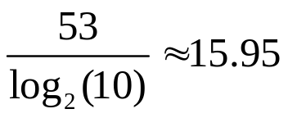
Subtractive Cancellation
Now, double uses 53 bits of precision:
Thus, 53 bits of precision is approximately equivalent to 16 decimal digits of precision
  Assume every calculation is restricted to 16 decimal digits of precision:
  0.8 + 0.000000000000000001 0.8
  u(0.800000000000000001) 0.3432038635702473
  u(0.8) 0.3432038635702473
  u(0.800000000000000001) – u(0.8) 0.0000000000000000
  The addition does not affect 0.8

Slide 21
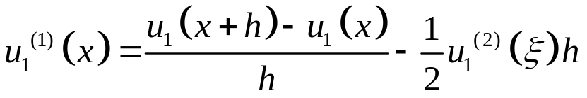
Subtractive Cancellation
But what happens in the binary world?
  Consider the function u₁(x) = x² e^{–x} and let us approximate the derivative at x = 1
  We will use Matlab and print out the double-precision floating-point numbers in their binary representation
  We will use h = 2^{–n} for n = 0, 1, 2, ...
    The bits that are correct (taking into account rounding) are marked in blue
    The zero bits resulting from subtractive cancellation are marked in red

Slide 22
Subtractive Cancellation
n | Approximation with h = 2^{-n}
0 | 0 01111111100 0110001100111111111000100010101001000010100011000000
1 | 0 01111111101 0001001011000100010001010100110011111011000011010000
2 | 0 01111111101 0100011011001011111010000000000101001110101100001100
3 | 0 01111111101 0110000001010100000100011111110101000010101011100000
4 | 0 01111111101 0110110010110101101101010010100010011001110001100000
5 | 0 01111111101 0111001011000011011101100110111001110111010100100000
6 | 0 01111111101 0111010111000000000111111000101000010010010110000000
7 | 0 01111111101 0111011100111011101101010100110110000110010010000000
8 | 0 01111111101 0111011111111000110010100011011010010000010000000000
9 | 0 01111111101 0111100001010111001001100110000110001010000000000000
10 | 0 01111111101 0111100010000110010010001100101100001110000000000000
11 | 0 01111111101 0111100010011101110101110001000110011100100000000000
12 | 0 01111111101 0111100010101001100111010111100011110000000000000000
13 | 0 01111111101 0111100010101111100000000111110110010000000000000000
14 | 0 01111111101 0111100010110010011100011111010000011100000000000000
15 | 0 01111111101 0111100010110011111010101010110001110000000000000000
16 | 0 01111111101 0111100010110100101001110000011111100000000000000000
17 | 0 01111111101 0111100010110101000001010011010101100000000000000000
18 | 0 01111111101 0111100010110101001101000100110000000000000000000000
19 | 0 01111111101 0111100010110101010010111101011110000000000000000000
20 | 0 01111111101 0111100010110101010101111001110100000000000000000000
21 | 0 01111111101 0111100010110101010111011000000000000000000000000000
22 | 0 01111111101 0111100010110101011000000111000000000000000000000000
23 | 0 01111111101 0111100010110101011000011111000000000000000000000000
24 | 0 01111111101 0111100010110101011000101010000000000000000000000000
25 | 0 01111111101 0111100010110101011000110000000000000000000000000000
26 | 0 01111111101 0111100010110101011000110100000000000000000000000000

Slide 23
Subtractive Cancellation
n | Approximation with h = 2^{-n}
27 | 0 01111111101 0111100010110101011000110000000000000000000000000000
28 | 0 01111111101 0111100010110101011000110000000000000000000000000000
29 | 0 01111111101 0111100010110101011000100000000000000000000000000000
30 | 0 01111111101 0111100010110101011001000000000000000000000000000000
31 | 0 01111111101 0111100010110101011000000000000000000000000000000000
32 | 0 01111111101 0111100010110101011000000000000000000000000000000000
33 | 0 01111111101 0111100010110101011000000000000000000000000000000000
34 | 0 01111111101 0111100010110101010000000000000000000000000000000000
35 | 0 01111111101 0111100010110101100000000000000000000000000000000000
36 | 0 01111111101 0111100010110101000000000000000000000000000000000000
37 | 0 01111111101 0111100010110100000000000000000000000000000000000000
38 | 0 01111111101 0111100010110100000000000000000000000000000000000000
39 | 0 01111111101 0111100010110000000000000000000000000000000000000000
40 | 0 01111111101 0111100010110000000000000000000000000000000000000000
41 | 0 01111111101 0111100010100000000000000000000000000000000000000000
42 | 0 01111111101 0111100011000000000000000000000000000000000000000000
43 | 0 01111111101 0111100010000000000000000000000000000000000000000000
44 | 0 01111111101 0111100000000000000000000000000000000000000000000000
45 | 0 01111111101 0111100000000000000000000000000000000000000000000000
46 | 0 01111111101 0111100000000000000000000000000000000000000000000000
47 | 0 01111111101 0111100000000000000000000000000000000000000000000000
48 | 0 01111111101 0111000000000000000000000000000000000000000000000000
49 | 0 01111111101 1000000000000000000000000000000000000000000000000000
50 | 0 01111111101 1000000000000000000000000000000000000000000000000000
51 | 0 01111111101 1000000000000000000000000000000000000000000000000000
52 | 0 01111111101 0000000000000000000000000000000000000000000000000000
53 | 0 00000000000 0000000000000000000000000000000000000000000000000000
100 % relative error

Slide 24
Subtractive Cancellation
Consequence:
  Unlike calculus, we cannot make h arbitrarily small
Possible solutions:
  Find a better formulas
  Use a completely different approach

Slide 25
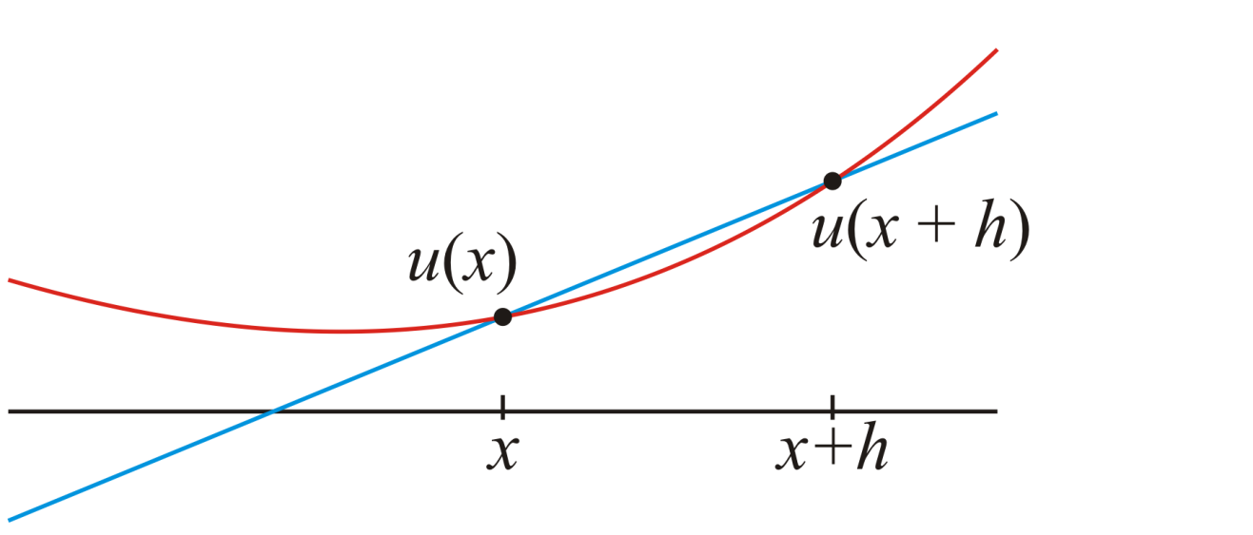
Better Approximations
Idea: find the line that interpolates the two points
(x, u(x)) and (x + h, u(x + h))

Slide 26
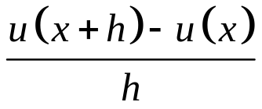
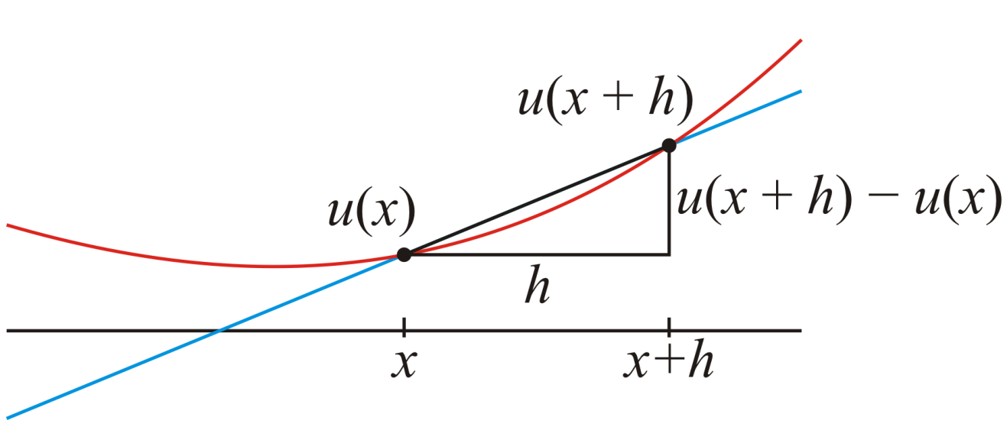
Better Approximations
The slope of this interpolating line is our approximation of the derivative:

Slide 27
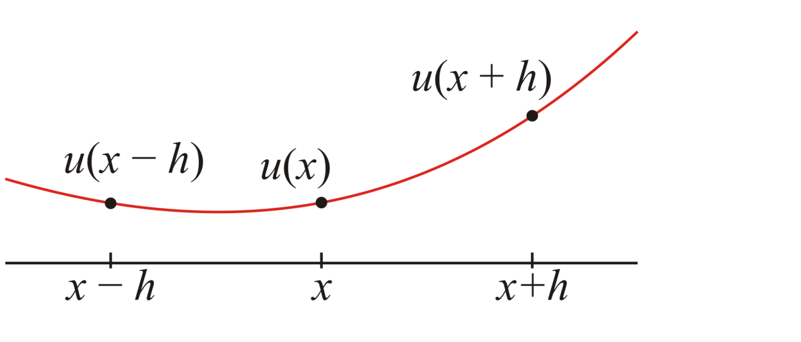
Better Approximations
What happens if we find the interpolating quadratic going through the three points
(x – h, u(x – h)) (x, u(x)) (x + h, u(x + h))
?

Slide 28
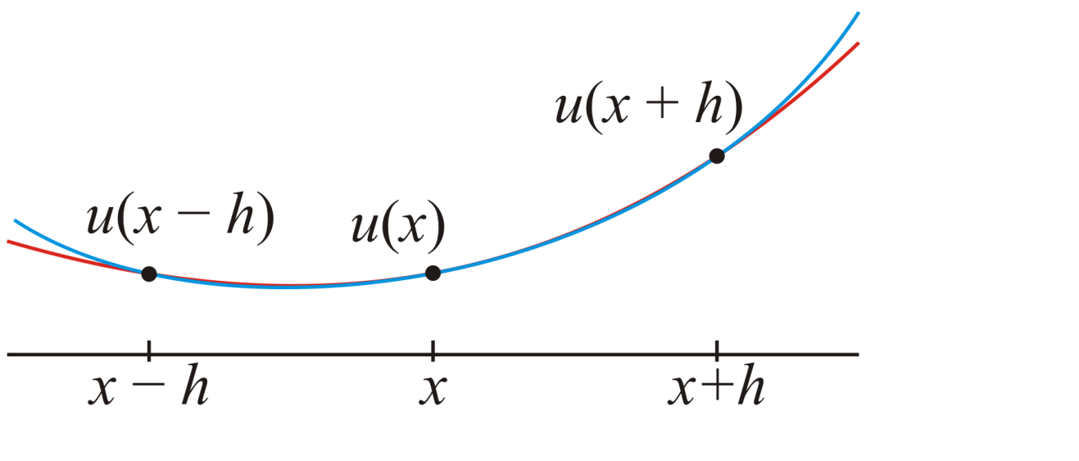
Better Approximations
The interpolating quadratic is clearly a local approximation

Slide 29
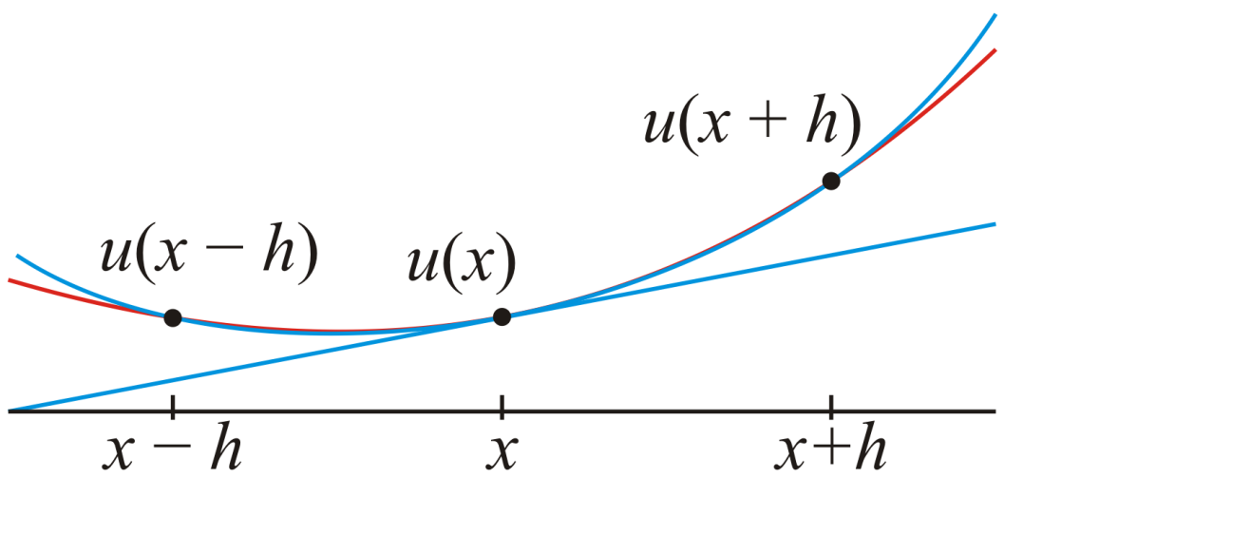
Better Approximations
The slope of the interpolating quadratic is easy to find:

Slide 30
Better Approximations
The slope of the interpolating quadratic is also closer to the slope of the original function at x

Slide 31
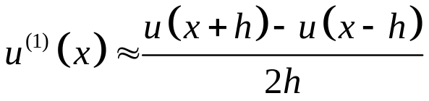
Better Approximations
Without going through the process, finding the interpolating quadratic function gives us a similar formula
Visually, we see these are better approximations, but how much better are they analytically?

Slide 32
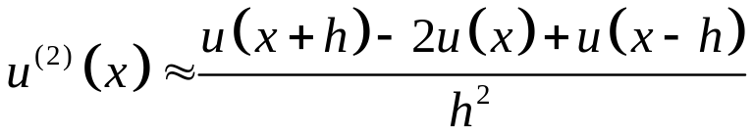
Better Approximations
Additionally, we can approximate the concavity (2nd derivative) at the point x by finding the concavity of the interpolating quadratic polynomial

Slide 33
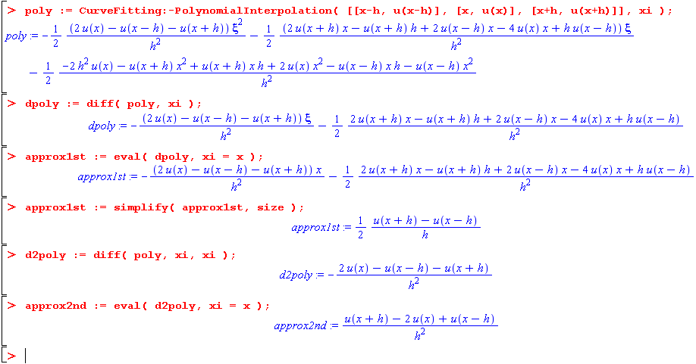
Better Approximations
For those interested, this Maple code finds these formulas

Slide 34
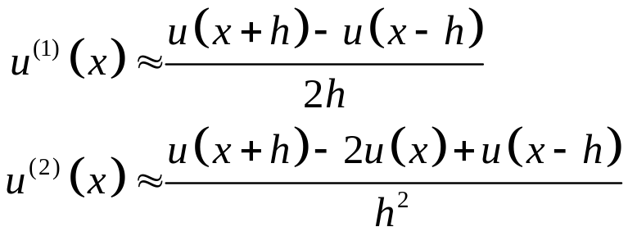
Better Approximations
Question: how much better are these two approximations?

Slide 35
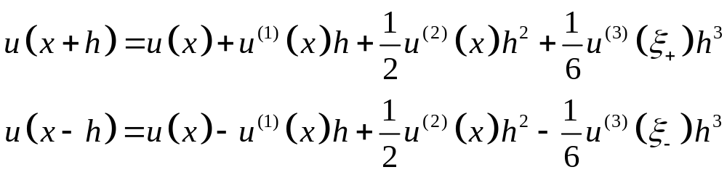


Better Approximations
Using Taylor series, we have approximations for both
u(x + h) and u(x – h):
Here, and

Slide 36
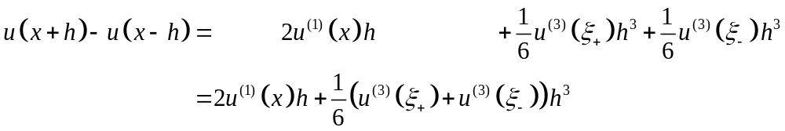
Better Approximations
Subtracting the second approximation from the first, we get

Slide 37
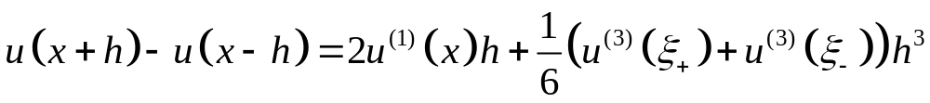
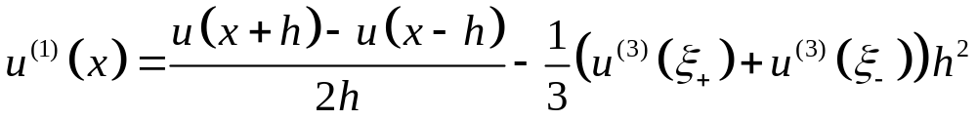
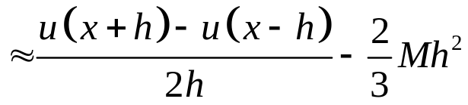
Better Approximations
Solving the equation
for the derivative, we get:

Slide 38
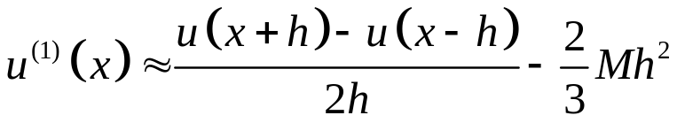
Better Approximations
The critical term is the h²
This says
  If we halve h, the error goes down by a factor of 4
  If we divide h by 10, the error goes down by a factor of 100

Slide 39
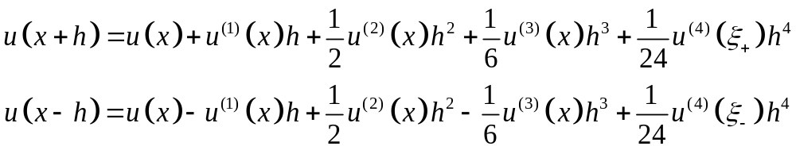
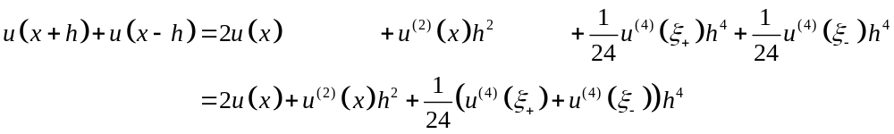
Better Approximations
Adding the two approximations

Slide 40
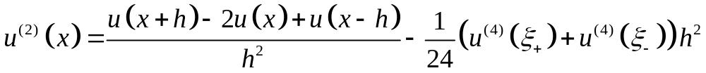
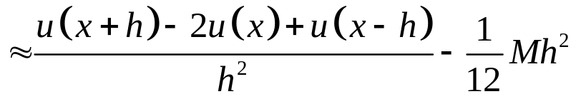
Better Approximations
Solving the equation
for the 2nd derivative, we get:

Slide 41
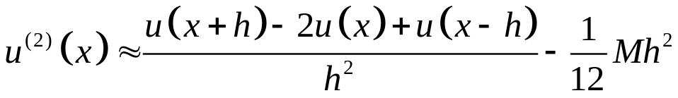
Better Approximations
Again, the term in the error is h²
Thus, both of these formulas are reasonable approximations for the first and second derivatives

Slide 42
Example
We will demonstrate this by finding the approximation of both the derivative and 2nd-derivative of u(x) = x³ e^{–0.5x} at
x = 0.8
Using Maple, the correct values to 17 decimal digits are:
  u⁽¹⁾(0.8) = 1.1154125566033037
  u⁽²⁾(0.8) = 2.0163226984752030

Slide 43

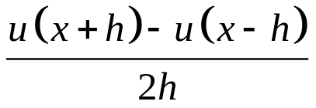
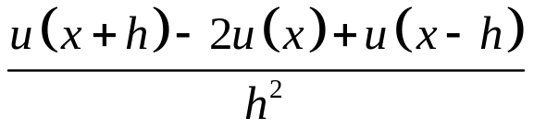
Example
h | Approximation | Error | Approximation | Error | Approximation | Error
10⁻¹ | 1.216270589620 | 1.0085e-1 | 1.115614538794 | 2.020e-04 | 2.0131210165303 | 3.2017e-3
10⁻² | 1.125495976919 | 1.0083e-2 | 1.115414523411 | 1.9668e-6 | 2.016290701661 | 3.1997e-5
10⁻³ | 1.116420737455 | 1.0082e-3 | 1.115412576266 | 1.9663e-8 | 2.016322378395 | 3.2008e-7
10⁻⁴ | 1.115513372934 | 1.0082e-4 | 1.115412556800 | 1.9340e-10 | 2.016322686593 | 1.1882e-8
10⁻⁵ | 1.115422638215 | 1.0082e-5 | 1.115412556604 | 9.9676e-13 | 2.016322109277 | 5.8920e-7
10⁻⁶ | 1.115413564790 | 1.0082e-6 | 1.115412556651 | 4.8181e-11 | 2.016276035022 | 4.6663e-5
10⁻⁷ | 1.115412656682 | 1.0082e-7 | 1.115412555929 | 6.7346e-10 | 2.0150547896945 | 1.2679e-3
10⁻⁸ | 1.115412562314 | 5.7103e-9 | 1.115412559538 | 2.9348e-9 | 0.555111512313 | 1.4612
10⁻⁹ | 1.115412484598 | 7.2005e-8 | 1.115412512353 | 4.4250e-8 | -55.511151231258 | 57.5275
u⁽¹⁾(0.8) = 1.1154125566033037 u⁽²⁾(0.8) = 2.0163226984752030

Slide 44
Better Approximations
To give names to these formulas:
First Derivative
1st-order forward divided-difference formula
2nd-order centred divided-difference formula
Second Derivative
2nd-order centred divided-difference formula

Slide 45

2nd-order Linear ODEs
Suppose we have the linear ordinary differential equation
where c₁, c₂ and c₃ are known constants and g(x) is a known forcing function
Recall our two approximations:
Substitute these into the ODE...

Slide 46
2nd-order Linear ODEs
The substitution yields
Now, multiply by 2h²
and collect similar terms

Slide 47
2nd-order Linear ODEs
The equation
is called the finite-difference equation approximating the 2nd-order linear ODE

Slide 48
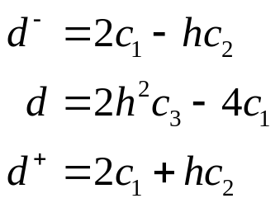
2nd-order Linear ODEs
For ease of understanding, we will define
We may now write
as
where d –, d and d ⁺ depend on c₁, c₂, c₃ and h

Slide 49
Boundary-value Problems
The final step in our problem is defining and solving boundary value problems:
We could use more general equations, but we will restrict ourselves to linear ODEs

Slide 50
Boundary-value Problems
The final step in our problem is defining and solving boundary value problems:
We note that there are two derivatives
  Finding the solution requires two integrations
  This requires two constraints

Slide 51
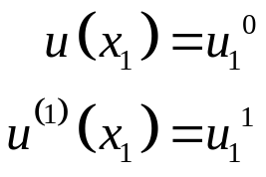
Boundary-value Problems
The final step in our problem is defining and solving boundary value problems:
One approach is to constrain both the value of the function and the derivative at a single point:
This defines an initial-value problem—all constraints are defined at an initial value x₁

Slide 52
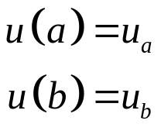
Boundary-value Problems
The final step in our problem is defining and solving boundary value problems:
An alternative system of constraints are two boundary values:

Slide 53
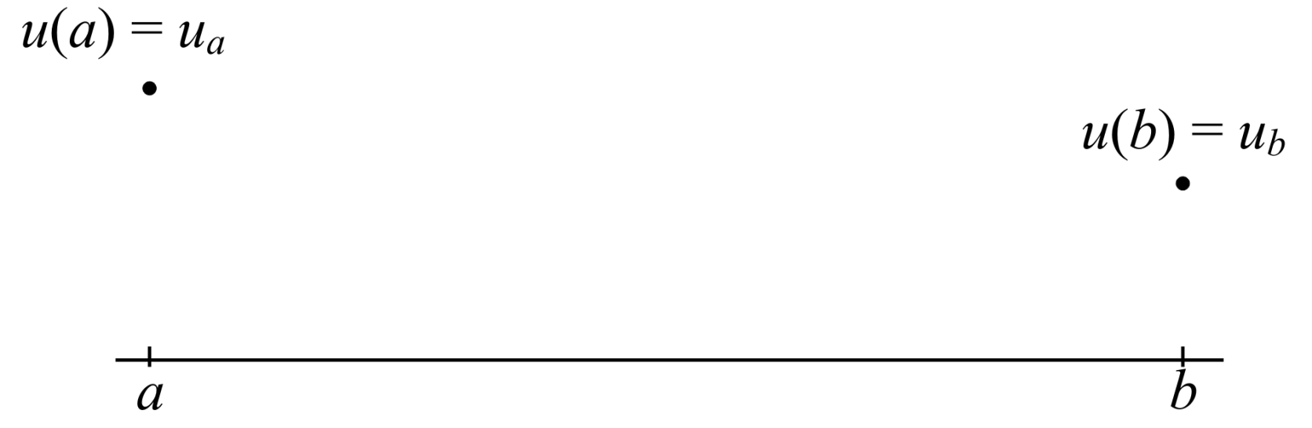
Boundary-value Problems
Given these, two constrains, we are looking for a function u(x) which equals both specified boundary values

Slide 54
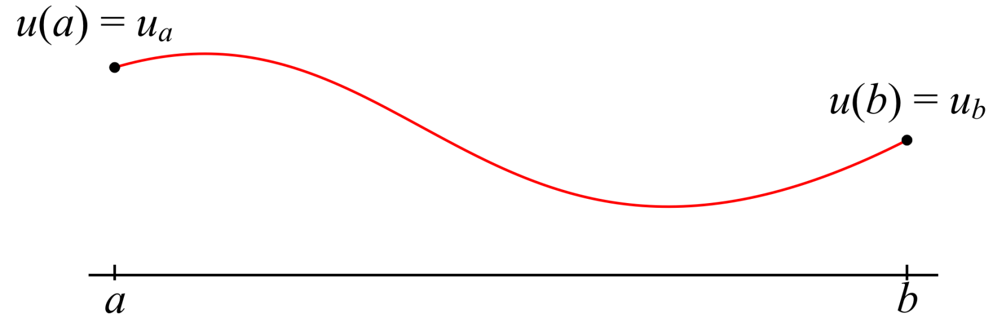
Boundary-value Problems
Not only must it satisfy the boundary values, but it must also satisfy the ODE

Slide 55
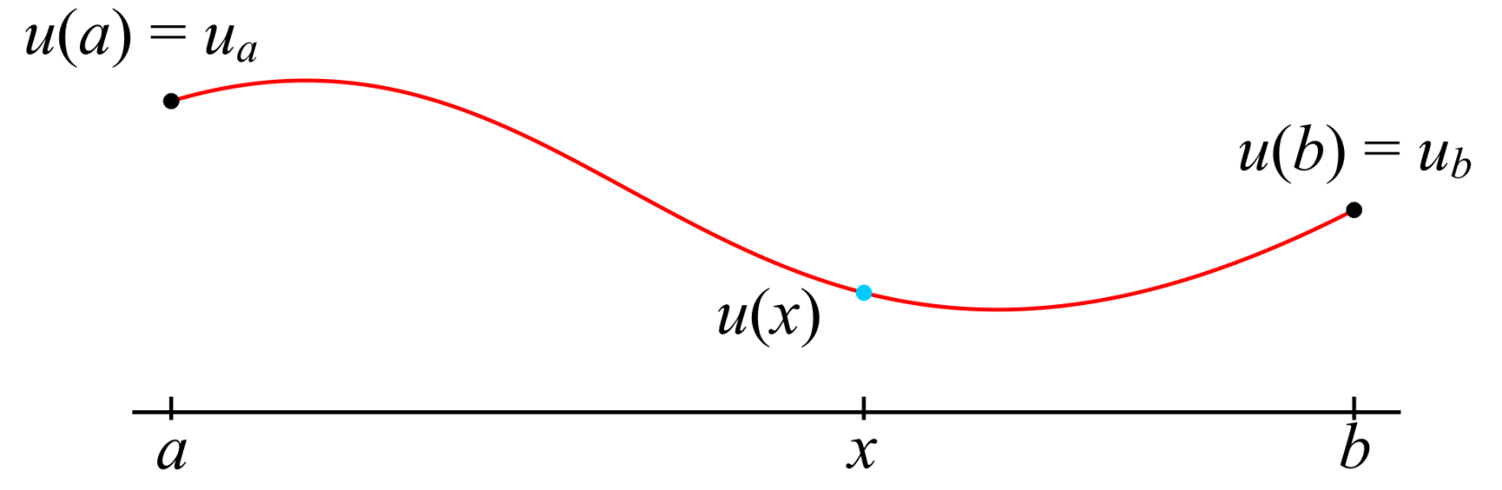
Boundary-value Problems
Given a point x and the value u(x)

Slide 56
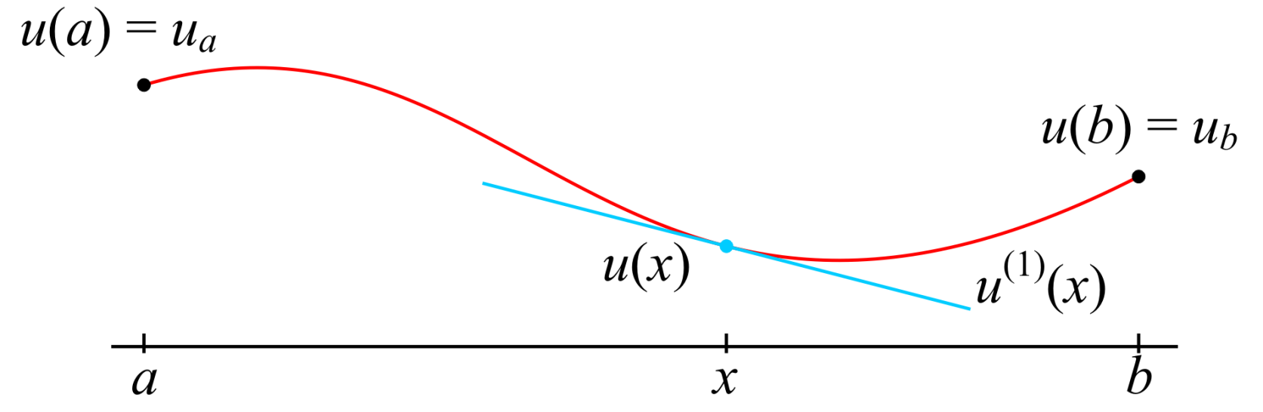
Boundary-value Problems
Given a point x and the value u(x), the derivative at x

Slide 57
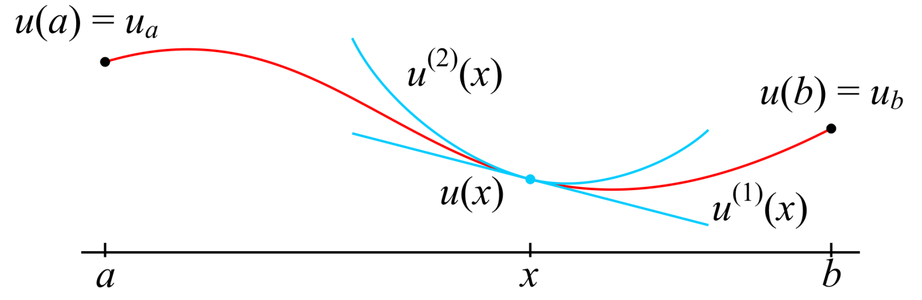
Boundary-value Problems
Given a point x and the value u(x), the derivative at x and the concavity at x, the linear combination must equal the forcing function

Slide 58
Boundary-value Problems
Assuming we are looking for a numerical solution, we cannot find the value at every point a < x < b

Slide 59
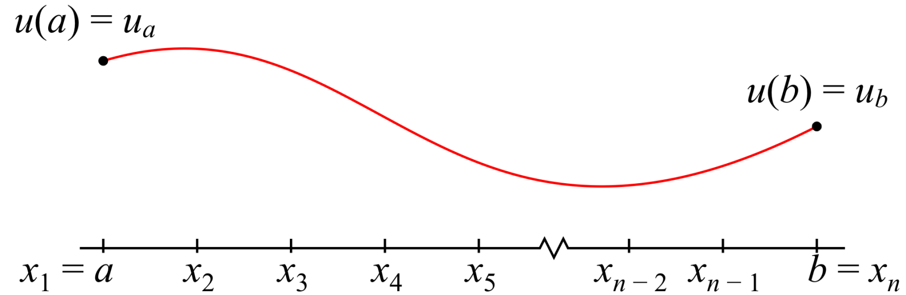
Boundary-value Problems
Instead, we will divide the interval into n equally spaced points

Slide 60
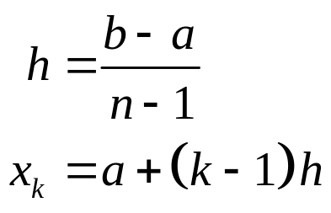
Boundary-value Problems
Instead, we will divide the interval into n equally spaced points

Slide 61
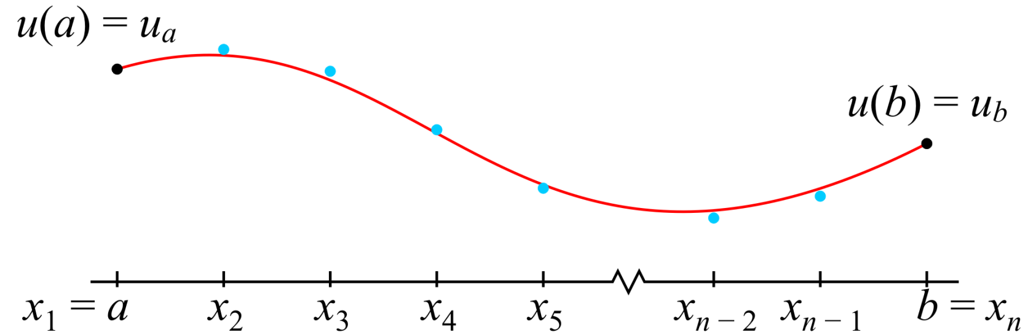
Boundary-value Problems
We will find values that approximate u(x_{k}) at each of these points x_{k}

Slide 62

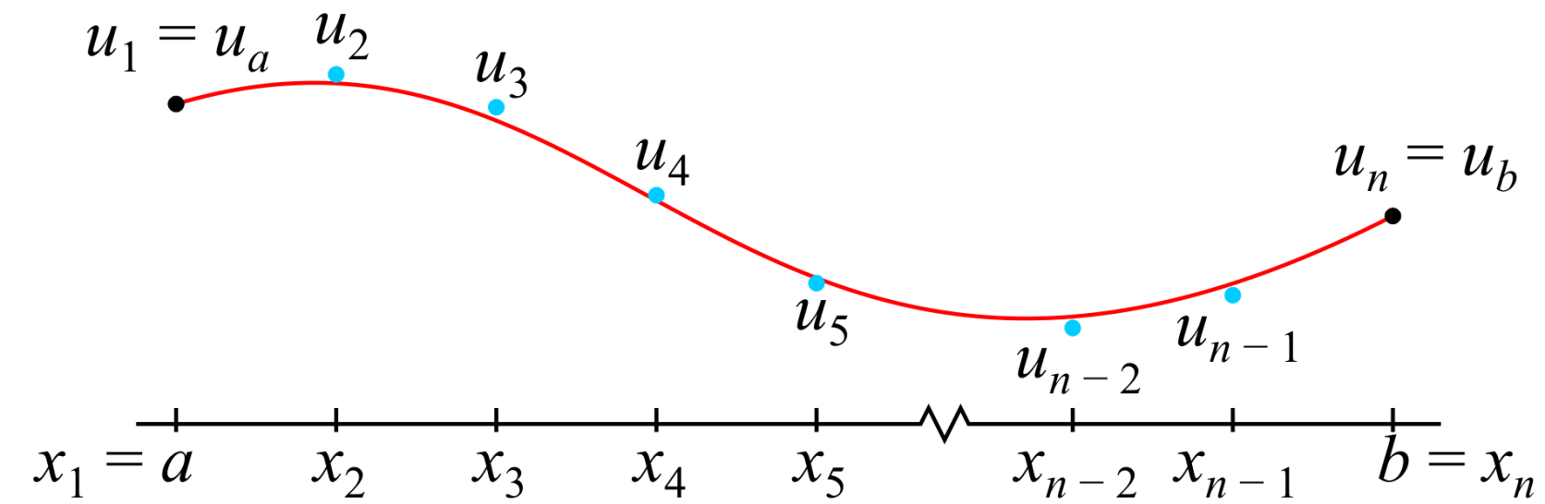
Boundary-value Problems
We will call the approximations
  Here u₁ = u_{a} and u_{n} = u_{b}

Slide 63

Boundary-value Problems
The problem: solve for the values for u₂ through u_{n – 1}

Slide 64
The System of Linear Equations
Let’s go back to your finite difference equation
and evaluate it at one of the points x_{k}
Recall that:

Slide 65
The System of Linear Equations
We therefore have the equation:
Now, x_{k} – h = x_{k – 1} and x_{k} + h = x_{k + 1}

Slide 66

The System of Linear Equations
We are, however, approximating , so
may be approximated by
This equation is linear in u_{k – 1}, u_{k} and u_{k + 1}
  Recall we started with a linear ordinary differential equation

Slide 67


The System of Linear Equations
For each interior point x₂, ..., x_{n – 1}, write out the linear equation:

Slide 68
The System of Linear Equations
This is n – 2 equations with n unknowns: u₁, ..., u_{n}

Slide 69
The System of Linear Equations
This is n – 2 equations with n unknowns: u₁, ..., u_{n}
Recall that g, h and the x-values are
given; thus, we can calculate the right-
hand side and it is therefore known

Slide 70
The System of Linear Equations
This is n – 2 equations with n unknowns: u₁, ..., u_{n}
  The system, however, is underdetermined

Slide 71
The System of Linear Equations
Fortunately, we know two values: u₁ and u_{n}

Slide 72
The System of Linear Equations
Fortunately, we know two values: u₁ and u_{n}
  Therefore, we can rewrite this system...

Slide 73


The System of Linear Equations
Fortunately, we know two values: u₁ and u_{n}
  Therefore, we can rewrite this system...

Slide 74


The System of Linear Equations
Thus we have an (n – 2) × (n – 2) matrix and two vectors
where

Slide 75
The Problem
Implement a function
function [x_out, u_out] = bvp( c, g, x_bndry, u_bndry, n )
that solves the boundary-value problem
Here:
  c = [c1 c2 c3]
  g is a function handle for g(x)
  x_bndry = [a, b]
  u_bndry = [u_a, u_b]
  x_out is a column vector of n x-values
  u_out is a column vector of n u-values

Slide 76
Relevant Matlab Instructions
The matrix constructor ones( m, n ) that creates an
m × n matrix of ones, for example:
    >> 3.2 * ones( 5, 1 )
    ans =
    3.2000
    3.2000
    3.2000
    3.2000
    3.2000

Slide 77
Relevant Matlab Instructions
The matrix constructor diag( v ) where v is an
n-dimensional column or row matrix creates a diagonal
n × n matrix with the entries of v on the diagonal:
    >> diag( 3.2 * ones( 5, 1 ) )
    ans =
    3.2000 0 0 0 0
    0 3.2000 0 0 0
    0 0 3.2000 0 0
    0 0 0 3.2000 0
    0 0 0 0 3.2000
5
5

Slide 78
Relevant Matlab Instructions
The matrix constructor diag( v, 1 ) where v is an
n-dimensional column or row matrix creates a diagonal (n + 1) × (n + 1) matrix with the entries of v on the super-diagonal:
    >> diag( 3.2 * ones( 5, 1 ), 1 )
    ans =
    0 3.2000 0 0 0 0
    0 0 3.2000 0 0 0
    0 0 0 3.2000 0 0
    0 0 0 0 3.2000 0
    0 0 0 0 0 3.2000
    0 0 0 0 0 0
6
6

Slide 79
Relevant Matlab Instructions
The matrix constructor diag( v, -1 ) where v is an
n-dimensional column or row matrix creates a diagonal (n + 1) × (n + 1) matrix with the entries of v on the sub-diagonal:
    >> diag( 3.2 * ones( 5, 1 ), -1 )
    ans =
    0 0 0 0 0 0
    3.2000 0 0 0 0 0
    0 3.2000 0 0 0 0
    0 0 3.2000 0 0 0
    0 0 0 3.2000 0 0
    0 0 0 0 3.2000 0
6
6

Slide 80
Relevant Matlab Instructions
The function linspace( a, b, n ) creates a row vector of n equally spaced points from a to b
    >> linspace( 2, 4, 5 )
    ans =
    2.0000 2.5000 3.0000 3.5000 4.0000
    >> linspace( 2, 4, 5 )'
    ans =
    2.0000
    2.5000
    3.0000
    3.5000
    4.0000

Slide 81
Relevant Matlab Instructions
If a Matlab scalar-valued function is appropriately designed, it will work element-wise on vector and matrix arguments
  Use element-wise powering, multiplication and division
    >> u = [1 2 3];
    >> v = [4 5 6];
    >> u.^2
    ans =
    1 4 9
    >> u .* v
    ans =
    4 10 18
    >> u ./ v
    ans =
    0.2500 0.4000 0.5000

Slide 82
Relevant Matlab Instructions
If we define a function appropriately, e.g.,
    function [y] = g(x)
    y = 3.2*x.*exp(-x.^2);
    end
We can evaluate g at all the entries of a vector
    >> x = linspace( 0, 2, 6 )
    x =
    0 0.4000 0.8000 1.2000 1.6000 2.0000
    >> g( x )
    ans =
    0 1.0907 1.3499 0.9098 0.3958 0.1172
Saved as g.m

Slide 83
Relevant Matlab Instructions
Alternatively, we can also use anonymous functions:
    >> g = @(x)(3.2*x.*exp(-x.^2));
    g =
    @(x)(3.2*x.*exp(-x.^2))
We can use this function, as well
    >> x = linspace( 0, 2, 6 )
    x =
    0 0.4000 0.8000 1.2000 1.6000 2.0000
    >> g( x )
    ans =
    0 1.0907 1.3499 0.9098 0.3958 0.1172

Slide 84
Relevant Matlab Instructions
If you call your function with the function defined in a file, you must pass a function handle:
    >> [x, u] = bvp( c, @g1, x_bndry, u_bndry, n );
If the functions are defined as anonymous functions, it is not necessary to convert it to a function handle:
    >> g1 = @(x)(0*x);
    >> [x, u] = bvp( c, g1, x_bndry, u_bndry, n );
% Saved as g1.m:
function [u] = g1(x)
u = 0*x;
end

Slide 85

Relevant Matlab Instructions
If we define a function appropriately, e.g.,
    function [y] = u_soln(x)
    y = 3.2*x.*exp(-x.^2);
    end
Similarly, we can plot the
points:
  >> x = linspace( 0, 2, 100 );
  >> plot( x, u_soln( x ), 'r.' );

Slide 86
Relevant Matlab Instructions
Extracting from and building vectors can be useful:
    >> u = linspace( 3, 5, 6 )
    u =
    3.0000 3.4000 3.8000 4.2000 4.6000 5.0000
    >> u(2:end - 1)
    ans =
    3.4000 3.8000 4.2000 4.6000
    >> [0 u(2:end - 1) 0]
    ans =
    0 3.4000 3.8000 4.2000 4.6000 0

Slide 87
Relevant Matlab Instructions
Extracting from and building vectors can be useful:
    >> u = linspace( 2, 5, 4 )'
    u =
    2
    3
    4
    5
    >> [0; u(2:end - 1); 0]
    ans =
    0
    3
    4
    0

Slide 88
Relevant Matlab Instructions
Error conditions are generated with the throw command:
    function [y] = sqr_int( x )
    if ~isscalar( x ) || ( x ~= round( x ) )
    throw( MException( 'MATLAB:invalid_argument', ...
    'the argument ''x'' is not an integer' ) );
    end
    y = x^2;
    end
if ~isscalar( x ) || ( x ~= round( x ) )
if x is not a scalar or x does not equal itself when rounded then...

Slide 89
Relevant Matlab Instructions
1 function [y] = sqr_int( x )
2 if ~isscalar( x ) || ( x ~= round( x ) )
3 throw( MException( 'MATLAB:invalid_argument', ...
4 'the argument ''x'' is not an integer' ) );
5 end
6
7 y = x^2;
8 end
For example:
    >> sqr_int( 3 )
    ans =
    9
    >> sqr_int( [1 2 3] ) % passing a vector
    ??? Error using ==> sqr_int at 3
    the argument 'x' is not an integer
    >> sqr_int( 3.14 ) % passing a non-integer real
    ??? Error using ==> sqr_int at 3
    the argument 'x' is not an integer

Slide 90



Matlab Example
Consider the boundary-value problem
We would call
bvp( [1 3 2], @g1, [0, 1], [4, 5], 9 )
This has the solution

Slide 91
Matlab Example
The matrices and vectors involved are:
x =
0
0.1250
0.2500
0.3750
0.5000
0.6250
0.7500
0.8750
1.0000
u_intr = M \ b;
u_intr =
5.1205
5.7524
6.0334
6.0668
5.9301
5.6805
5.3602
u =
4.0000
5.1205
5.7524
6.0334
6.0668
5.9301
5.6805
5.3602
5.0000
M =
-3.9375 2.3750 0 0 0 0 0
1.6250 -3.9375 2.3750 0 0 0 0
0 1.6250 -3.9375 2.3750 0 0 0
0 0 1.6250 -3.9375 2.3750 0 0
0 0 0 1.6250 -3.9375 2.3750 0
0 0 0 0 1.6250 -3.9375 2.3750
0 0 0 0 0 1.6250 -3.9375
b =
-6.5000
0
0
0
0
0
-11.8750

Slide 92

Matlab Example
Creating the plot, we have
    >> plot( x, u, 'o' );
    >> hold on
    >> xs = linspace( 0, 1, 100 );
    >> plot( xs, u2(xs), 'r' );

Slide 93

Matlab Example
Consider the same boundary-value problem but with a forcing function
We would call
bvp( [1 3 2], @g2, [0, 1], [4, 5], 9 )
This has the solution (courtesy of Maple):

Slide 94
Matlab Example
The matrices and vectors involved are:
x =
0
0.1250
0.2500
0.3750
0.5000
0.6250
0.7500
0.8750
1.0000
u_intr = M \ b;
u_intr =
5.1652
5.7893
6.0113
5.9678
5.7810
5.5382
5.2790
u =
4.0000
5.1652
5.7893
6.0113
5.9678
5.7810
5.5382
5.2790
5.0000
M =
-3.9375 2.3750 0 0 0 0 0
1.6250 -3.9375 2.3750 0 0 0 0
0 1.6250 -3.9375 2.3750 0 0 0
0 0 1.6250 -3.9375 2.3750 0 0
0 0 0 1.6250 -3.9375 2.3750 0
0 0 0 0 1.6250 -3.9375 2.3750
0 0 0 0 0 1.6250 -3.9375
b =
-0.0884
-0.1250
-0.0884
-0.0000
0.0884
0.1250
0.0884

Slide 95

Matlab Example
Creating the plot, we have
    >> plot( x, u, 'o' );
    >> hold on
    >> xs = linspace( 0, 1, 100 );
    >> plot( xs, u3(xs), 'r' );

Slide 96


Laplace’s Equation
One special case is Laplace’s equation in one dimension:
This has the rather trivial solution:
  A straight line connecting the boundary values
  This is useful, never-the-less, because Laplace’s equation is the limiting case of the heat conduction/diffusion equation

Slide 97


Laplace’s Equation
One special case is Laplace’s equation in one dimension:
The important point is the finite difference equation:
or
  That is, the point u_{k} is the average of the two neighbouring points

Slide 98
Summary
We have looked at using finite-difference equations for approximating boundary-value problems
  1st- and 2nd-order divided-difference approximations of the derivative
  2nd-order approximation of the 2nd derivative
  Boundary-value problems
  Finite-difference equations approximating ODEs
  The approximation of linear ODEs by a system of equations
  The implementation in Matlab
  Laplace’s equation in one dimension

Slide 99
References
[1] Glyn James, Modern Engineering Mathematics, 4th Ed., Prentice Hall, 2007, p.778.
[2] Glyn James, Advanced Modern Engineering Mathematics, 4th Ed., Prentice Hall, 2011, p.164.

